Slide 1
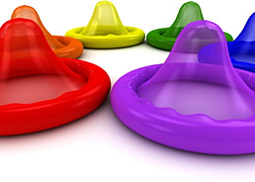
Wrap it up
12 steps to proper condom use
Image from: www.nysyouth.net
Information from: health.columbia.edu/topics/sexual-health/safer-sex

Slide 2
Condoms

Slide 3
Step 1
Consent and foreplay precede action.

Slide 4
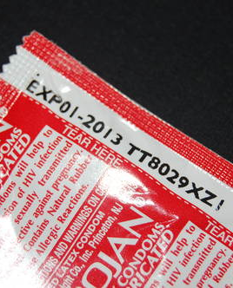
Step 2
Check expiration date on condom.
Image from: www.std.about.com

Slide 5
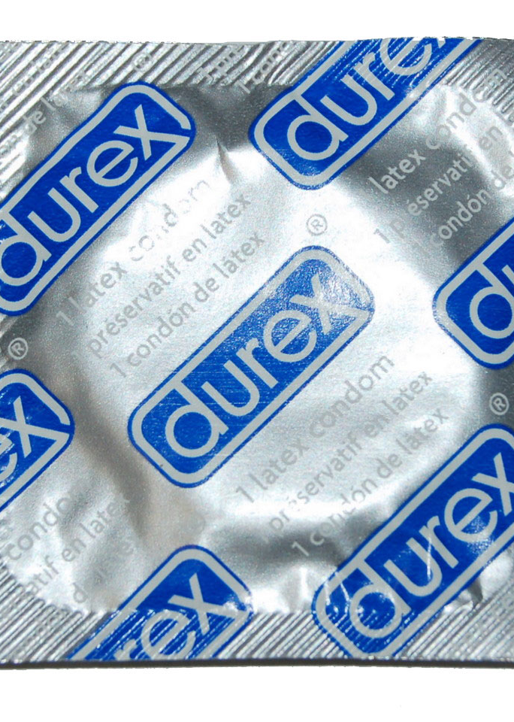
Step 3
Pillow test - does air stay in the package?
Image from:www.rubbersbymail.com

Slide 6
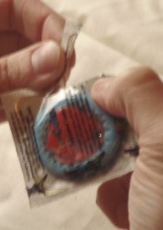
Step 4
Tear open carefully - not with your teeth!
Image from: www.genderwellness.com

Slide 7

Step 5
Add a drop of lube inside condom for added pleasure.
Image from: www.condomunity.com

Slide 8
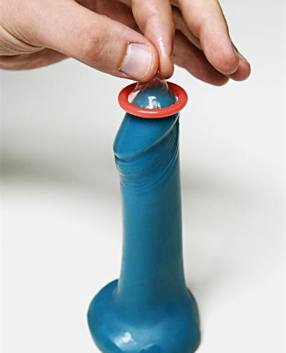
Step 6
Pinch tip to leave room for ejaculate.
Image from: www.avert.org

Slide 9
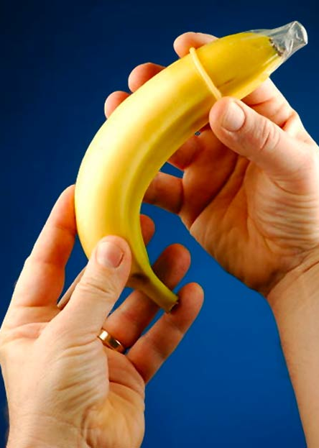
Step 7
Roll condom to base of penis or object.

Slide 10
Step 8
Gently guide air bubbles out of condom.

Slide 11

Step 9
Add lube - friction can break a condom.
Image from: www.amazon.com

Slide 12
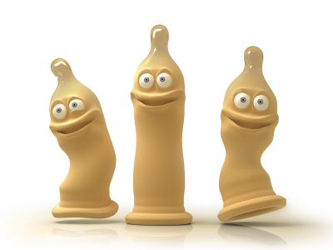
Step 10
Enjoy the action!
Image from:www.estranchbeacon.com

Slide 13
Step 11
Hold base of condom while pulling out.

Slide 14

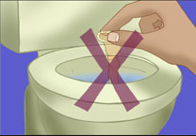
Step 12
Remove and throw in trash, do not flush.
Image from: www.health.qld.gov

Slide 15
Watch the Planned Parenthood Video

