Slide 1
Types of cars
Welcome!
This module will introduce some various types of cars in the market.
Click on various of of cars to know more!
Types of Cars
Asia
Continental
Hyundai
Mazda
Jeep
BMW

Slide 2
Types of cars
There are two types of make:
Asia
Continental
Examples of Asia make:
Hyundai
Mazda
Examples of Continental make:
Jeep
BMW
Click your mouse to go to next page

Slide 3


Types of cars
Hyundai Veloster:
Mazda 3:
Click your mouse to go to next page

Slide 4
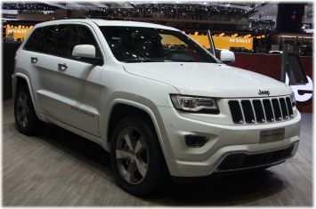
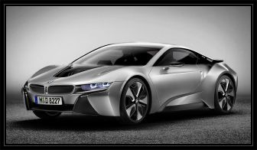
Types of cars
Jeep:
BMW:
This is the end of this module

