Slide 1
TYPE OF AIR CRAFT
Click on picture to view

Slide 2
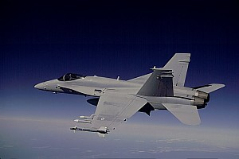

Slide 3
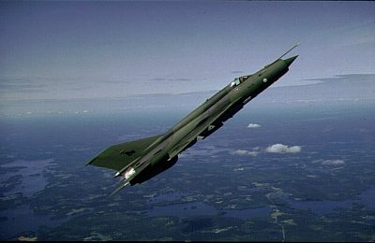

Slide 4
