Slide 1
Public Strategy - the What? the Why? and the How?
Strategy, Policy & Security Group Lunchtime Talk
04 Dec 2015, PDW
Harry Woodroof, PhD FRSA
Strategic Environment Team
OFFICIAL

Slide 2
Strategy …….
A strategy is something like, an innovative new product; globalization, taking your products around the world; be the low-cost producer. A strategy is something you can touch; you can motivate people with; be number one and number two in every business. You can energize people around the message.
Jack Welch. Chairman & CEO, General Electric, 1981 - 2001
All men can see these tactics whereby I conquer, but what none can see is the strategy out of which victory is evolved.
Sun Tzu. General and philosopher, 5thC B.C.(?)
…… not always associated with crystalline clarity!
OFFICIAL
Notes:
Nearly everything to do with strategy seems to be ‘messy’ – just like the real world!
Can’t even get a universally agreed defintion - let alone a crisp one.
Jack Welch : mega-star of US industry for decades … his description : starts with wooly words (‘something like’, innovation, globalisation), couple of trite ideas (sell widely, cheaply) then he resorts to metaphor …
And Sun Tzu even makes a virtue of obscuring what it is (though his was a special subset – military strategy – where secrecy clearly has special merits!)
But, my point is valid : there’s a lot of confusion around the word ‘Strategy’.
My aim in this talk is not to provide all the answers, but to stimulate thought and debate on a topic that is of importance to all of us.
And of course everything to do with Strategy, must be of particular interest to a Group whose title is ‘Strategy, Policy and Security’ !
Start by getting stuck into the really Basic Questions: Why is it important? What is it? and How do you do it well?……

Slide 3
Why do strategy?
OFFICIAL
Notes:
And I’m going to begin with the easy one : Why do strategy?
And I’m NOT being ironic; compared to What is Strategy? And How do you best do it?, this really is the Easy One!
So, What are the benefits?
What do we hope to get from it?
As members of the Strategy, Policy and Security Group, I’m sure we’ve all got views. But here’s a few thoughts from Jan Polley…..

Slide 4
Slide by Jan Polley,
National School
of Government.
Talk to the
FAN Club, Nov 2008
An understanding of
plausible futures
Why be strategic?
A stretching,
consistent and aligned
vision of the future
Organisational core
purpose and ‘line of
sight’
GOOD PUBLIC
STRATEGY
PROVIDES ..
Organisational
alignment and ability
to prioritise and
allocate resources for
delivery
A set of outcomes that
frame the policy
process to create
public value
OFFICIAL
Notes:
… Jan Polley of the late-lamented NSG (now largely replaced by a website!)
… speaking at the equally late-lamented Futures Analysts Network - or FAN Club – over 7 years ago. But she spake eternal truths.
Understanding of plausible futures :….. Clearly essential if we’re going to be good Boy Scouts and ‘Be Prepared’. And note her use of the plural ‘futures’. That’s bang on the nail for reasons I’ll unpack later.
Next, a vision of the future. Singular tense now, which is helpful. Too many visions can be distracting!
And the vision has got to be stretching. That’s good : organisations that don’t stretch themselves won’t survive, and don’t deserve to.
Consistency always helps too : a vision containing inconsistencies or contradictions won’t take you very far!
And by aligned, I think Jan means aligned with higher level aims like ‘National Survival’ or ‘Economic Growth’ that any strategy – except the very Grandest of Grand Strategies - with a Capital ‘G’ – is going to sit within.
Thirdly, strategy should provide a set of outcomes that provide a framework for policy to be developed inside, and tested against, and measured against once you move from development to implementation.
That statement might trigger a huge debate right away about the relationship between strategy & policy. If the strategy frames the policy, as is clearly implied, then that means strategy comes before, and sits above, policy. Well that’s massively controversial, as many people argue that the policy should come first. As always, it depends on what you mean by the words policy and strategy. So let’s not get diverted by that now, but perhaps we’ll come back to it in Q&A.
Jan ends this box with a few less controversial words about creating public value. That’s Civil Service jargon for ‘doing the right thing for the UK’. So make sure your outcomes all offer something useful to the country, whether that’s UK plc, the cohort of 4 year olds who’ll be next year’s new Year 1 school kids; or, if you’re thinking about say, our science strategy for Space, the users of the goods and services that Space provides.
And the 4th box takes us down to the level of Management, and Organisational Structure and Processes. The set of Outcomes can be used to ensure that the internal structure is aligned. So if you have a set of say, 4 Outcomes you really want to achieve, you can make sure you have bits of your organisation actually working on them, and that they are prioritised when the money and other resources are shared out. And of course that approach need not to be limited to organisational design and management; you can – indeed should – apply the same thinking to the design of a research programme.
And in the final box, I think Jan is taking us from the organisational level and the world of senior management down to the level of the most junior and newly-arrived member of staff. Because a good strategy will set out in words they can all understand what the core purpose of the organisation is, and will allow them to see what their role is, and will ensure the Objectives they and their Line Managers write for what we call the PDA process contribute to the Organisation’s core purpose. So this ‘line of sight’ or ‘golden thread’ running from top to bottom of the organisation is a great management and communication tool. And of course it can be applied to the design and management of research too.
None of that probably too contentious.
The arguments really start when we ask the next question. :WHAT is strategy?

Slide 5
What is strategy?
OFFICIAL
Notes:
First thing to say is “There is no single view.”
Swiftly followed by “There is no correct view.”
Frankly it means many different things to many different people.
So it’s a confused as well as a contested area, so here’s my attempt to bring it together
I certainly don’t offer the next slide as a definitive answer to the question What is Strategy?
But if it crystallises some aspects of the debate, even just sets out the terms of it, then perhaps that’s a step forward.

Slide 6
3 views of strategy
The FUTURE
is
UNCERTAIN
The FUTURE
is
UNCERTAIN
All for MANAGING UNCERTAINTY BETTER
The
End-
point
&
‘Way-
ahead’
A military Officer told me:
“IT’S ABOUT THE PLAN”
‘The
Why?’
&
Risks
(+ & -)
&
Limits
The
Agility
to
respond
to
Reality
An Academic told me:
“IT’S ABOUT THE ‘SOAP’”
Today’s
problem
Events
Ends
What?
Ways
How?
People
Creates
Ideas;
Brings
Focus
… next stage
CHOICES
… and the next
Means
With What?
A?
B?
C1?
C2?
No
No
No
Yes
Plausible Futures
Thinking your way through
an ENDLESS SOAP OPERA
A Whitehall adviser told me:
“IT’S ABOUT SAYING “NO””
The FUTURE
is
UNCERTAIN
The FUTURE
is
UNCERTAIN
Good strategy has all 3
OFFICIAL
Notes:
Start with a reality : The Future is Uncertain. Any disagreement? Right : that’s the problem we’re trying to deal with. And it affects everything we do. It’s all around us. So I’ve got it at all 4 corners of my slide. And it’s ever-present. So it’s staying there even though this slide is about to get very busy indeed!
So let me suggest the chief purpose of Strategy is to help us manage that uncertainty better.
And I’m going to present 3 different views on what strategy is.
But I’m not going to say one of them is right and the other two are wrong. Instead, I’m going to suggest that all 3 are valid. To some extent they’re complementary. But there are also real tensions between some aspects of them.
But I would suggest Good strategy uses all 3 approaches. And that strategy tends to be done badly if only one of the approaches is taken, and the other 2 are ignored.
MIL VIEW:
When Ends, Ways & Means come together COHERENTLY, then you have a plan! If those 3 aren’t coherent, ie you haven’t got the Means, you don’t!
WHITEHALL STRATEGY TEAMS’ VIEW:
Acknowledge there is some overlap between ‘End Point’ and the ‘Choice’ that gets a ‘Yes’. But the Choice approach usually forces you to give reasons - the ‘Why?’ – than the ‘Define the End Point and you’ll be OK’ approach does. And understanding the reasons is really helpful if things go awry and you need to get things back on track. Also, its (probably) better at exploring the risks (opportunities, not just threats) and the limits on what you’re trying to accomplish.
Academic approach (based on writings by Prof Sir Lawrence Freedman, KCL Dept of War Studies):
‘A strategy is not synonymous with a plan’ (Freedman) : ‘No plan survives contact with the enemy (or reality’ (Anon) or “Everybody has a plan until they get punched in the mouth” (Mike Tyson)
Strategy starts with today’s problem’ situation not some far-flung future. And is about moving successfully from Today’s problem to the next stage; and then the ones after that ….
His vital – but not widely understood - insight is that as well as how you get to the next stage being affected by people, events, futures (the things in stars) what you do and how you do it also in turn affects people, events, the future etc and therefore influences your options for the stage after that. Red arrows try to show this quasi-feedback effect. They ought to appear at every stage; but only a few are shown to avoid flooding the slide with them. So ‘one thing follows another in a continual process that needs updating and responding to events.’ (Freedman). Hence the (brilliant) soap opera analogy. And it’s usually a soap opera without end : there’s always going to be another Act in the drama – so notion of an ‘end point’ and ’ultimate objective’ is not helpful; even mis-leading. Thinking your way through this dynamic situation helps you focus on the really important factors, and helps give ideas for solutions you probably wouldn’t otherwise think of if you only take the Ways/End/Means or even Choices approaches. And doing that thinking gives you/your organisation the AGILITY that’s needed to respond to the reality of an uncertain world. Most military officers of course get this. They say “The plan is often valueless; but the planning is vital”. Or ‘Those who fail to plan; plan to fail’ NB NOT ‘those who don’t have a plan ….’ Again, they emphasise the planning, not the plan.
Freedman’s approach gives you the ability to adjust, adapt and augment, which those great pragmatists – the British military – are so superb at.
So if you accept my basic premise that all three of these views of what strategy is are valid; then the challenge is HOW do we combine them into a PROCESS that builds on the strengths that all 3 approaches have and also manages to reconcile the tensions, even contradictions, between them.

Slide 7
What you need to do good strategy…
OFFICIAL

Slide 8
Slide by Jan Polley,
National School
of Government.
Talk to the
FAN Club, Nov 2008
Demand from the
Top (elected
Officials/Boards
To be strategic you
need …
A strong sense
of public value
An inclusive
process
PRE-
CONDITIONS
for STRATEGY
IN
GOVERNMENT
ARE ..
High quality and
diverse analytical
capability that
flexes
An organisation
that permits and
encourages
challenge
OFFICIAL
Notes:
TO BE STRATEGIC YOU NEED:….
Got to start with having a strong and clear sense of public value : that’s about being certain that what your organisation or research is trying to do is valuable, and useful, and – at its most basic – a good thing to do, and a good thing to spend public money on. If you’re not clear about that, you won’t be able to produce a decent strategy
Next, demand from the top : Doing something entirely from the bottom-up, when there’s no demand for it from decision-makers and key influences really is hard work. And frankly it’s questionable if it’s worth it.
An inclusive process: good strategy is not produced by one person shutting themselves in a room; scribbling away and saying ‘Here’s the strategy!’. You need a range of views. As diverse as possilbe. If possible, from outside the organisation as well as inside. People who can brig totally different experience and viewpoints; and can ask the questions and raise the issues you would never have thought of. Including the really awkward challenging questions.
But no use having them if the culture is wrong, is one where the ‘thought-police’ are in control and unorthodox thinking isn’t acceptable. Challenge, if its done well and constructively, is hugely important; but it needs the right environment to work.
And finally, you need an agile bunch of analysts that can shift their focus on to issues which pop up unexpectedly as a result of the Challenge, and can bring multi-disciplinary approaches, and evidence bases, to bear. And in Dstl, that ought to be a real strength.

Slide 9
How (and how not) to do good strategy…
OFFICIAL

Slide 10
A common, flawed?, strategy process
Current operating environment
Us now
Analysis of data
Based on view of a single future.
Sometimes the “most likely”, often merely the “preferred” or “hoped-for”,
Future!”
Trend projections
The plan
Future operating environment
Us in the future
OFFICIAL
Notes:
This is a typical strategy model used in Government. Although not all strategies contain even all these features! (e.g. some appear not to be under-pinnned by any data!)
It sets out the organisation’s current position within an operating or immediate transactional environment, ideally informed by analysis of data and other evidence
It then projects current trends forward to indicate what the future operating environment will be, and sets out where we want to be, and what we want to do, within that.
The plan – usually immediately re-labelled as the strategy - is then about getting us from where we are today to where we want to be in the future – or maybe where we think we’re most likely to end up.
Such a process is flawed, usually in two ways. First, it often only plans for the future you hope will happen. Unless you’re confident you can control the future to ensure that’s what happens (in which case you probably don’t need a strategy anyway!) that’s really “brave” (i.e. stupid). A better option is to plan for the future you reckon is most likely to happen. But even that isn’t that smart because if you plan for that future, and the future turns out differently your strategy is likely to fail; and the more so the more you’ve optimsed everything for that future. The second point – or flaw - is that all plans based round a view of a single future are inherently ‘brittle’ and likely to fail early when they meet the uncertainties of the real world.
So, how to do it better? See next slide!

Slide 11
Futures and strategy : a resilient strategy
Us now
Current operating environment
Uncertainties – use futures
Wider world
(STEEP/
STEMPLE)
Analysis of data
4
1
3
2
Certainties – use projections
The plan
Adaptation plan
Avoidance/ mitigation plan
Indicators & Warnings
‘Most likely’ future, or
‘preferred’ future if
future is controllable
Future(s) to be avoided
Less- preferred future(s)
Range of possible futures
OFFICIAL
Notes:
This, by contrast, is process for producing a resilient strategy
The first difference is that is looks beyond the immediate operating environment to the wider world – looking at all parts of the policy spectrum (Social, Technological, Economic, Environmental, Political). Sometimes has Legal, Ethical & Military added. (Adding Military generally useful when working with MoD as they always claim the Military is different so needs its own category. Debatable – but worth going along with to avoid getting off on the wrong foot!)
The process then recognises - rather than ignores - the existence of Uncertainty, and uses a combination of futures tools (where things are uncertain) and projections/models (where things are more certain) to map out different possible futures
The plan – the Strategy - then sets out how we get to our most likely future – or, if we’re sure we can control all the important influences, our preferred future.
Other parts of the plan (Annexes) are how we might avoid or mitigate movement towards any futures we really don’t like or want to end up in (the triangle). And how we might adapt to less preferred futures (the square) if we can live with them, even if it’s not ideal, or if the changes are outside our control
Finally, useful (but hard!) to have set of “Indicators & Warnings” or “signposts” or “tripping points” to help you recognise which of the possible futures you are heading towards – so you can either relax if you’re on course for your planned-for or preferred future, or take timely adaptation or avoidance action to deal with the other futures before they arrive. And if you’re really smart, you can use your Is&Ws to help you track and understand the dynamic feedbacks (the Red Arrows) in the Academic view of strategy in the earlier ‘3 Views’ slide.
And the really smart folk & organisations use the insights they get from this process to work out what they need to change in their own organisation, and even outside it, to make the ‘preferred’ future happen. So they influence the future, rather than merely react to it. They’re really being strategic. Or making their own luck.
Tell Gary Kass case study about Natural England use of this approach and how it helped them get through a 30% budget cut from DEFRA because they had done a strategy exercise like this the year before, so had the bones of a Mitigation plan ready on shelves of the CE and every Board member.

Slide 12
Some tools for strategy : GO-Science Guidance Notes NB The tools are called ‘strategic futures’ tools by the horizon scanners of GO-Science who wrote the Guidance Notes. But many of the tools e.g. scenarios are also routinely used by many other analytical disciplines.
OFFICIAL

Slide 13
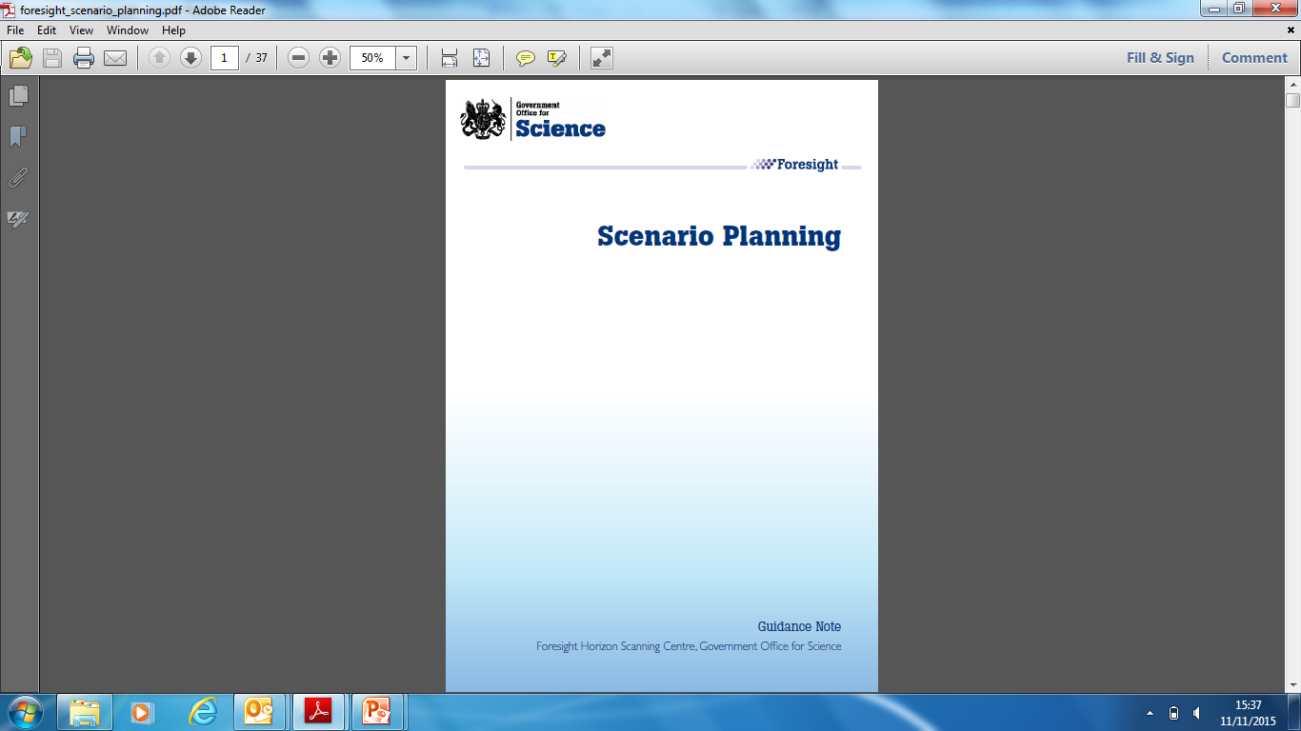
GO-Science (2009) Scenario Planning Guidance
http://webarchive.nationalarchives.gov.uk/20140108140803/http:/www.bis.gov.uk/assets/foresight/docs/horizon-scanning-centre/foresight_scenario_planning.pdf
http://webarchive.nationalarchives.gov.uk/20140108140803/http:/www.bis.gov.uk/assets/foresight/docs/horizon-scanning-centre/foresight_scenario_planning.pdf
OFFICIAL
Notes:
2009 : still valid!

Slide 14
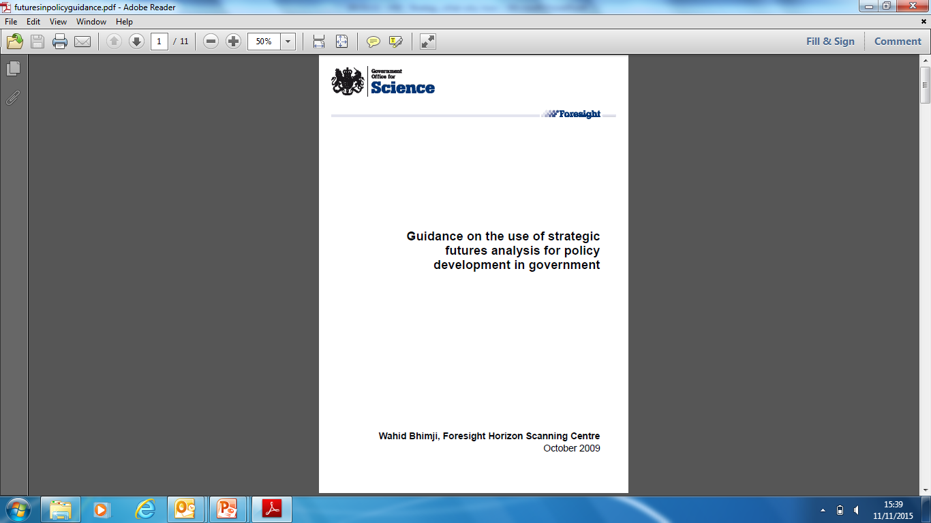
GO-Science (2009) Strategic Futures Guidance
OFFICIAL

Slide 15
GO-Science (2009) Strategic Futures Guidance
Few words.
Numerous diagrams and flow-charts
linking tools for a specific use
or stage of the process.
Tools described in HSC’s 2009 ‘Toolkit’
re-published at http://www.iriss.org.uk/sites/default/files/future_risk_and_opportunities_card_pack.pdf
OFFICIAL
Notes:
2009. Still valid. Never seen anything to replace this Guidance Note (sadly, nowhere to be found on the Web, but a few folk (e.g. me) have it. And still use it.
Likewise the Toolkit that goes with it. Other Toolkits are available! But I still reckon this is about the best. IRISS (luckily) got holds of it and re-published its contents. Without the interactivity of the web-based original, but the meat is still there.

Slide 16
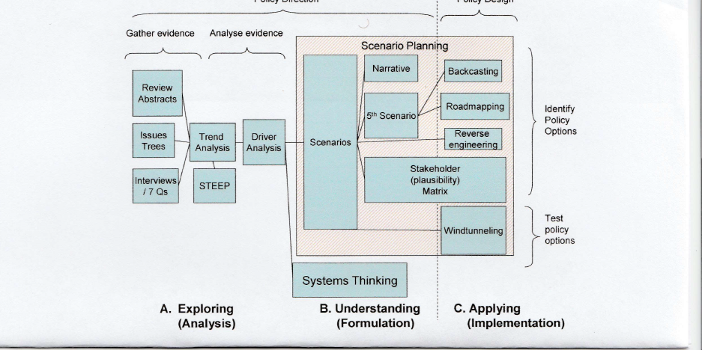
… from GO-Science (2009) Guidance
Policy Direction Policy Design
OFFICIAL
Notes:
Different frameworks and descriptions of the various stages of the strategy and policy process.
And the tools you might best use at the different stages.

Slide 17
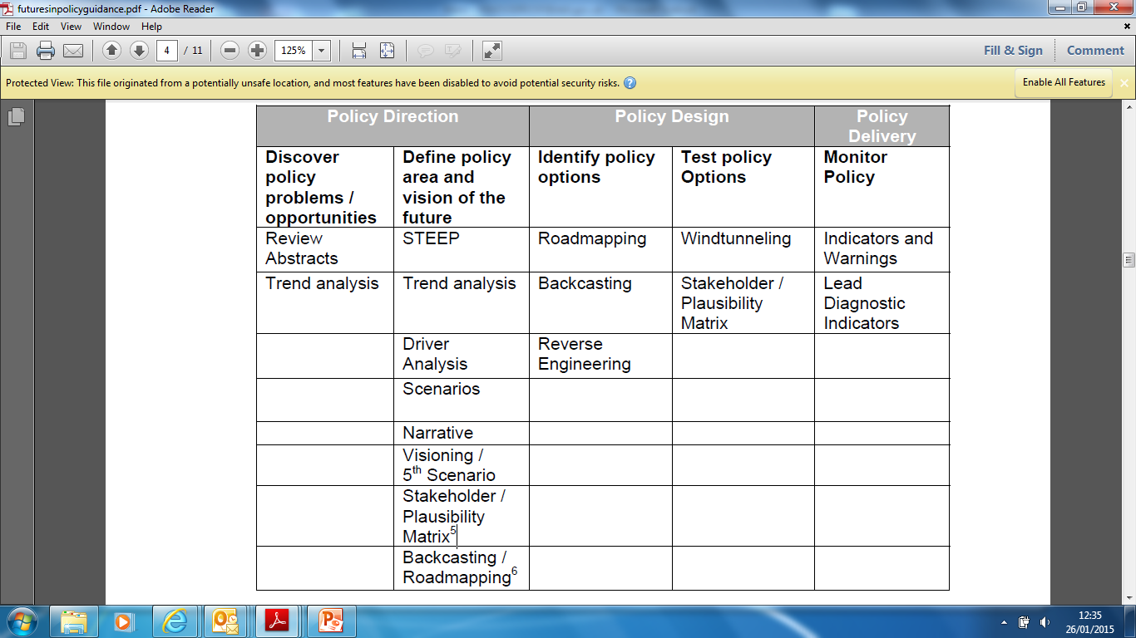
… from GO-Science (2009) Guidance
Futures techniques that contribute to particular policy direction, design, or delivery processes.
OFFICIAL
Notes:
Another framework (along the top). And suitable tools for each stage.

Slide 18
… from GO-Science (2009) Guidance
Gather evidence | Analyse evidence | Identify risks and opportunities | Engage with stakeholders | Engage with ministers
Review Abstracts | Driver Analysis | Scenarios | Scenarios | 5th Scenario
Seven Questions | Trend Analysis | Driver Analysis | 5th Scenario | Visioning
STEEP | STEEP | Backcasting | Visioning | Narrative
 |  | Reverse Engineering | Backcasting
 |  |  | Reverse Engineering
 |  |  | Roadmapping
 |  |  | Seven Questions
Futures techniques that contribute to gathering and analysing evidence, identifying risks, and engaging with ministers or stakeholders.
OFFICIAL

Slide 19
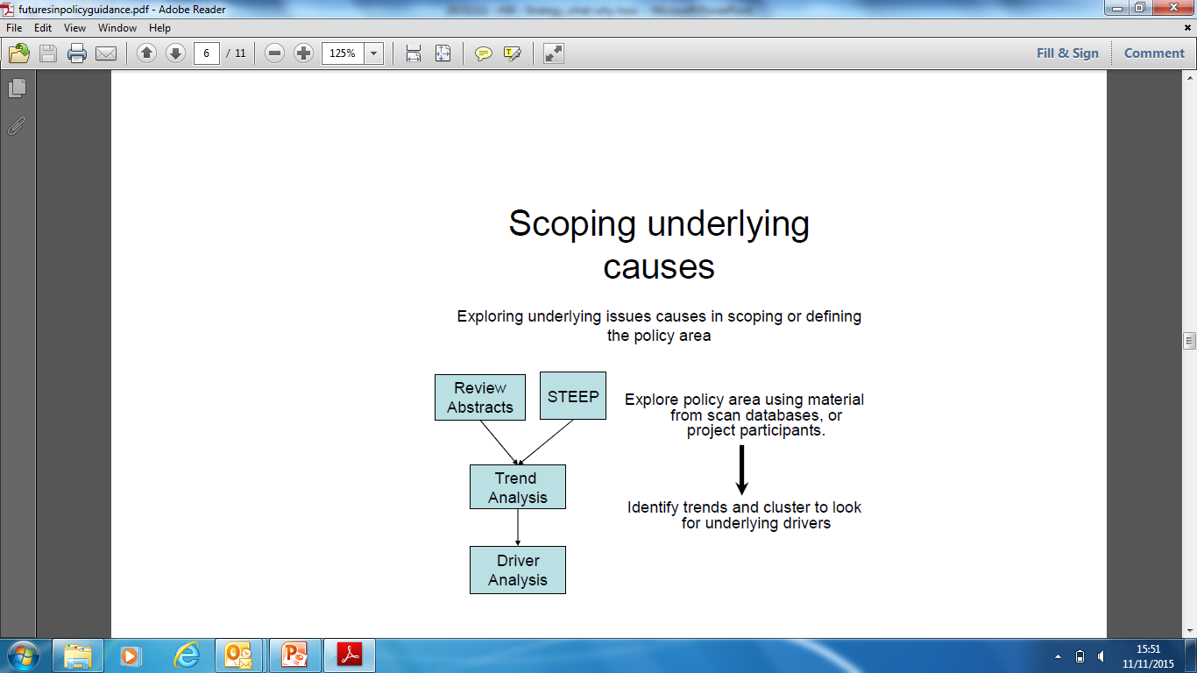
… from GO-Science (2009) Guidance
Sequence of techniques for a specific use. Guidance has several such flow-charts.
OFFICIAL

Slide 20
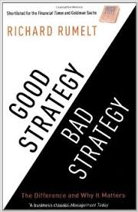
A good strategy solves a problem and has three stages
DIAGNOSIS : define and explain the challenge, and why it’s important
GUIDING POLICY for dealing with it
COHERENT ACTIONS to carry out the policy
Warning: don’t jump to Stages 2 & 3 too quickly!
OFFICIAL
Notes:
GOOD STRATEGY/BAD STRATEGY: Taken from Wikipedia …Professor Richard P. Rumelt described strategy as a type of problem solving in 2011. He wrote that good strategy has an underlying structure he called a kernel. The kernel has three parts: 1) A diagnosis that defines or explains the nature of the challenge; 2) A guiding policy for dealing with the challenge; and 3) Coherent actions designed to carry out the guiding policy.
President Kennedy illustrated these three elements of strategy in his Cuban Missile Crisis Address to the Nation of 22 October 1962:
1.Diagnosis: "This Government, as promised, has maintained the closest surveillance of the Soviet military buildup on the island of Cuba. Within the past week, unmistakable evidence has established the fact that a series of offensive missile sites are now in preparation on that imprisoned island. The purpose of these bases can be none other than to provide a nuclear strike capability against the Western Hemisphere."
2.Guiding Policy: "Our unswerving objective, therefore, must be to prevent the use of these missiles against this or any other country, and to secure their withdrawal or elimination from the Western Hemisphere."
3.Action Plans: First among seven numbered steps was the following: "To halt this offensive buildup a strict quarantine on all offensive military equipment under shipment to Cuba is being initiated. All ships of any kind bound for Cuba from whatever nation or port will, if found to contain cargoes of offensive weapons, be turned back."
:::::::::::::::::::::::::::::::::
By HW : An example of great Public Strategy. At one of the most dangerous moments for the World that any of us in this room will have lived through. Probably the most dangerous. And it worked!
And note my warning at the bottom. Don’t start solutionising too soon – something public sector folk of all types tend to do! Understand the problem first! (See much of Freedman’s ‘academic’ approach, and the early stages of the ‘Resilient’ strategy model …. Spend time and other resource doing that well…. Or, in a nutshell, if you’ve got the time, and you always do (even Kennedy/Cuba) : “Think before you Act.”
Terrible advice of course if you’re a junior Infantry Officer whose patrol unexpectedly comes under fire : you need to Do Something. Immediately. You can’t call an O-Group and say, shall we go left? Shall we go right? But by the time they get up to slightly higher levels of command they’re not dealing with that type of situation. And wider experience, and the training they get at Staff College etc, should help them transition into a mental mode where a more strategic approach can be applied to their desk jobs in Main Building, the FLCs, DE&S and elsewhere. And on Operations. The challenge is of course to Find the Time, when ‘The Tyranny of the In-Tray (In-Box)’ means too often that ‘Today’s Business is Compelling’ .

Slide 21
“However beautiful the strategy, you should occasionally look at the results.” Winston Churchill
Keep it grounded and pragmatic.
And about the problem at hand.
Don’t let it become either a theoretical exercise or just about the future.
OFFICIAL
Notes:
Finally, not sure if Churchill was actually a great strategist – in WW2 that was generally reckoned to be (FM Viscount) Alanbrooke (the CIGS) – but he’s always good for a quote!
And what’s he’s really saying is …. (bullets)

Slide 22
Questions?
OFFICIAL

