Slide 1
Instruments for Teat Surgery

Slide 6
short, narrow, 1 inch diameter round-pointed metal or plastic tube used to pass from the exterior, through the teatcanal and into the teat cistern. Used to relieve pressure in the gland when the teat canal is obstructed. Well-designed ones have a bulge followed by a constriction near the hub so that the tube is self-retaining. Called also teat tube.

Slide 8
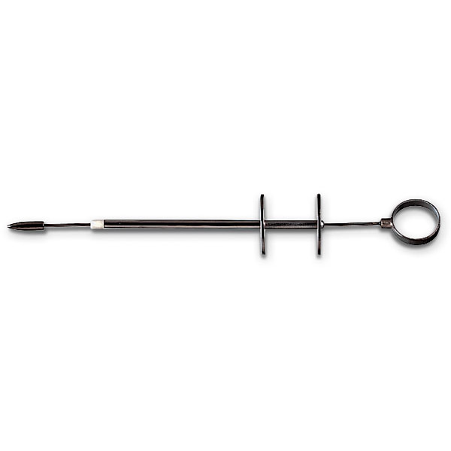
Teat Bistoury
Used to enlarge teat canal

Slide 9
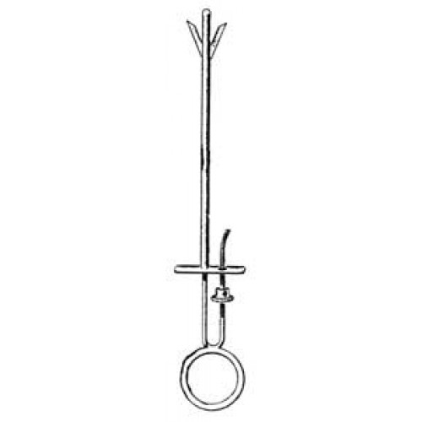
Teat Slitter

Slide 10
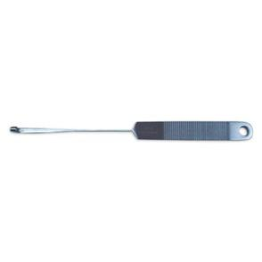
Cornell Teat Curette
Used to remove masses inside teat.
has a long thin neck and a flat blade with a blunt-ended turned around tip with a straight cutting edge. Designed for curetting back towards the operator.

Slide 11
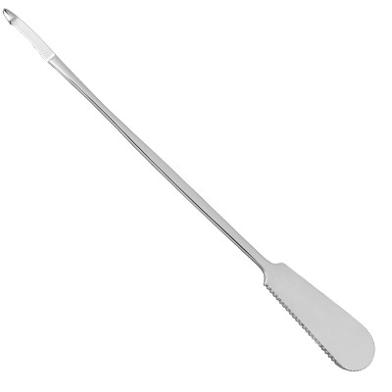
Teat Bistoury
Designed for opening stenosed teat sphincters.
The point is blunt and rounded, the cutting edge is inset from the true edge of the blade and is about 0.5 in long.
The bistoury is inserted into the canal and withdrawn sharply so as to incise the scar tissue vertically. Three or four incisions are made in this way.

