Slide 1
Endotracheal
Intubation

Slide 2
Cattle
Endotracheal intubation is performed digitally in adult cattle.
A speculum is placed in the animal’s mouth, and the jaws are separated as far as possible.
Care should be taken not to injure the tongue while positioning and opening the mouth.

Slide 3
Cattle
The left or right hand is placed into the animal’s mouth until the epiglottis can be palpated.
The other hand is used to insert an appropriately sized cuffed endotracheal tube into the animal’s mouth under the first hand and using the first hand to guide it into the trachea.
The endotracheal tube can be secured to the animal’s muzzle with gauze bandage or tape to prevent it from becoming dislodged during the operative procedure.
Notes:
The hand, arm, and endotracheal tube should be thoroughly lubricated with the animal’s saliva or a lubricant jelly (KY gel) before inserting them into the animal’s mouth. The endotracheal tube should be advanced into the trachea to about the middle of the neck. Care should be taken not to advance the tube too far because this could result in endobronchial intubation and hypoxemia.

Slide 4
Small Ruminants and Swine
The animal should be positioned on its sternum, and the head should be elevated and extended straight up at a right angle to the body.
The laryngoscope is advanced into the mouth until the larynx is observed and its tip is then used to hold down the epiglottis, visualizing the opening to the trachea.

Slide 5
Small Ruminants and Swine
A stylet is placed through and should extend approximately 20 cm beyond the end of an appropriately sized (generally determined lubricated (KY gel), cuffed endotracheal tube.
The stylet is then placed into the mouth and visually guided through the larynx.
It advances about 5 to 10 cm into the trachea, depending upon the size of the animal.
The endotracheal tube is then slowly advanced over the stylet.
It is rotated slowly as it approaches and passes the larynx.

Slide 6
Small Ruminants and Swine
Once the endotracheal tube is positioned in the trachea, the stylet is removed and the endotracheal tube cuff inflated (until no air exits the mouth).
It is secured to the animal’s head or muzzle.
Notes:
Care should be taken not to move the stylet once it has been positioned in the trachea to avoid unnecessary trauma and inadvertent puncture of the larynx or trachea.

Slide 7
Endotracheal intubation in a calf. Note that the head and neck are extended perpendicular to the body. A long laryngoscope blade can be used to visualize the larynx
and deflect the epiglottis ventrally to provide a clear view of the opening to the trachea

Slide 8
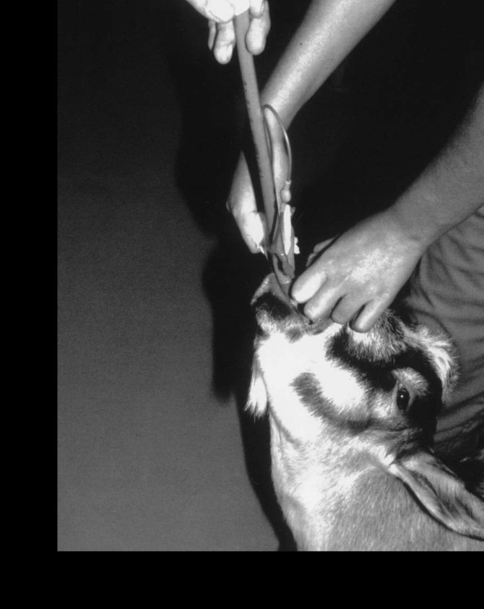
Endotracheal intubation in a goat. Note that the
head and neck are extended perpendicularly to the body and
that a stylet is used to stiffen the endotracheal tube for placement
through the larynx into the trachea

Slide 9
Adult cattle, small ruminants, and swine are allowed to breathe spontaneously unless there are signs of respiratory depression (low rate or volume), hypoxemia(cyanosis) or respiratory distress.
Ventilators are useful for longer (>1hour) procedures; otherwise respiration can be supported by manual inflation of the lungs (Ambu bag, rebreathing bag) with the animal breathing 6 to 10 times per minute to an inspiratory pressure of 20 to 30cm H20.

