Slide 1


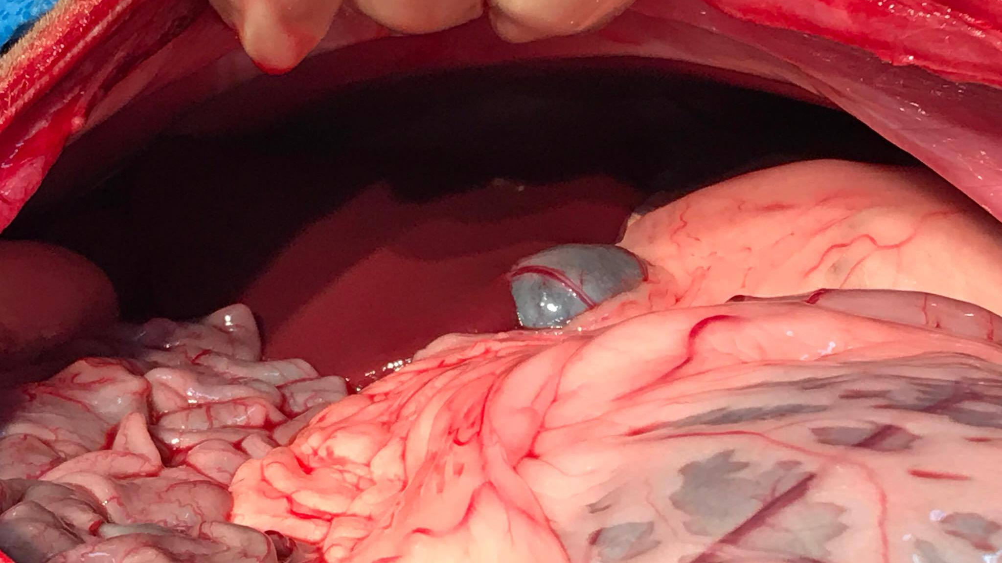
Right paralumbar Laparotomy/Celiotomy in Rebecca
-A flow of the procedure

Slide 2

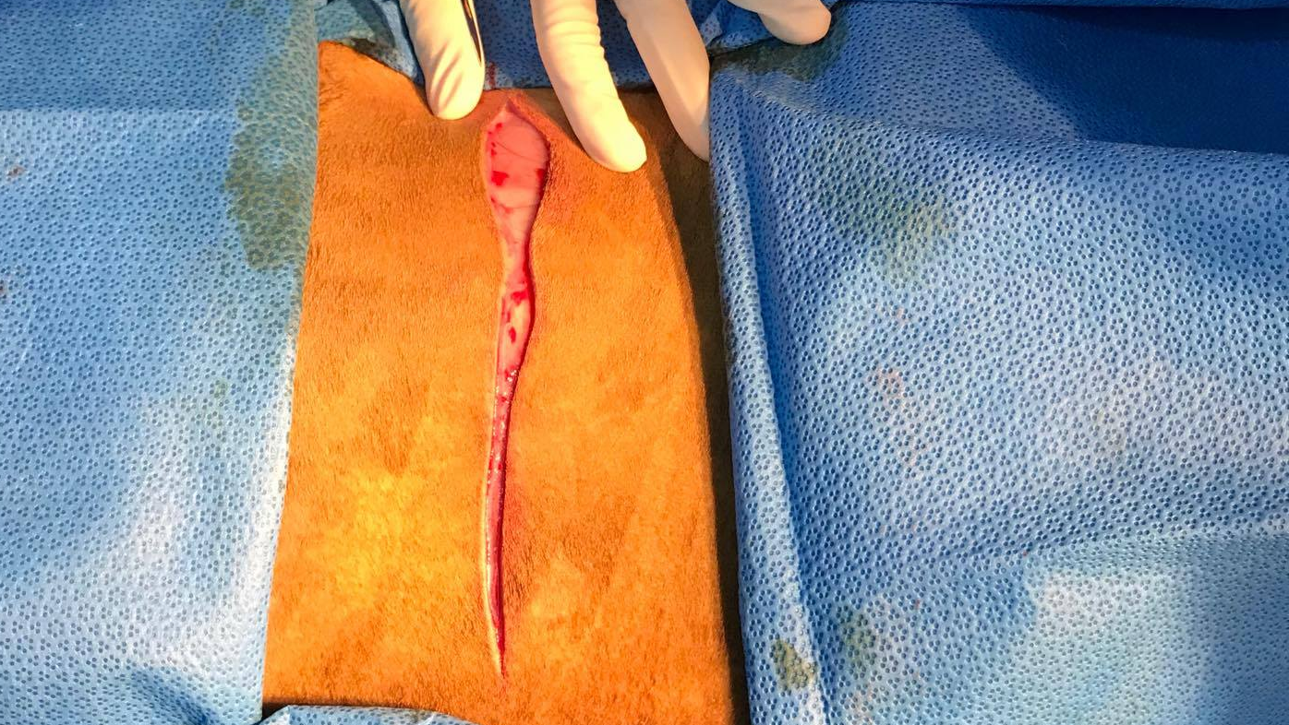
Incision through skin

Slide 3
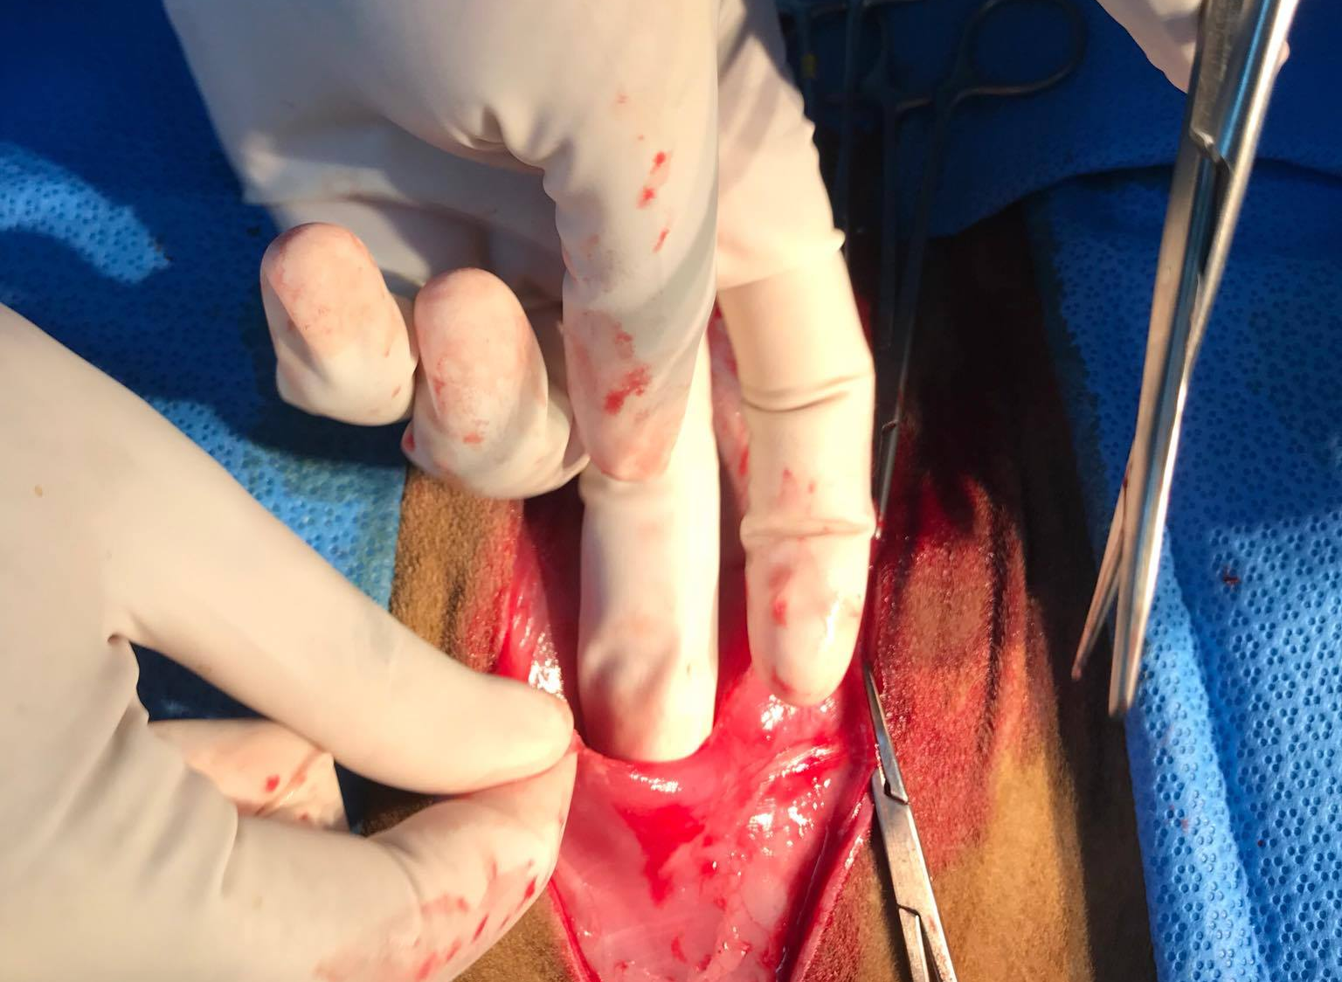
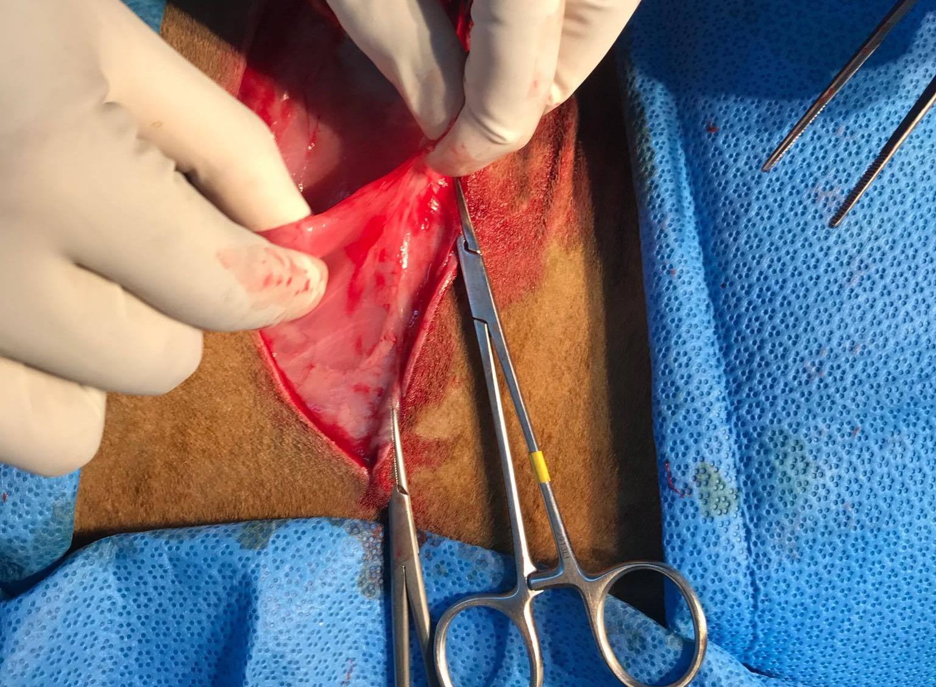
Cutaneous trunci

Slide 4
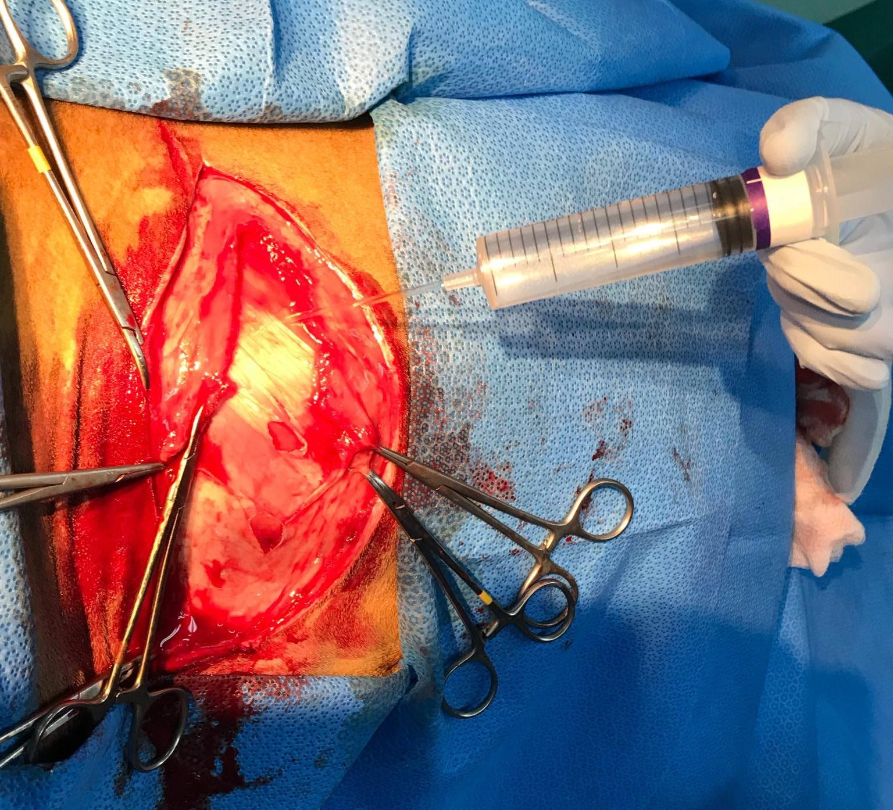
Splash block intact External oblique

Slide 5
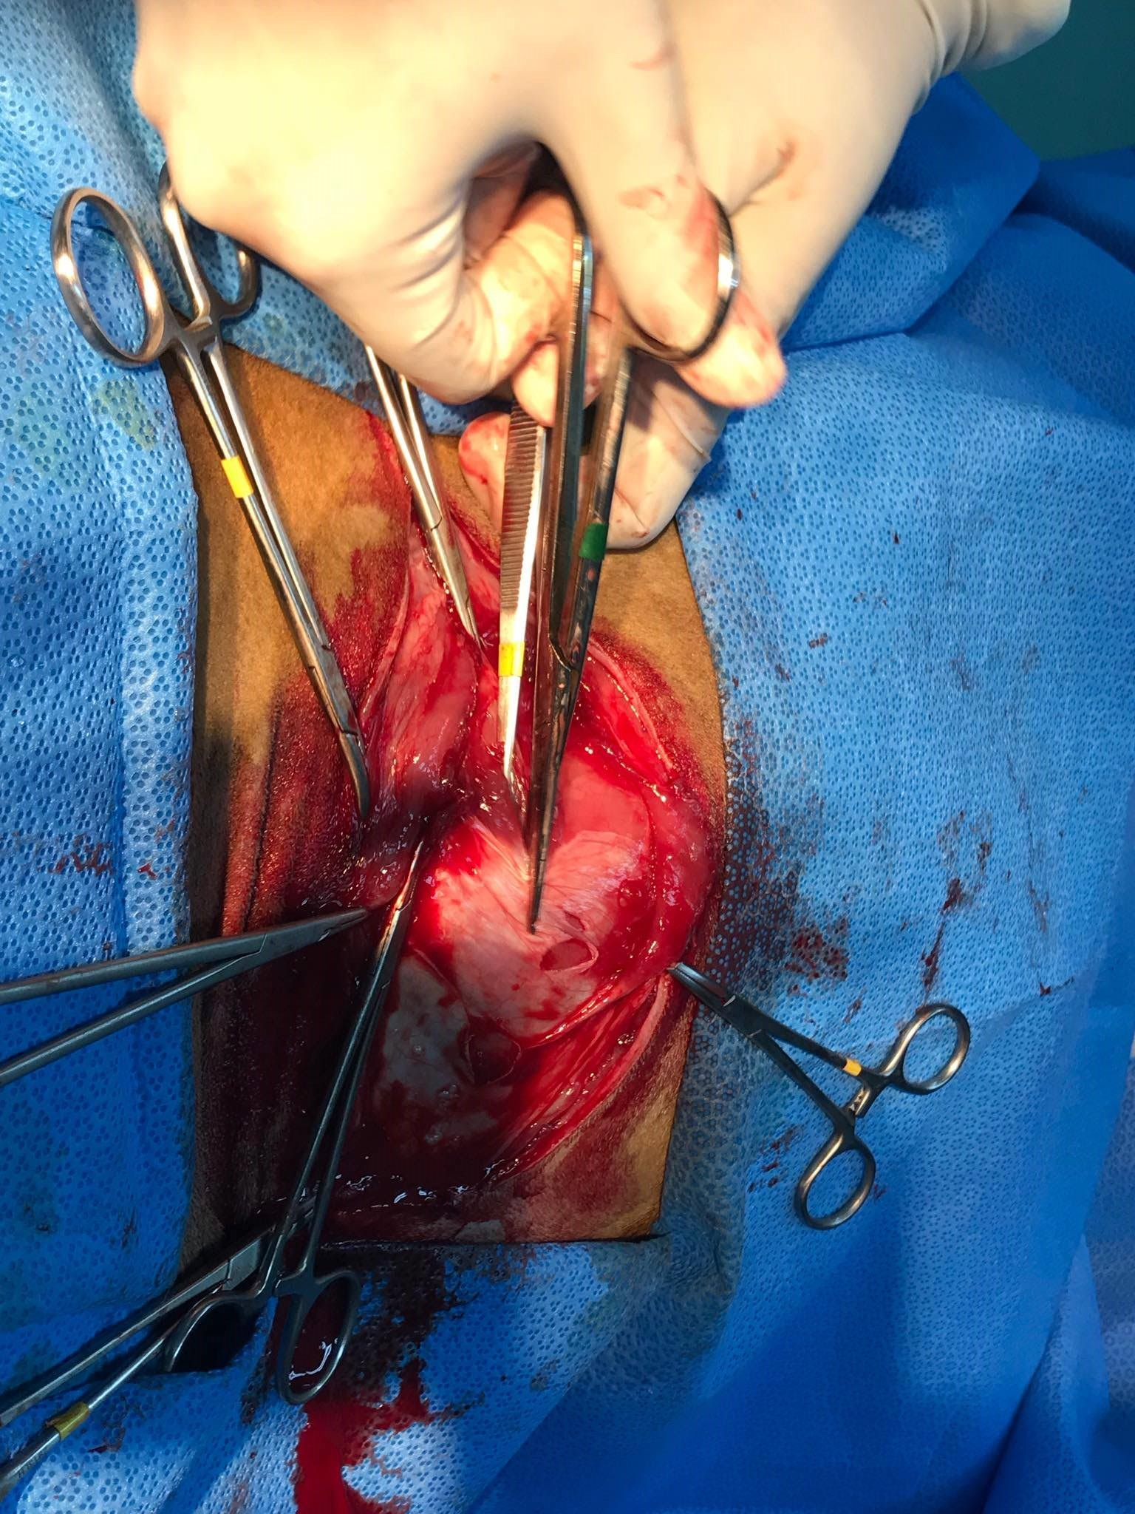
Cutting through External Oblique

Slide 6
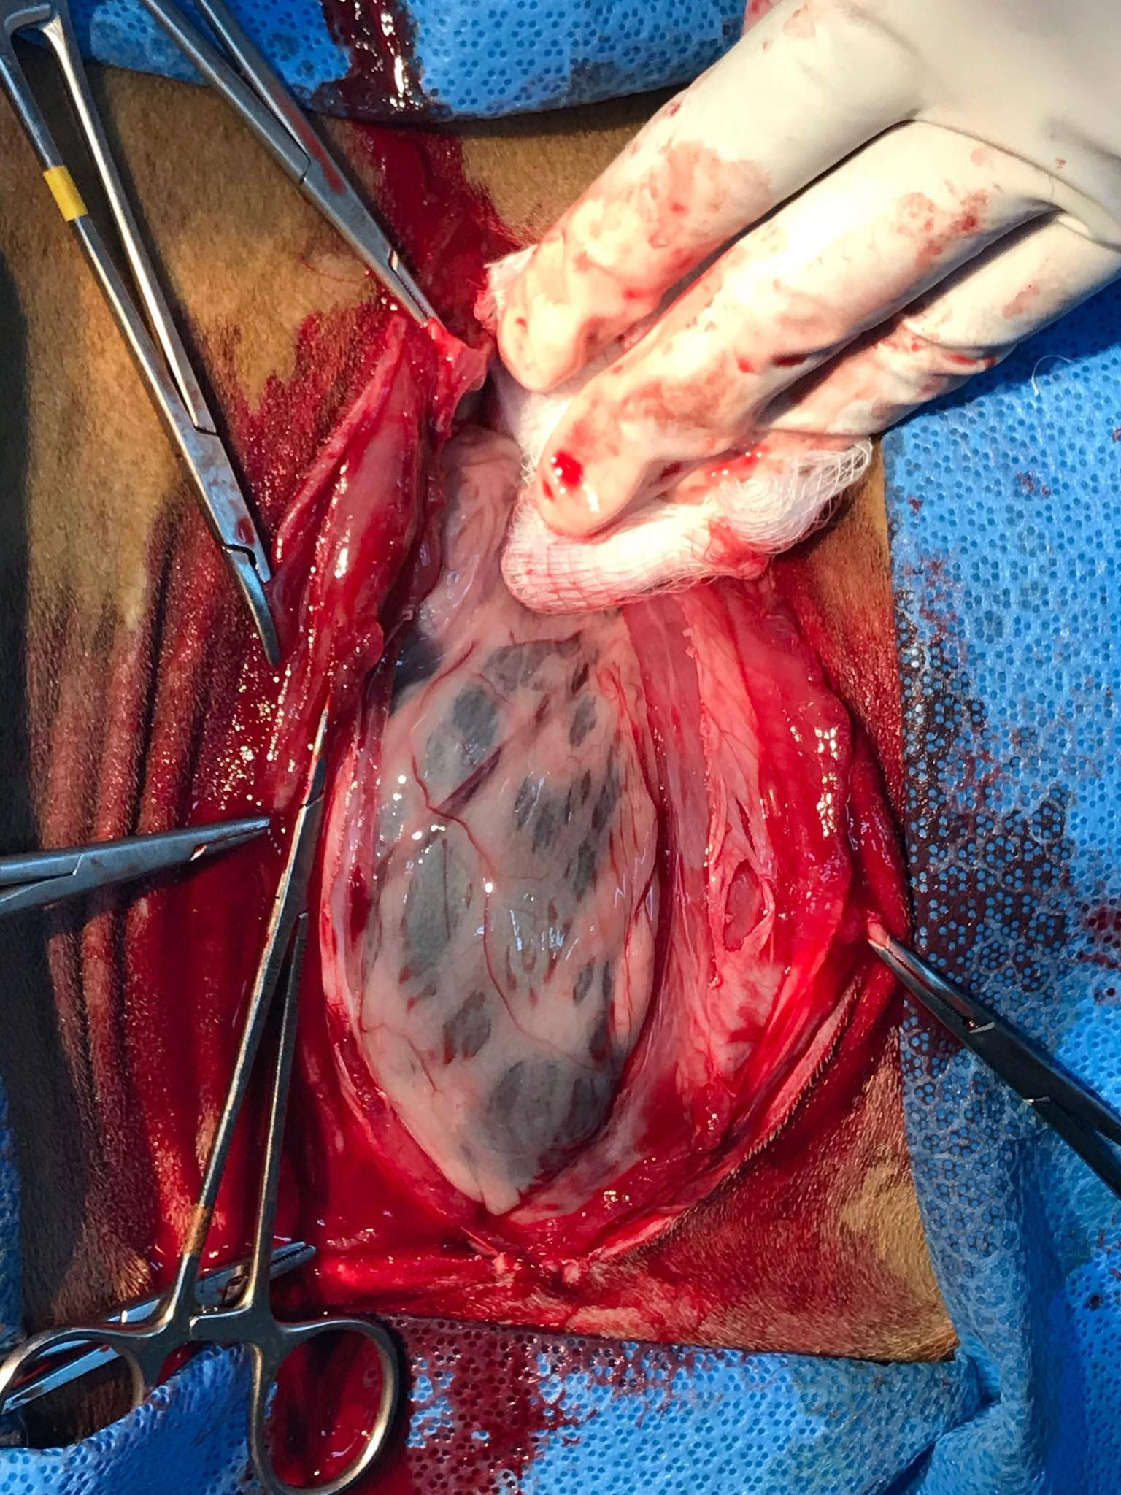
Omentum over Rumen

Slide 7
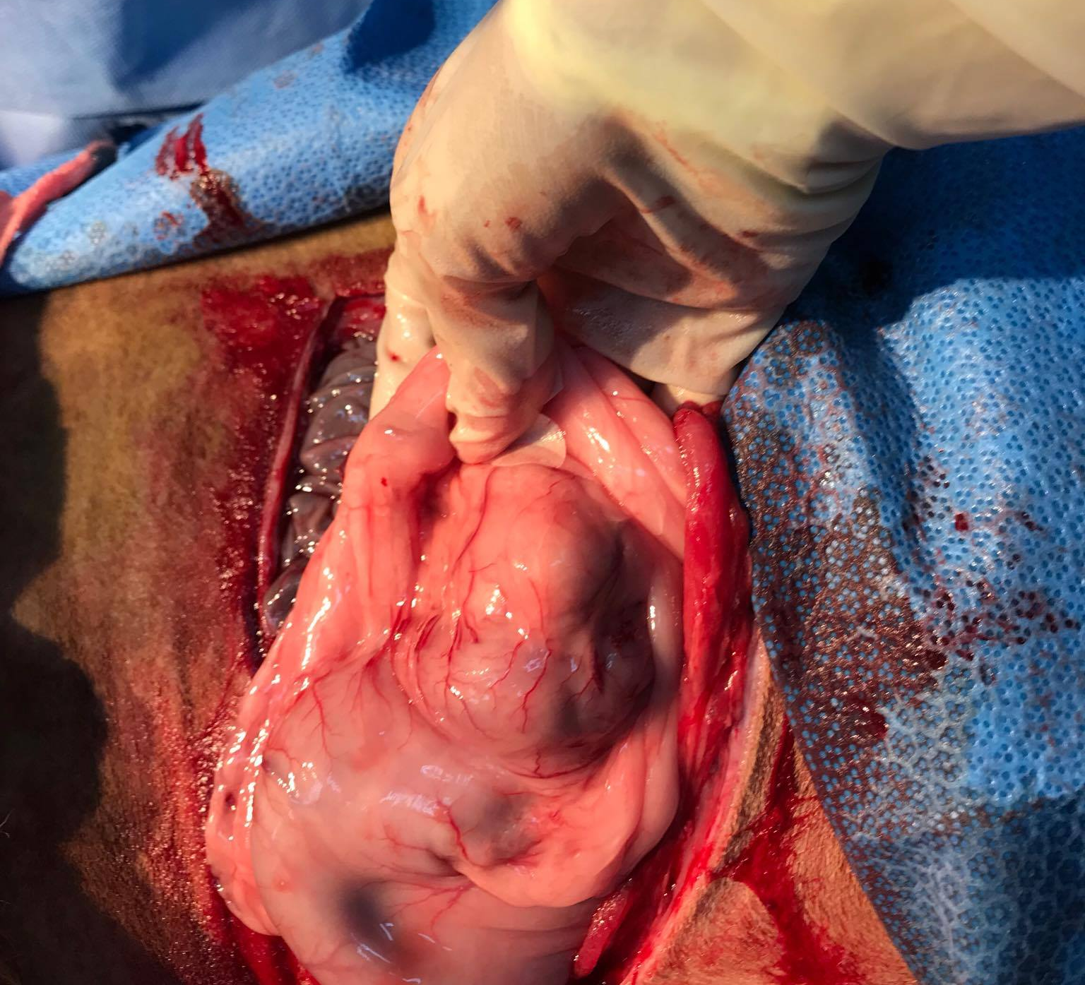
Abomasum, Pylorus, Sow's ears

Slide 8
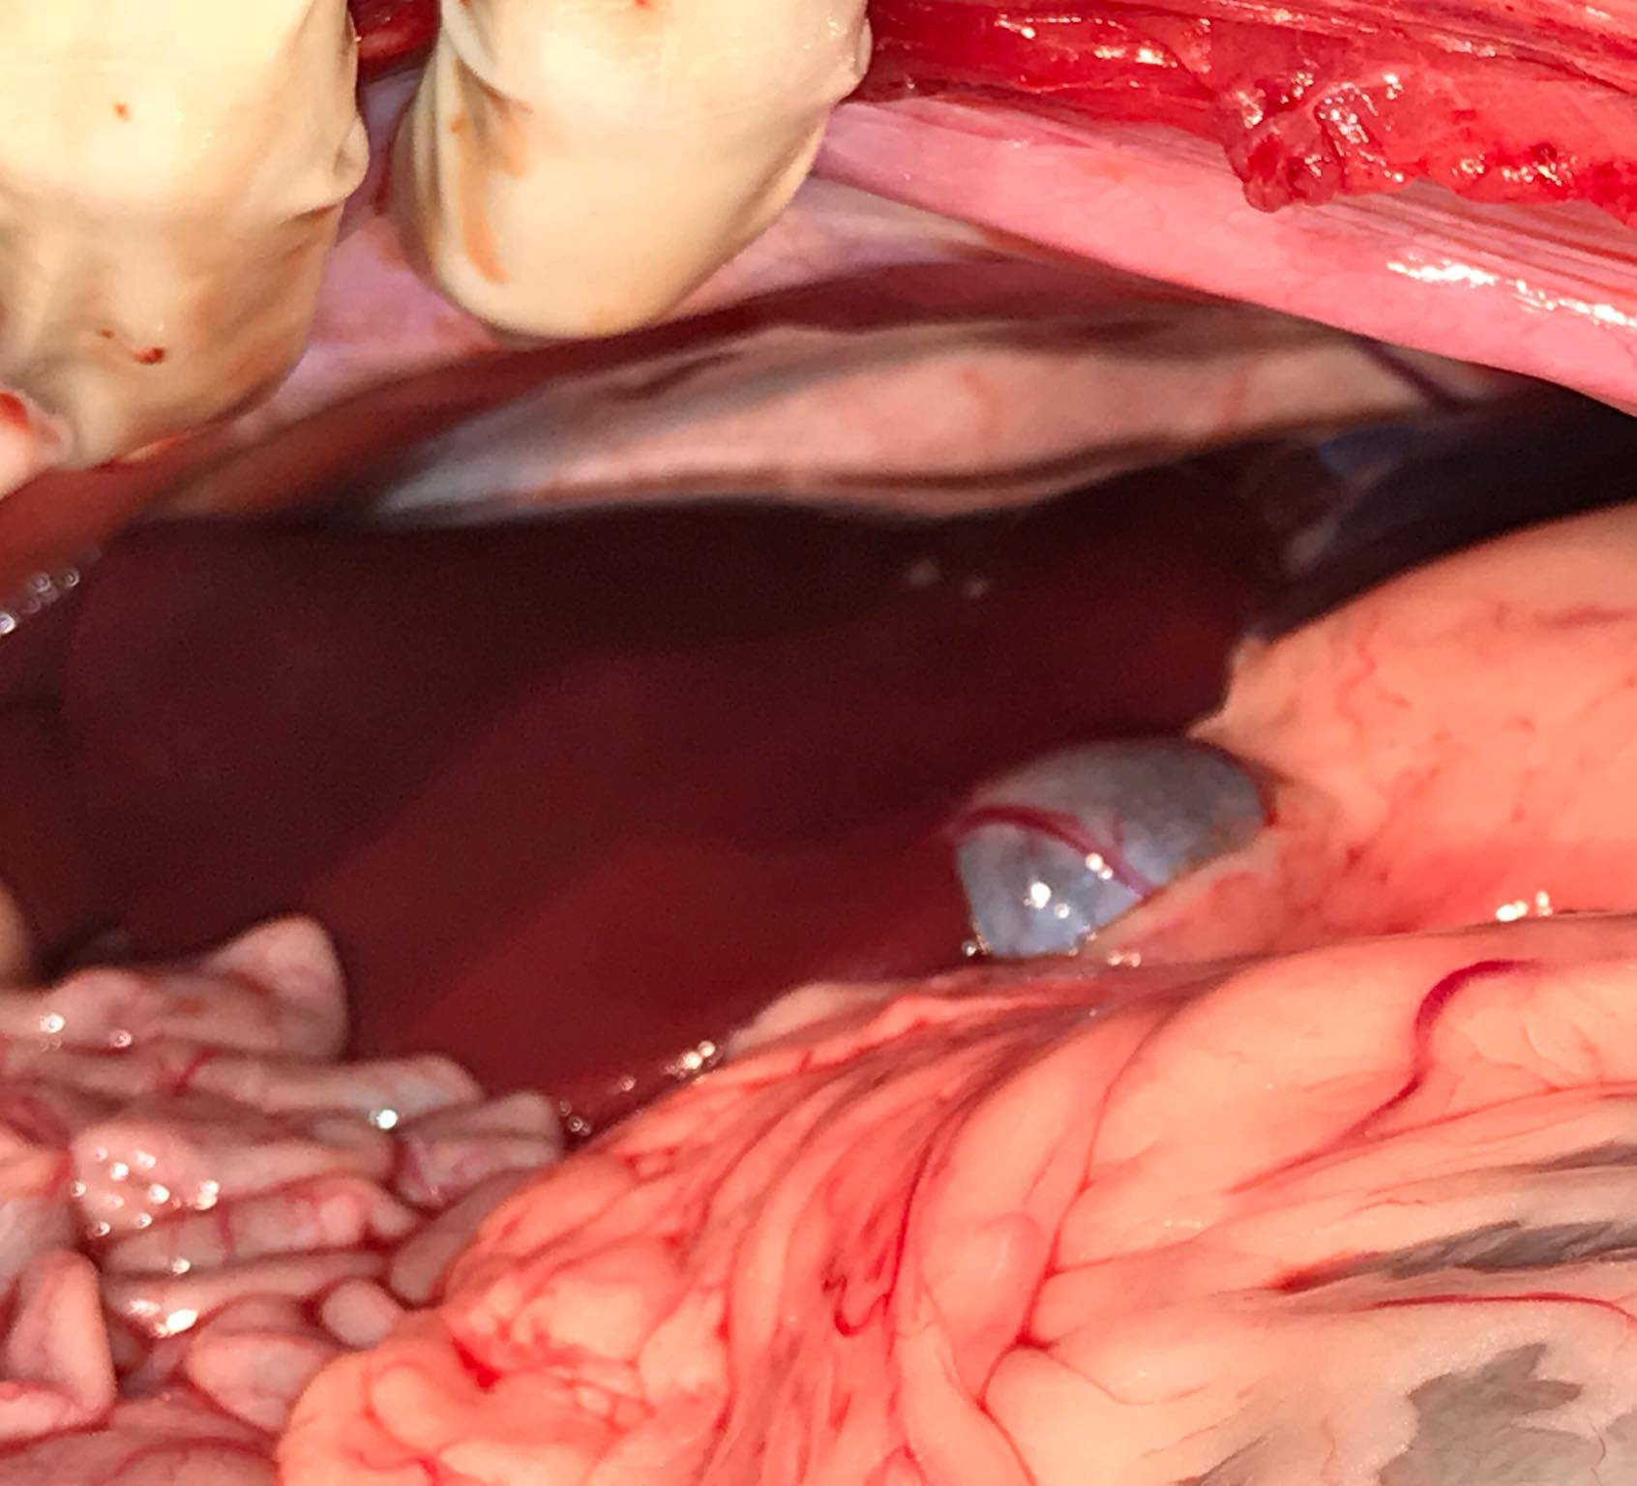
View into Cranial Abdomen

Slide 9
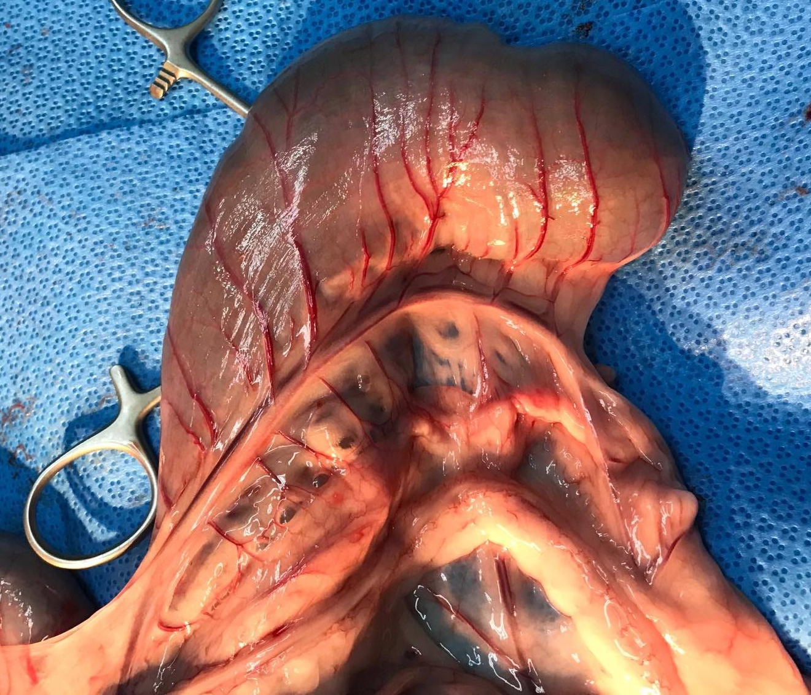
Ceacum

Slide 10
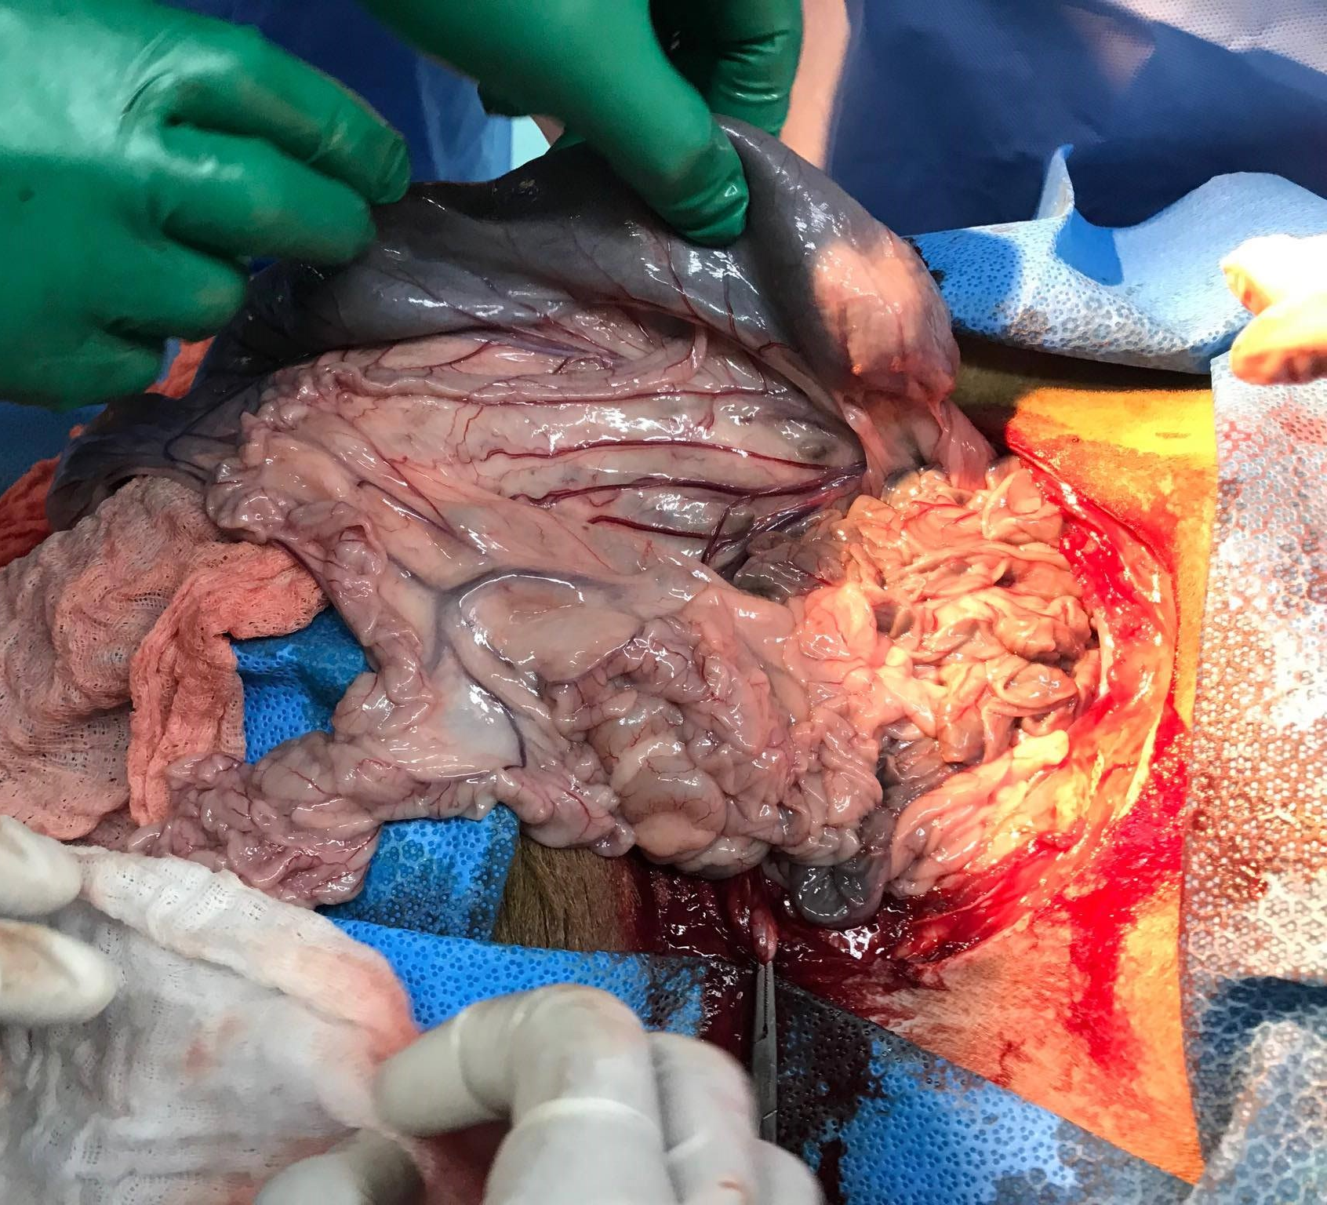
Ceacum and Small Intestine

Slide 11
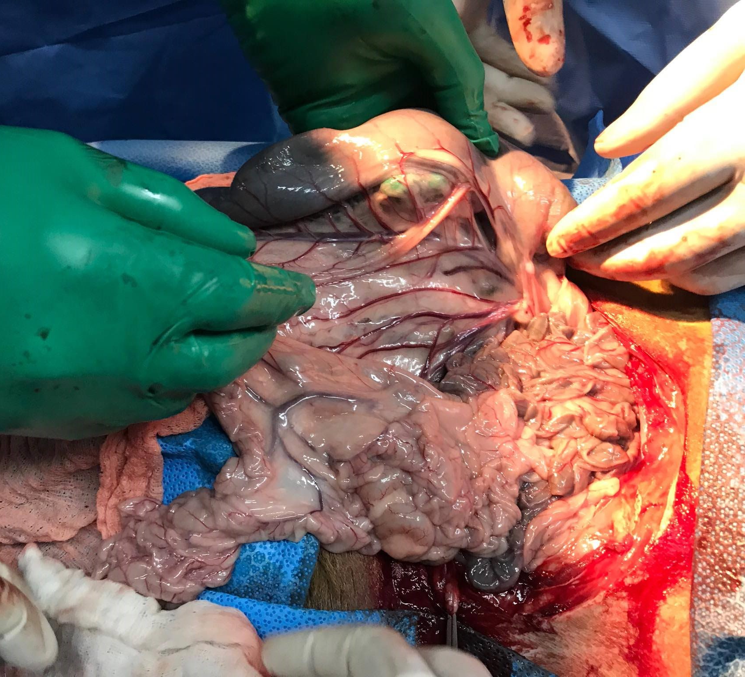
Ileocecocolic Junction

Slide 12
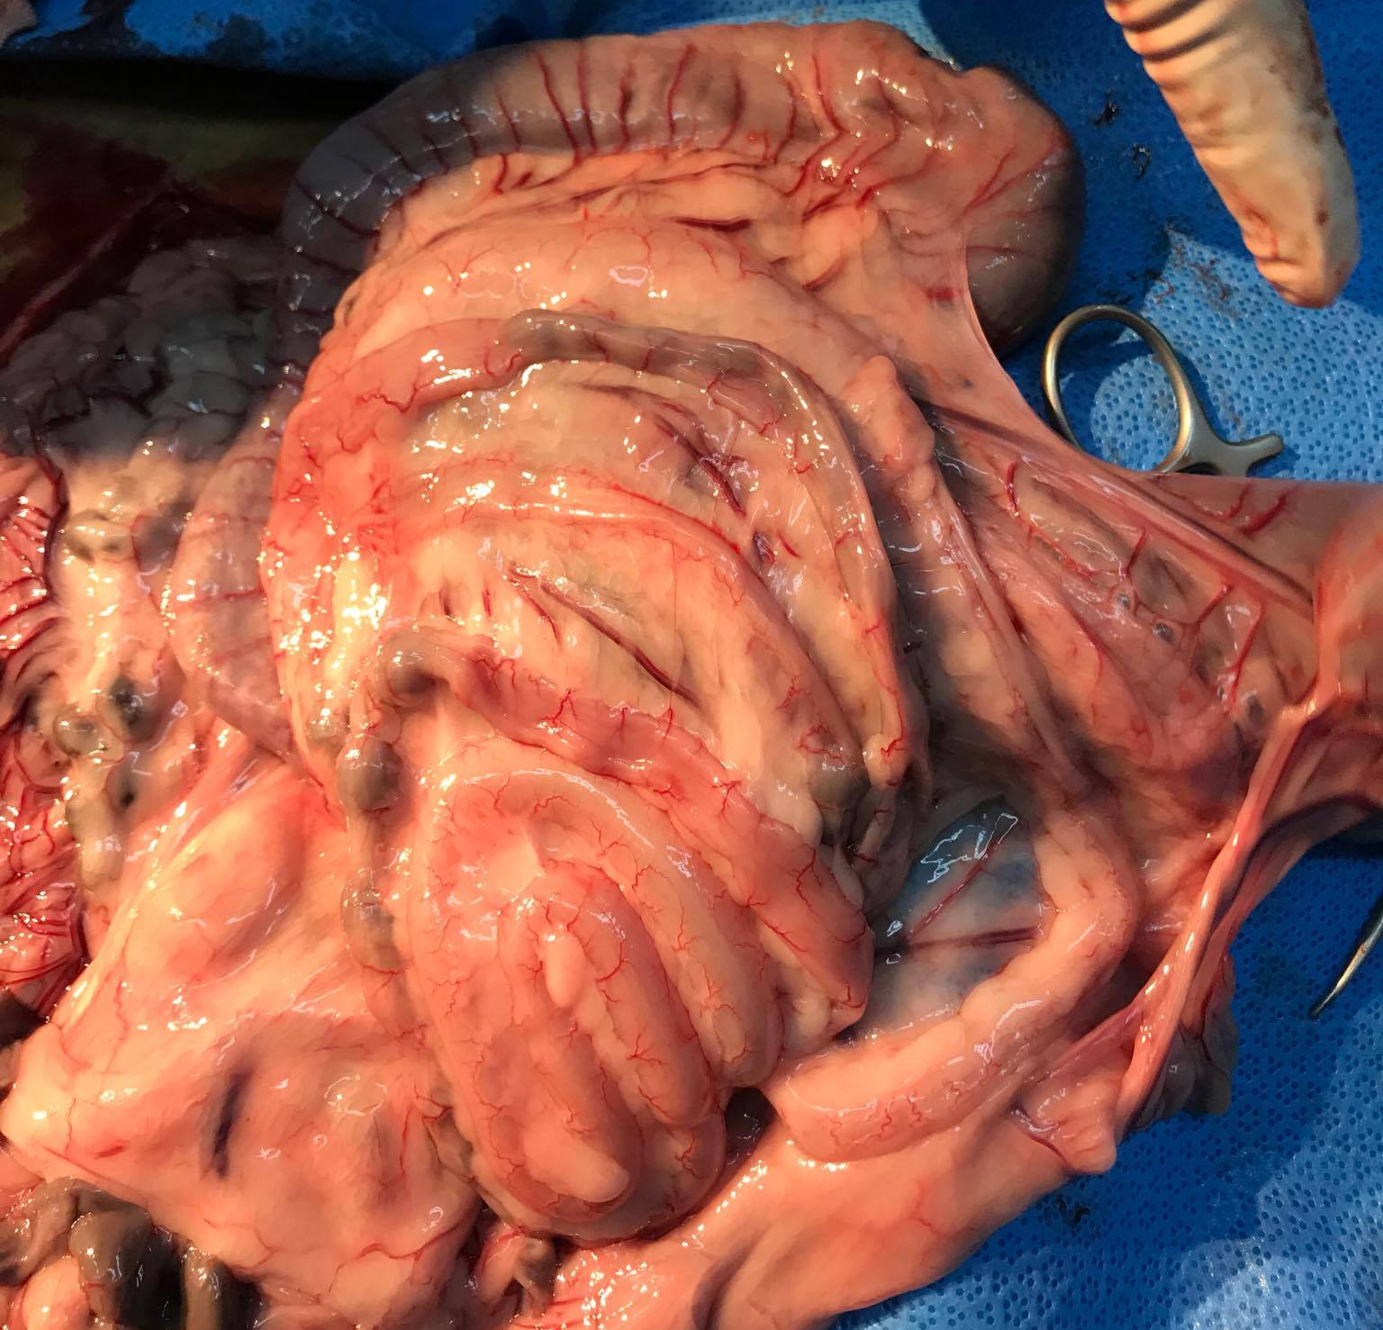
Spiral Colon

Slide 13
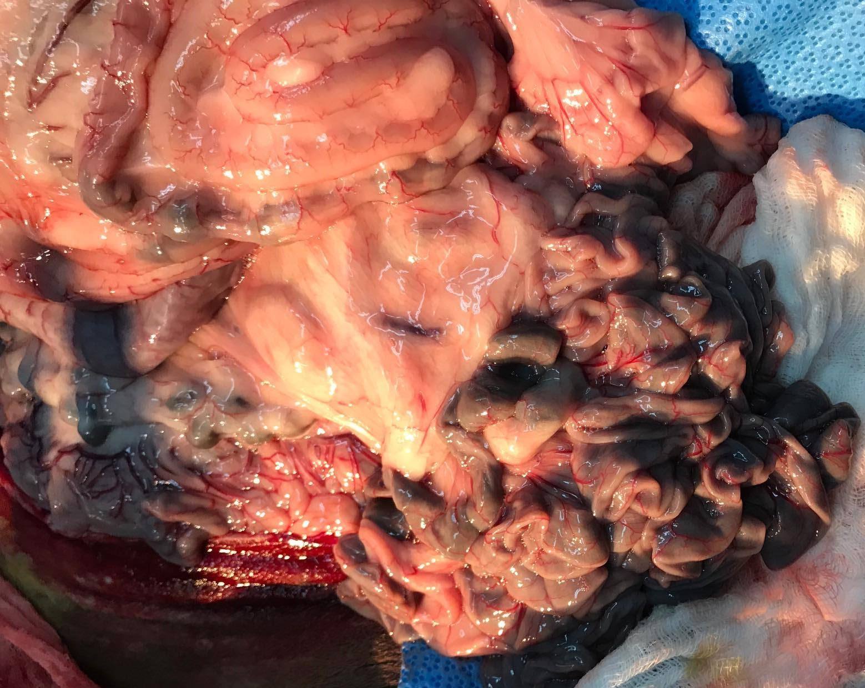
Small Intestine and Spiral colon

Slide 14
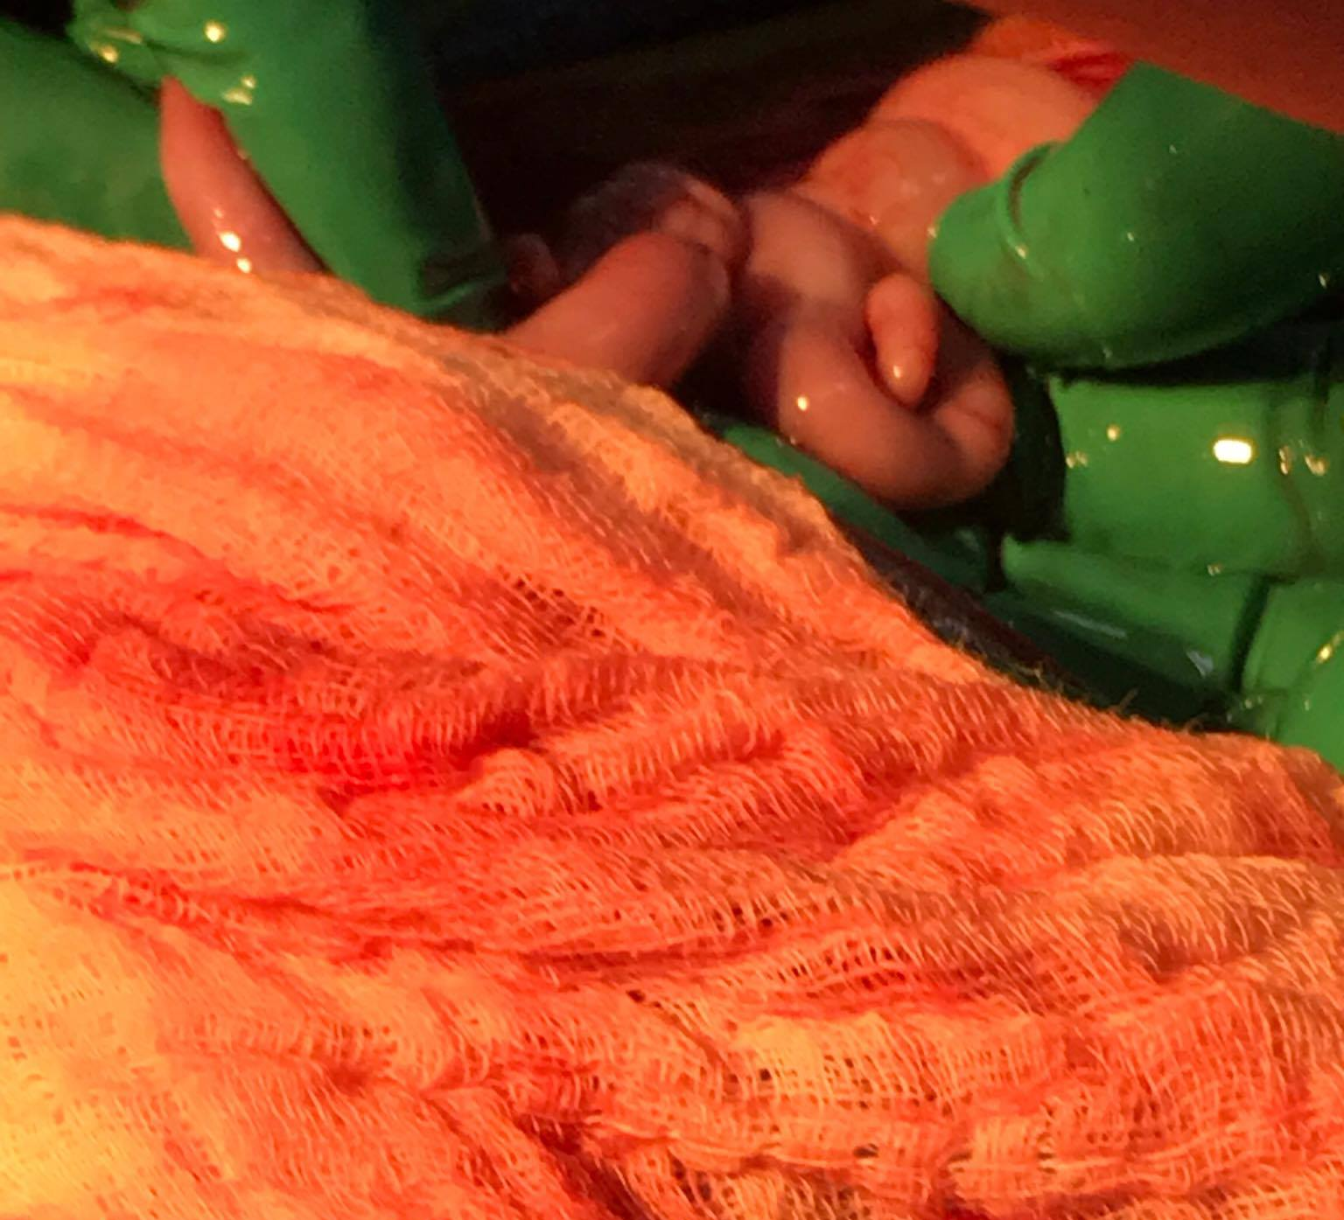
Uterine Horns

Slide 15
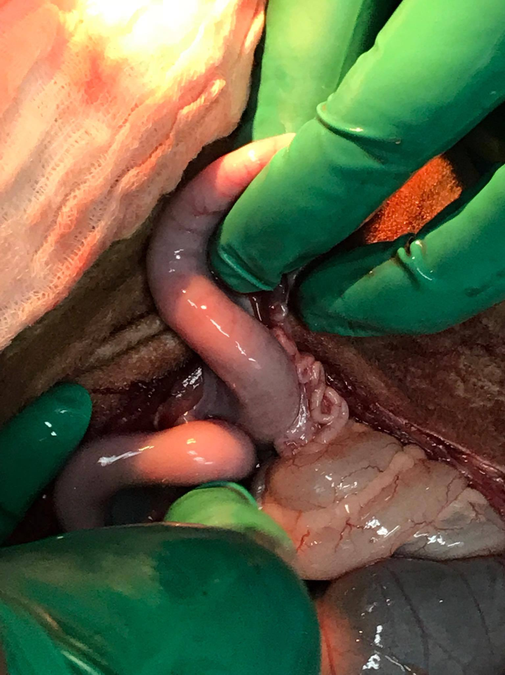
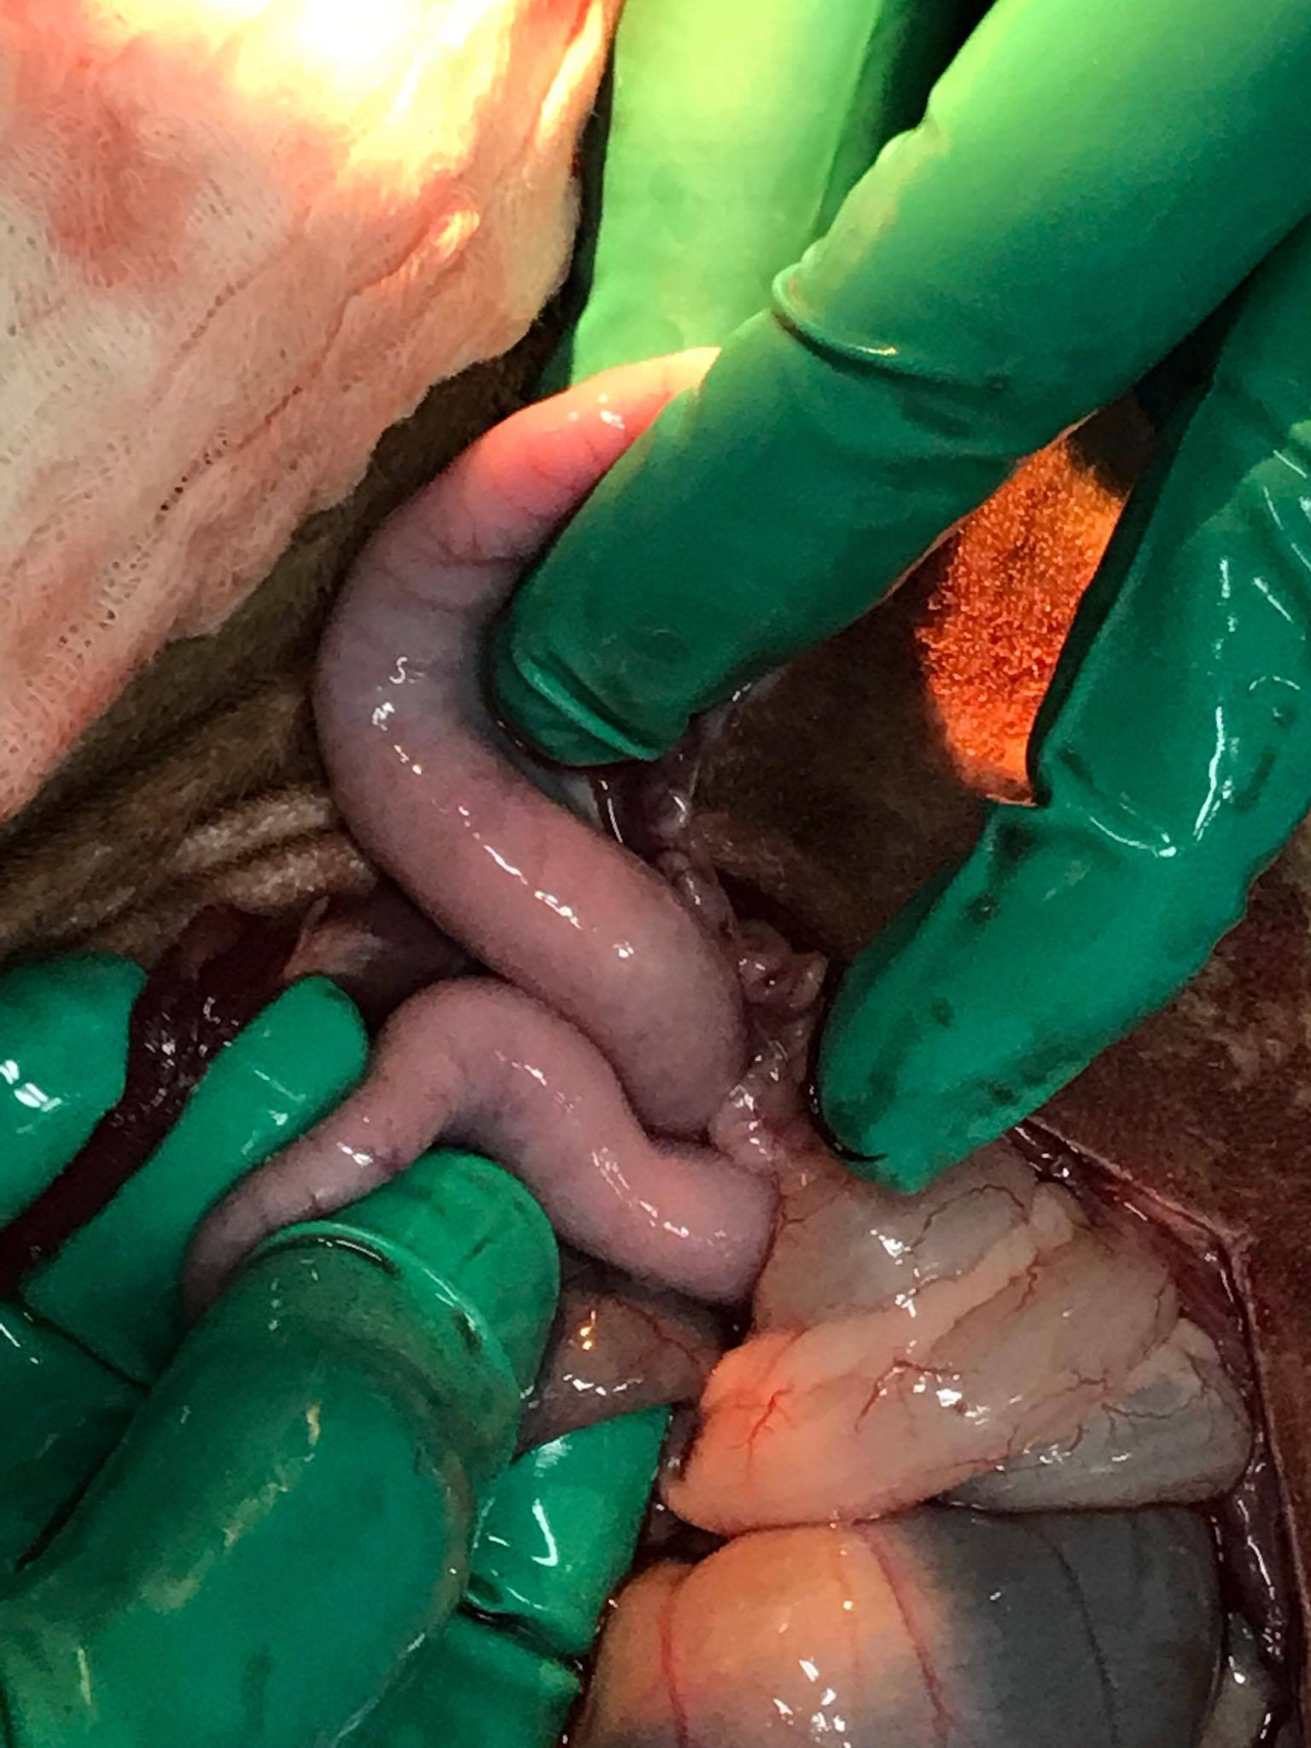
Uterine Horns

Slide 16
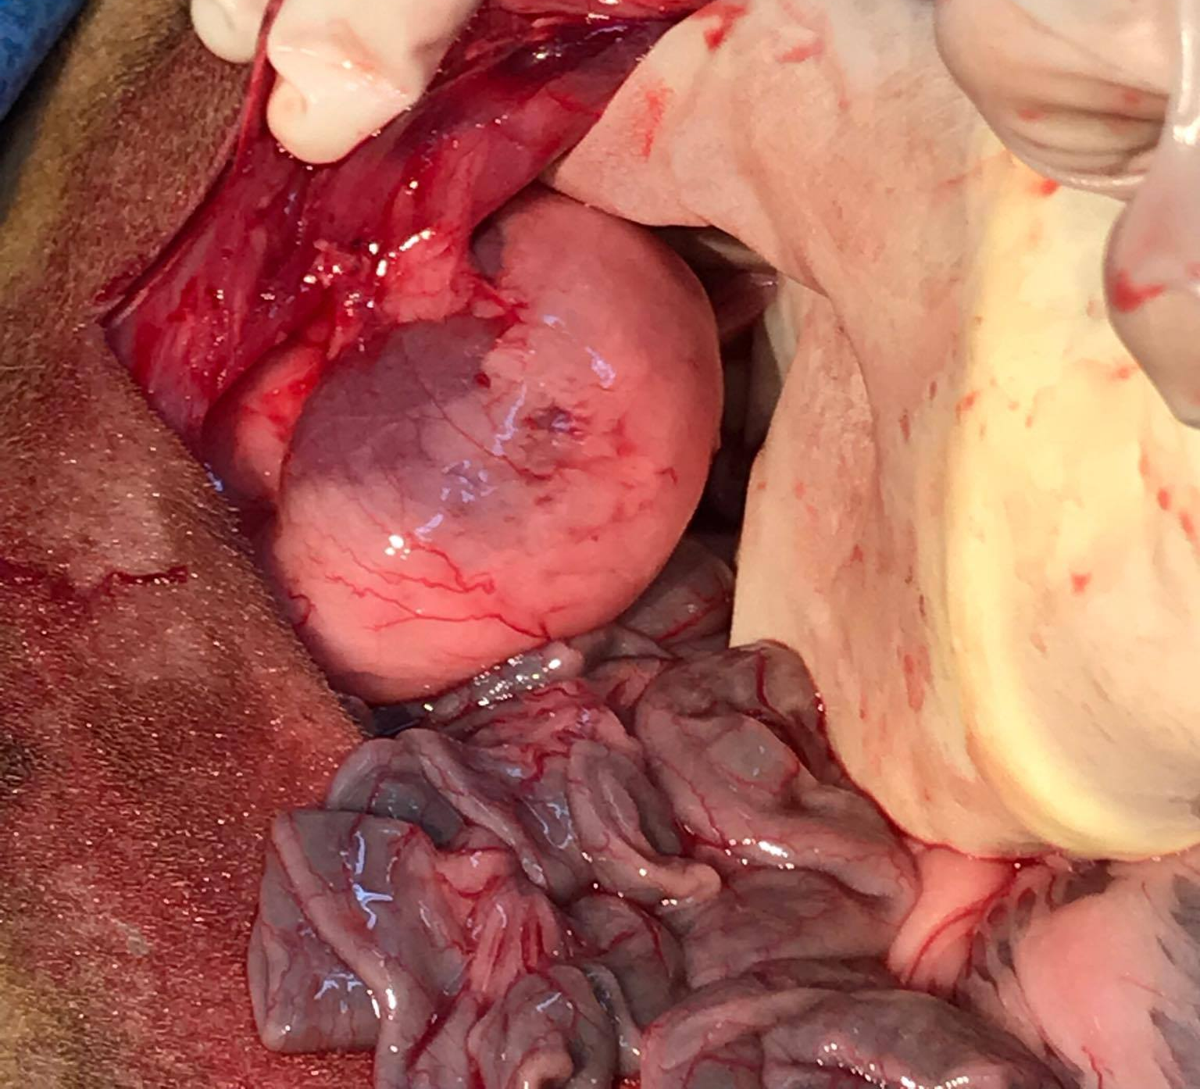
Kidney and Small Intestine

Slide 17
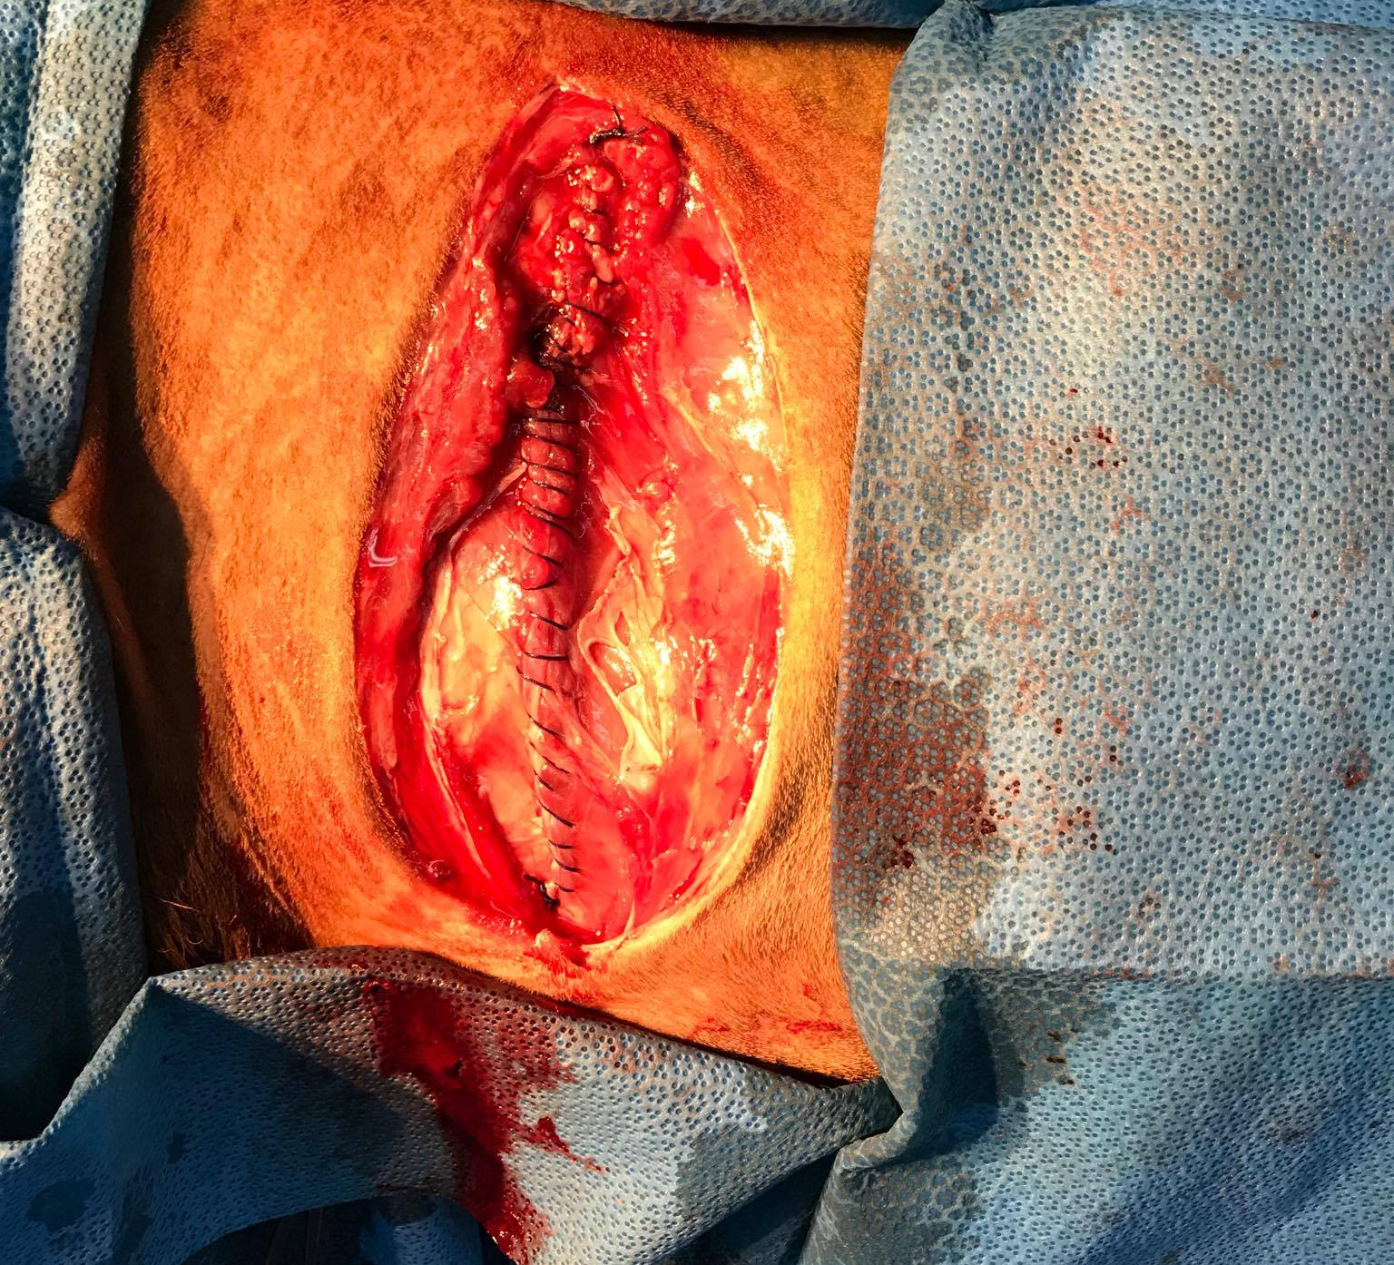
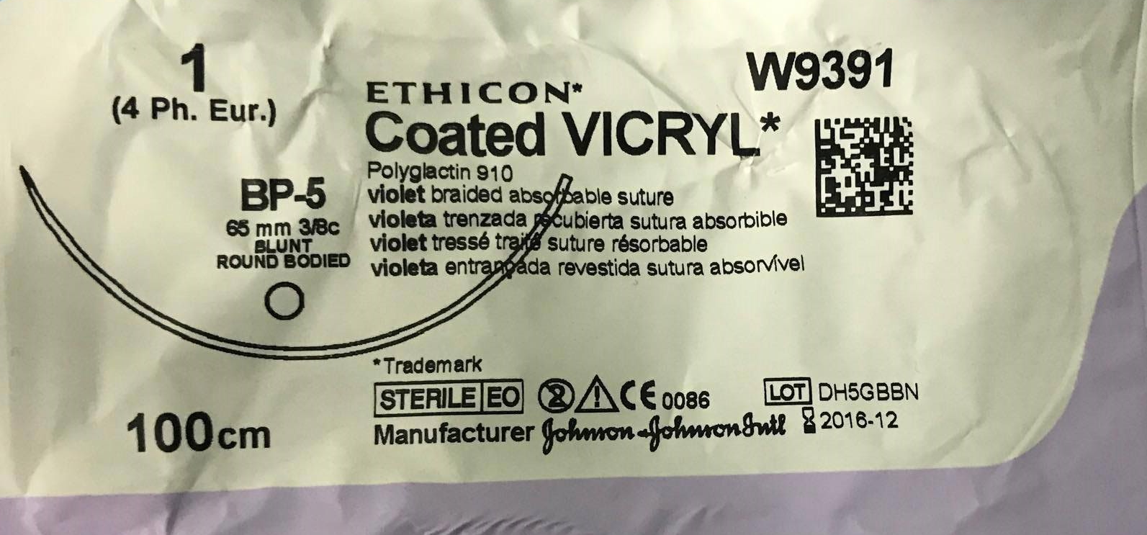
Simple Continuous of Transverse and Peritoneum with Vicryl

Slide 18
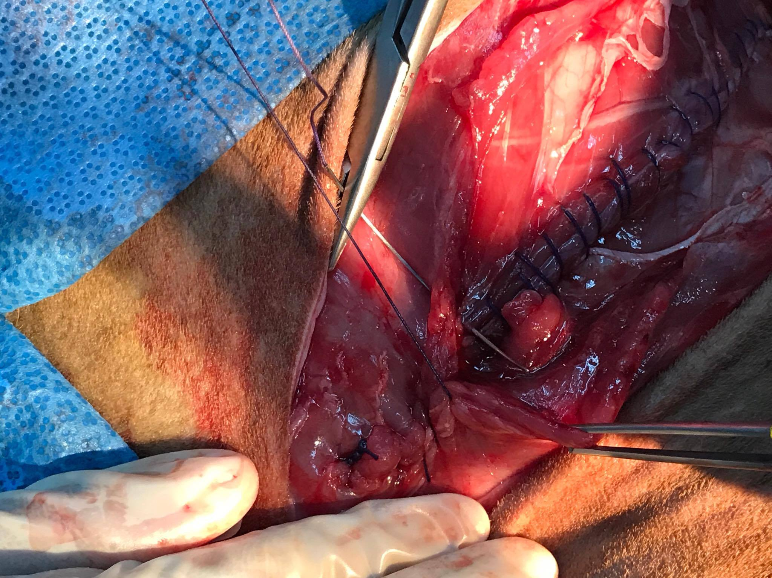
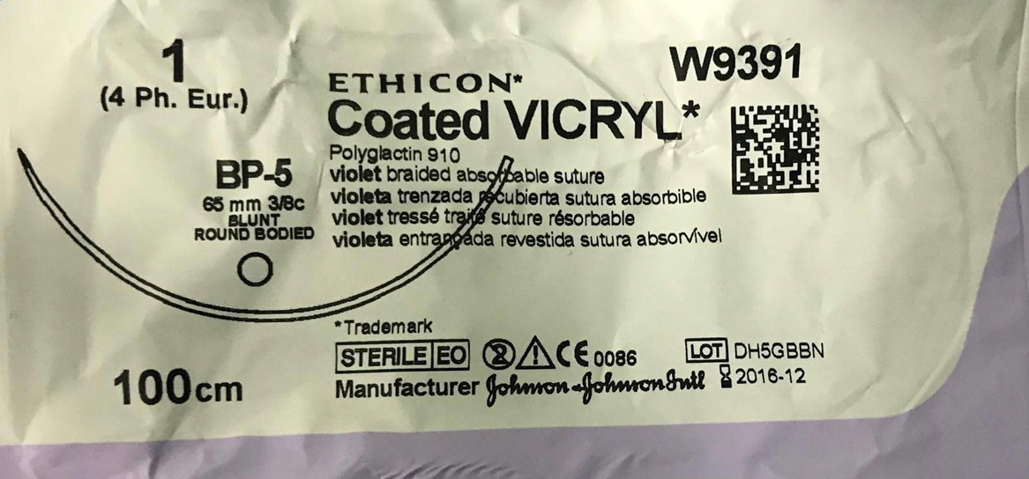
Simple Continuous Suture of External and Internal Oblique with Vicryl

Slide 19
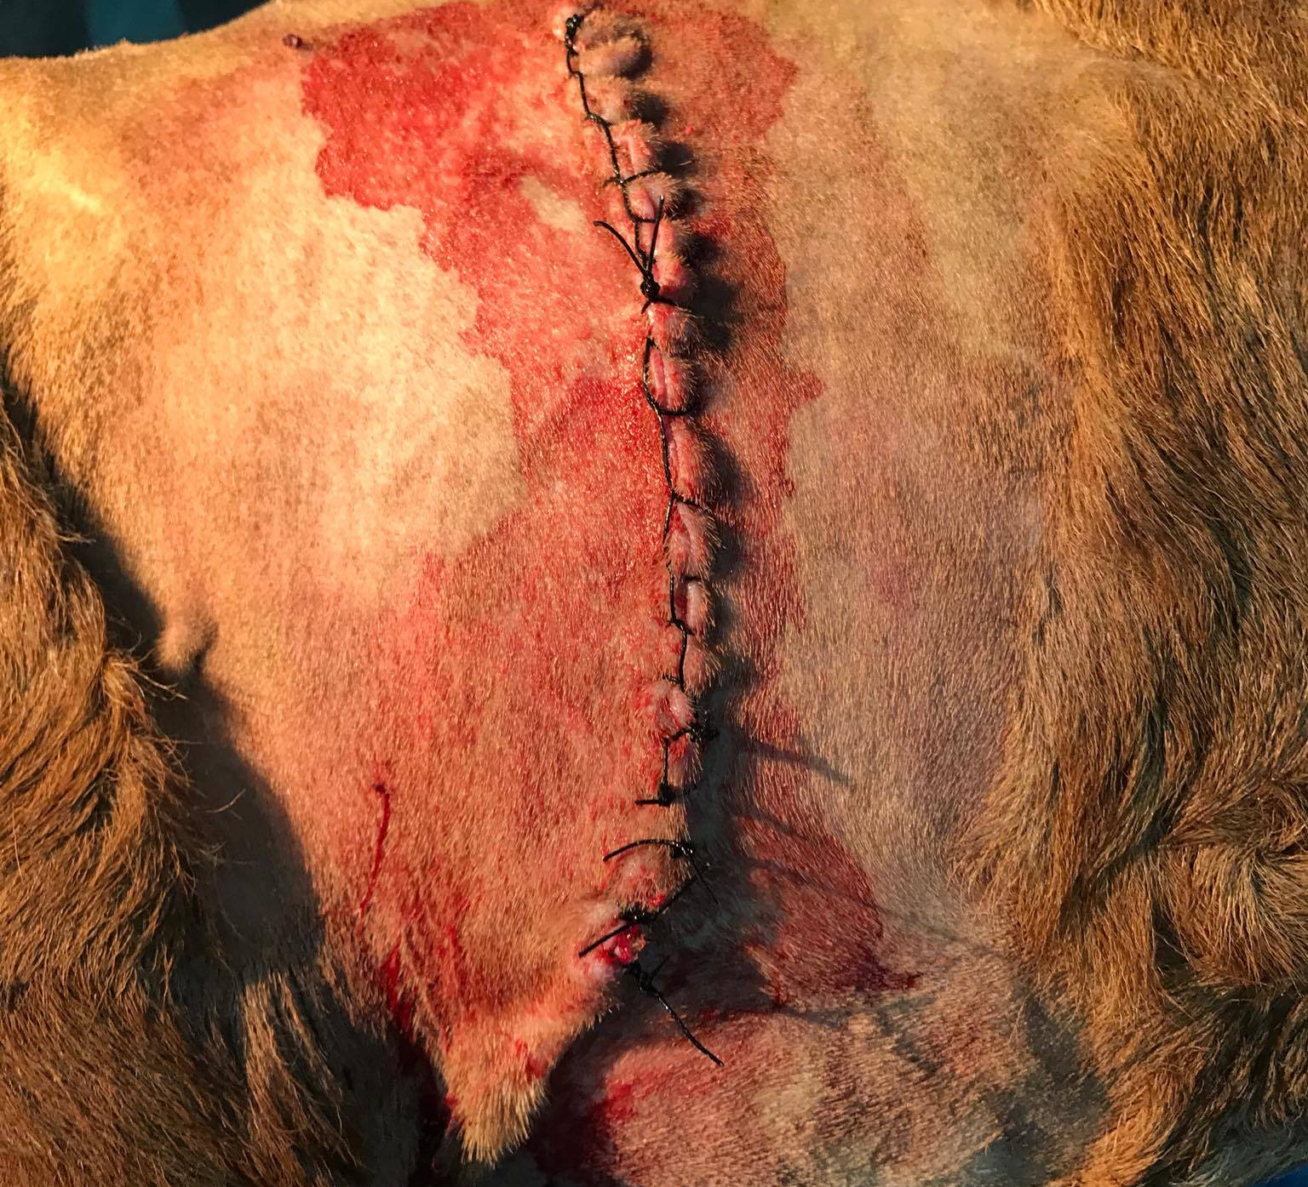
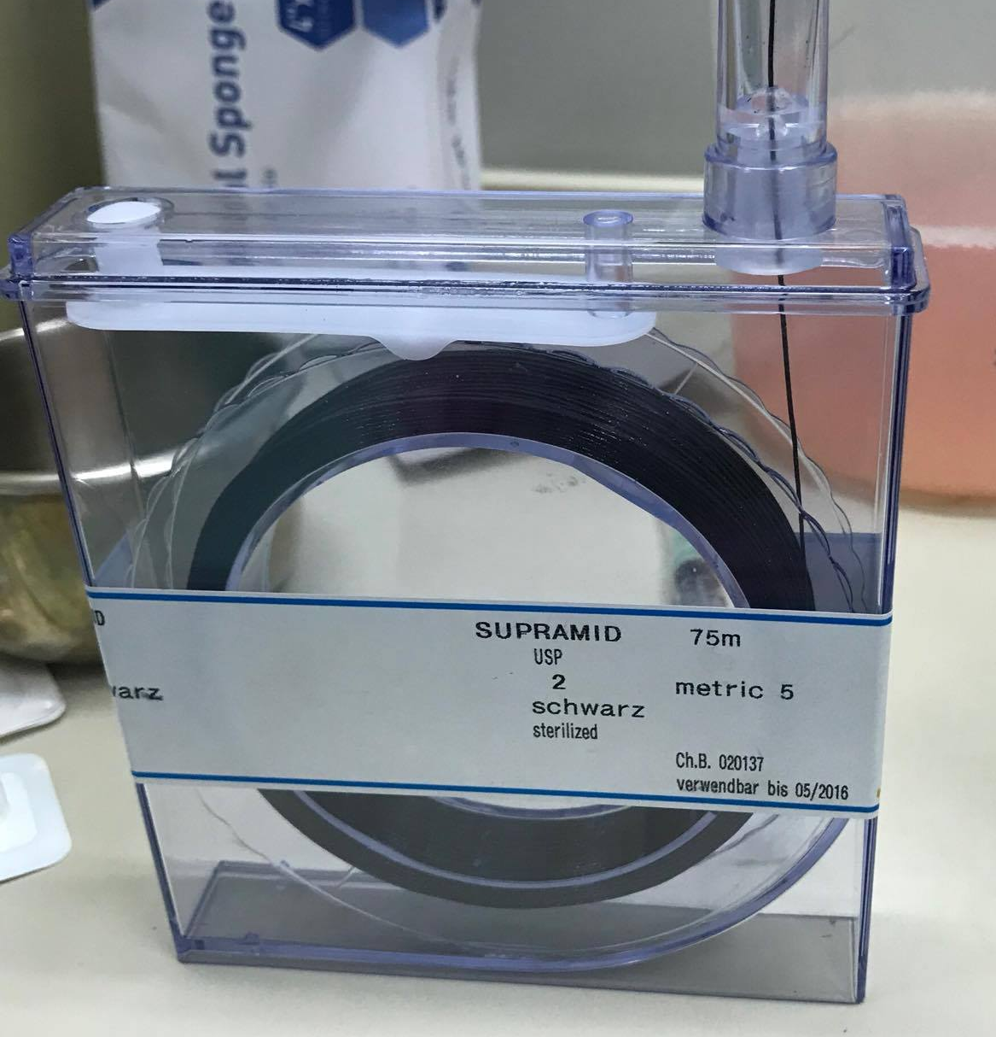
Ford Interlocking Pattern with Supramid

Slide 20
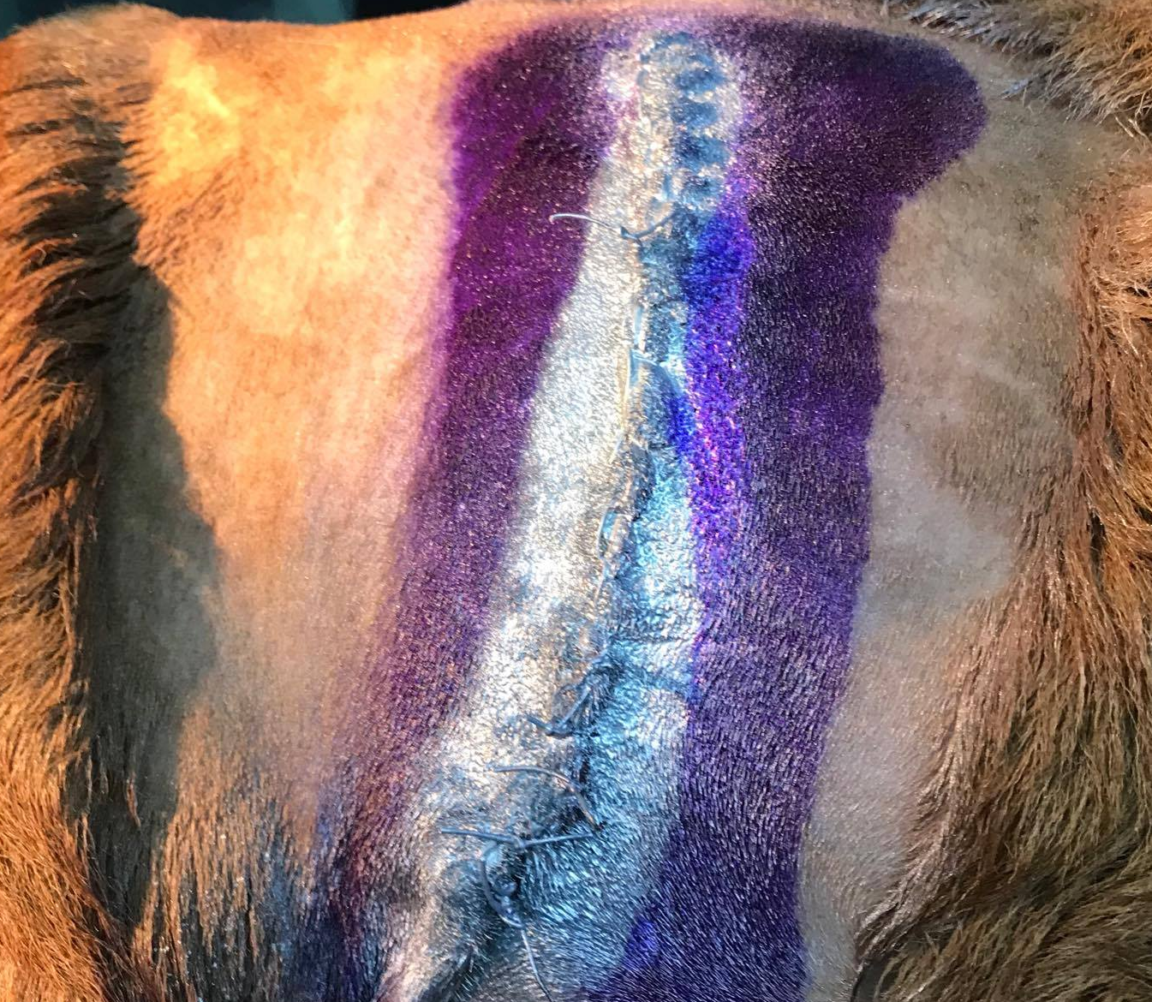
Immediate after surgery care for Rebecca

