Slide 1
WELCOME!
This is a module to teach you all about the different types of Christmas trees.
This knowledge may help you decide which type of trees to get.
Click a particular topic in the Navigation Map on the right to go to a particular topic.
Or use the navigation buttons at the bottom right to move between the pages or to return to this Home page.
Enjoy the module!
Home Page
NATURAL
ARTIFICAL
BLUE SPRUCE TREE
BALSAM FIR TREE
Snowy Aspen Spruce Christmas Tree
Artificial Christmas Tree With Real Fee(PE) Needles

Slide 2
NATURAL TREES
A Christmas tree is a decorated tree, usually an evergreen conifer such as spruce, pine, or fir or an artificial tree of similar appearance, associated with the celebration of Christmas. The modern Christmas tree was developed in early modern Germany (where it is today called Weihnachtsbaum or Christbaum), in which devout Christians brought decorated trees into their homes.The tree was traditionally decorated with "roses made of colored paper, apples, wafers, tinsel, [and] sweetmeats", with the apples and round ornaments representing the fruit of knowledge of good and evil from the Book of Genesisin the Christian Bible.^{[1]}

Slide 3
BLUE SPRUCE TREE
In the wild, Blue Spruce grows to about 23 m (75 ft), but when planted in parks and gardens it seldom exceeds 15 m (49 ft) tall by 5 m (16 ft) wide. It is a columnar or conical evergreen conifer with densely growing horizontal branches. It has scaly grey bark on the trunk with yellowish-brown branches.
Waxy grey-green leaves, up to 3 cm (1 in) long, are arranged radially on the shoots which curve upwards. The pale brown cones are up to 10 cm (4 in) long.
The specific epithet pungens means "sharply pointed", referring to the leaves.
The blue spruce is the State Tree of Colorado.

Slide 4
BALSAM TREE
Balsam fir is a small to medium-size evergreen tree typically 14–20 metres (46–66 ft) tall, occasionally reaching a height of 27 metres (89 ft). The narrow conic crown consists of dense, dark-green leaves. The bark on young trees is smooth, grey, and with resin blisters (which tend to spray when ruptured), becoming rough and fissured or scaly on old trees. The leaves are flat and needle-like, 15 to 30 mm (⁵⁄₈ to 1 ¹⁄₈ in) long, dark green above often with a small patch of stomata near the tip, and two white stomatal bands below, and a slightly notched tip. They are arranged spirally on the shoot, but with the leaf bases twisted so that the leaves appear to be in two more-or-less horizontal rows on either side of the shoot. The needles become shorter and thicker the higher they are on the tree. The seed cones are erect, 40 to 80 mm (1 ¹⁄₂ to 3 ¹⁄₄ in) long, dark purple, ripening brown and disintegrating to release the winged seeds in September.

Slide 5
ARTIFICAL TREES
An artificial Christmas trees is an artificial pine and fir tree manufactured for the specific purpose of use as a Christmas tree. The earliest artificial Christmas trees were wooden, tree-shaped pyramids or feather trees, both developed by Germans. Most modern trees are made of polyvinyl chloride (PVC) but many other types of trees have been and are available, including aluminum Christmas trees and fiber-optic illuminated Christmas trees.

Slide 6
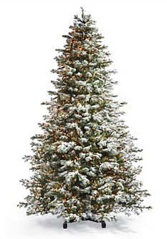
Snowy Aspen Spruce Christmas Tree

Slide 7
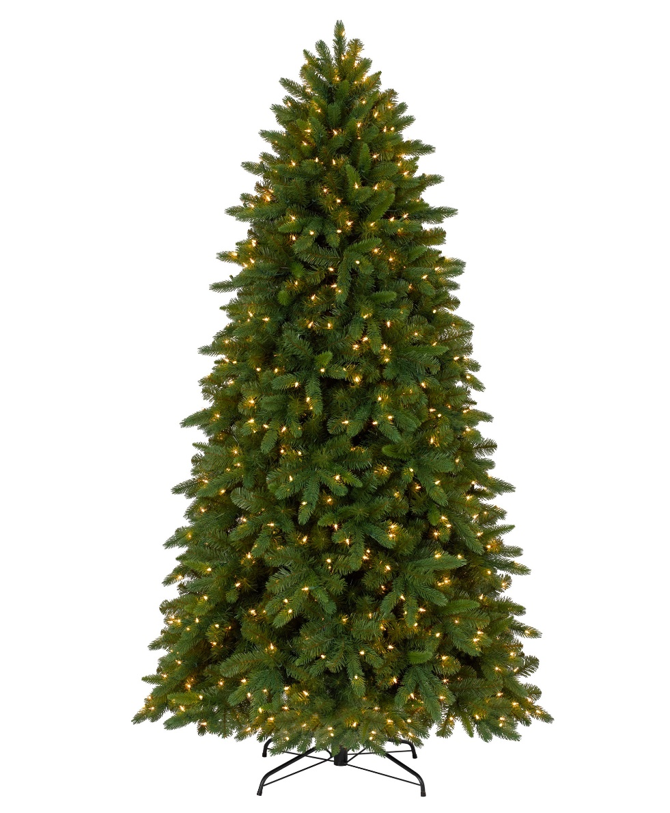
Artificial Christmas Tree With Real Fee(PE) Needles

