Slide 1
Types of fishes

Slide 2

Types of fishes
Fishes
Marine fish
Freshwater fish
Shark
Seahorse
Piranha
Cat fish
Cold-blooded with the exception of Tuna family and the Mackerel shark family
More than 24,000 different species of fish in the world
Most fish have a skeleton made of bone
Sharks, have a skeleton made of cartilage
In Seahorse the males that get pregnant instead of the females
Cat Fish???

Slide 3
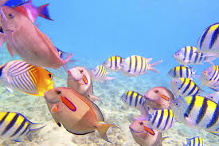
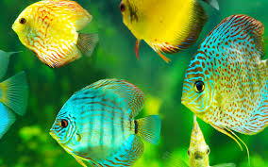
Types of fishes
Lets Play a Game
CLICK ME

