Slide 1
Types of Regional Cuisines
Asian
European
Oceanic
Regional Cuisines are based upon national, state or local regions.
Regional Cuisines may vary based upon food availability and trade, varying cliamtes, cooking traditions and practices, and cultural differences.
Click on the links beside to navigate and understand more about different regional cuisines around the world.

Slide 2

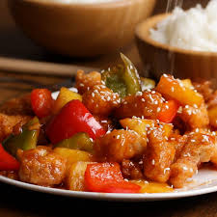
Asian Cuisines
Asia, being the largest and most populous continent, has many great cuisines.
Asian Cuisines are generally classified under the following areas; Central Asian, east Asia, South Asian, Southeast Asian and West Asian.
For more information about the different Asian Cuisines, click on the WEB LINK.

Slide 3

European Cuisines
European Cuisines refers collectively to the cuisines of Europe and other Western countries.
European Cuisines includes cuisines of Europe, including that of Russia, as well as non-indigenous cuisines of North America, Australasia, Oceania and Latin America, which derive substantial influence from European settlers in those regions.
For more information about the different Asian Cuisines, click on the WEB LINK.

