Slide 1
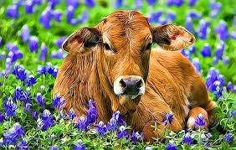
DEHORNING
This process is the removal of the horns and tissue that produces horns thus preventing the formation of horns, on cattle, sheep, and goat, after the horns have formed. This process is common management practice on dairy farms as diary cattle are not naturally polled animals. Dehorning of cattle is recommended to be done at an young age in calves as it lowers stress on the calf and animal welfare concerns. Risk involved with older cattle are, death, reduce or loss of productivity such as less milk produced or decreased weight gain.
http://www.thebeefsite.com/articles/2261/dehorning-of-calves/

