Slide 1
Dehorning Pre-OP
Physical exam
Equipment: Restraint, Surgical
Restraint
Area prep
Drugs: Anaesthesia and pain relief, Nerve-blocking drugs
Farmer-client communication
Complications
Minimisation of complications

Slide 2
PHYSICAL EXAM
Table 1.0 Criteria for Physical Examination
 | Temp/°C | Pulse/bpm | Resp/bpm
Initial readings
After sedation
Gender | Weight (assumed to be 140kg in this case for the purpose of drug calculations) | BCS Should ideally be 3 | ASA Should ideally be 1
N.B. The American Society of Anaesthesiologists has developed a classification system for human patient physical status which has been widely adapted to veterinary patients. It indicates a correlation between physical status and outcome. An ASA risk is a 1-to-5 score adapted for animals.
‘ASA 1’ is ideal and indicates ’Minimal risk of a normal healthy patient with no underlying disease.’

Slide 3
PRE-ANAESTHETIC PREPARATION
Physical examination to determine any abnormalities. Auscultate for cardiac dysrhythmias and murmurs as well as abnormal lung sounds.
Stabilise animal’s physiology in debilitated animals (e.g. gastrointestinal disorder).
IV catheterization placement – 18G.
Laboratory evaluation would provide useful prescreening information.
Sedate the calf with an injection of the calculated ‘low dose’ of Xylazine (as recumbency is not desirable for the procedure) and administer the calculated volume of NSAID (Flunixin meglumine).

Slide 4
DRUGS TO BE ADMINISTERED
Table 1.1 Drug Calculations for Drugs to be Administered
Analgesia |  | Sedation/anaesthesia
NSAID | Local anaesthetic
Flunixin Meglumine | Lidocaine 2% | Xylazine
Dose: 1.1-2.2mg/kg IV | Dose: 10ml (5ml per cornual nerve) | Dose: 0.025mg/kg
Conc: 50mg/ml | Toxic dose: 10(140)/2(10)= 70ml | Conc: 2% IM
Vol: 1.1(140)/50=3.08ml IV | Half toxic dose: 70ml/2= 34ml Vol: 10ml (5ml per cornual nerve) | Vol: (0.025)(140)/2(10)=0.175ml IV or IM

Slide 5
OTHER DRUG CALCULATIONS
Table 1.2 Emergency Drug Calculation
Tolazoline | Atropine | Epinephrine | Penstrep-400
Dose: 0.02mg/kg | Dose: 0.04mg/kg | Dose: 0.02mg/kg | Dose: 20,000IU/kg
Conc: 100 mg/ml | Conc: 1mg/ml | Conc: 1 mg/ml | Conc: 200,000IU/ml
Vol: 0.02(140)/100= 0.028ml | Vol: 0.04(140)/1= 5.6ml SC | Vol: 0.02(140)/1= 2.8ml IM or SC | Vol: 20000(140)/200000= 14ml IM (not >5ml per inj. site)

Slide 6
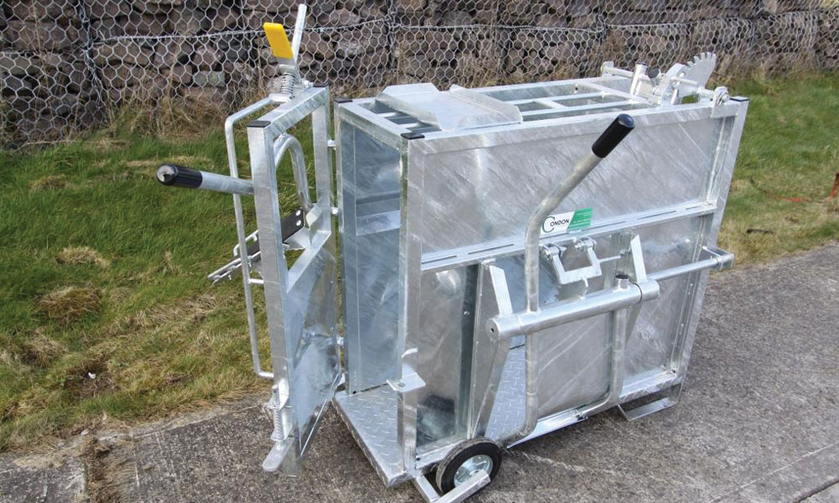
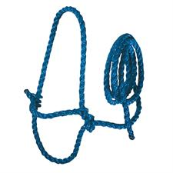
EQUIPMENT: RESTRAINT
Calf Dehorning Crate Deluxe
Halter (optional)
Condon Calf Dehorning Crate Deluxe
Halter

Slide 7
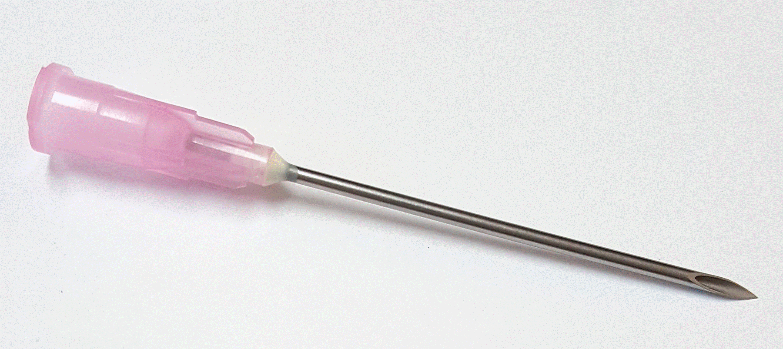
EQUIPMENT: SURGICAL
18-20G 1.5cm needle
2- 3ml syringes
5- 5ml syringes
1- 10ml syringe
18G 1.5cm needle
3ml, 5ml and 10m syringes, respectively

Slide 8
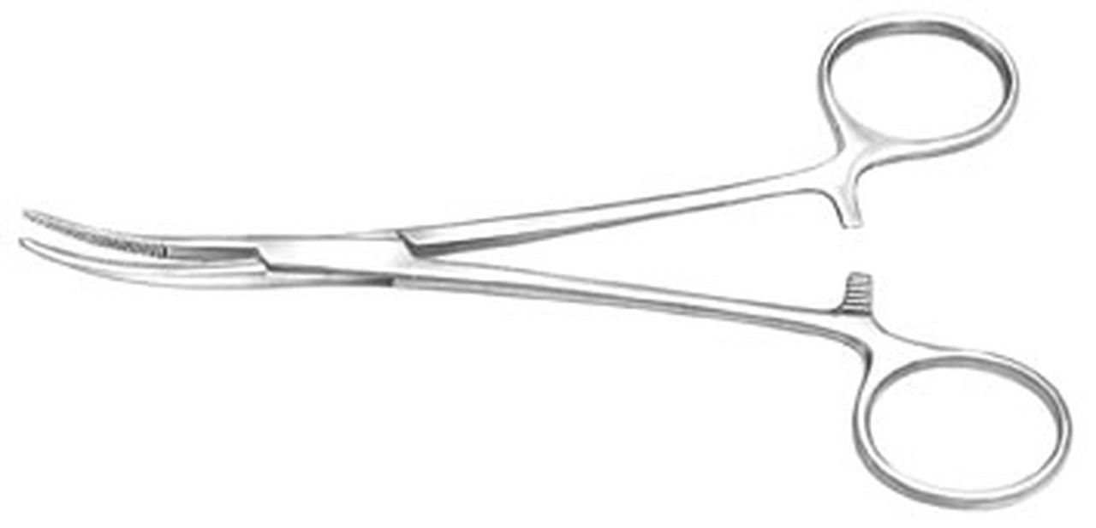
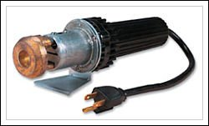
EQUIPMENT- SURGICAL
Barnes-type dehorner
Foreps (as a haemostat) or hot iron (for cauterisation)
Barnes-type scoop dehorner
Hot-iron
Kelly forceps

Slide 9
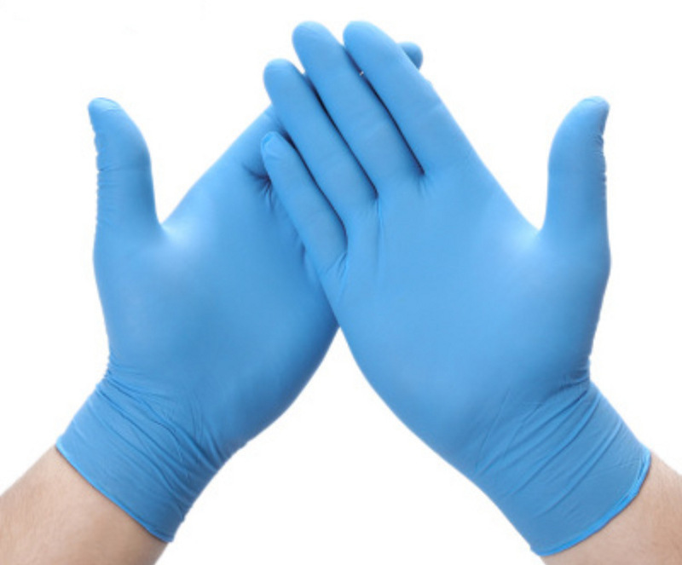
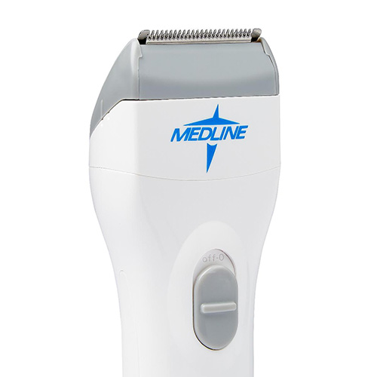
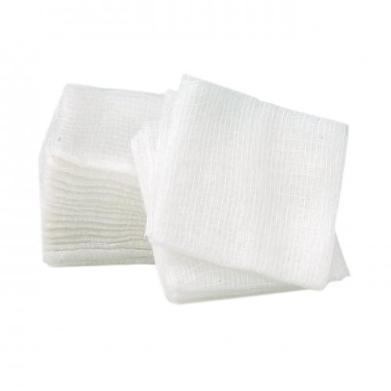
EQUIPMENT- SURGICAL
Gloves
Hair clippers
Sterile surgical gauze
Surgical gloves
Surgical hair clippers
Sterile surgical gauze

Slide 10
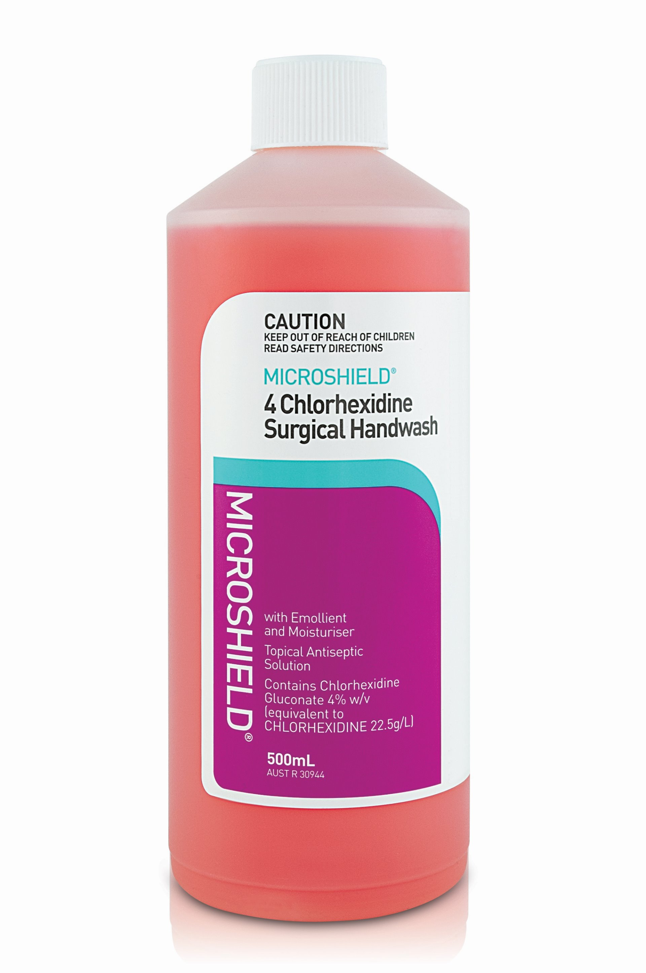
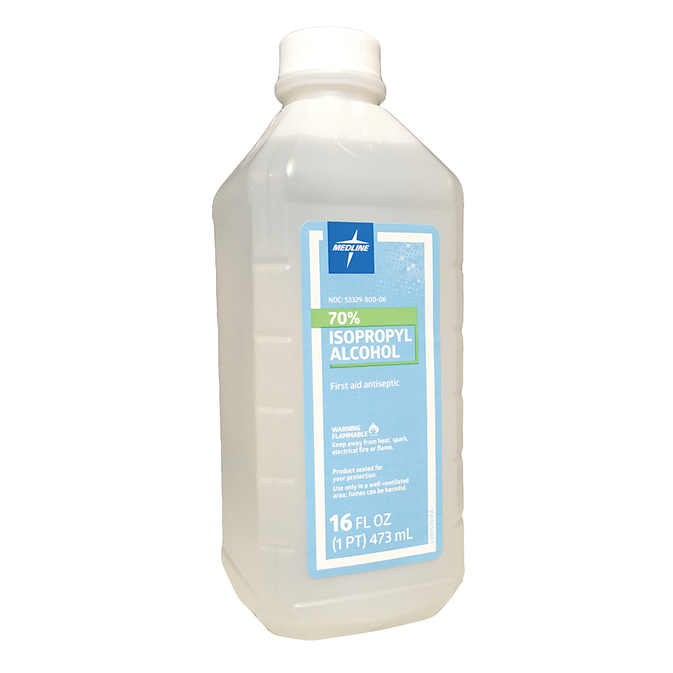
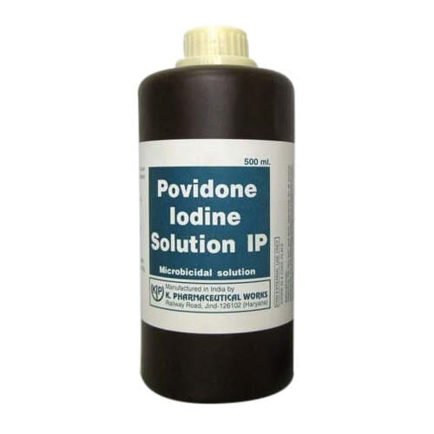
EQUIPMENT- SURGICAL
Chlorhexidine surgical scrub
70% Isopropyl Alcohol
Povidone Iodine
Chlorhexidine Surgical Scrub
Povidone Iodine
70% Isopropyl Alcohol

Slide 11
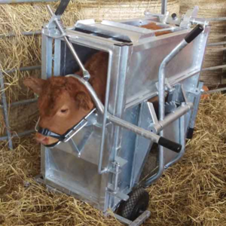
RESTRAINT METHOD
1) Place calf in a Calf Dehorning Crate for good control during the procedure
2) Lock the calf’s head down with the locking bar neck yoke
3) Put the calf’s nose into a ring and tilt the head forward, allowing easier access for nerve block.
4) Having an assistant behind the calf to push forward or move backward as required is helpful.
Depicts calf restrained in Condon Calf Dehorning Crate Deluxe prior to dehorning

Slide 12
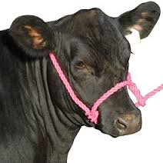
RESTRAINT METHOD
A halter securely tied to a ring, post or head of the crate may also be helpful for better control.
Depicts calf restrained with a halter tied to a ring/ post or head of dehorning crate

Slide 13
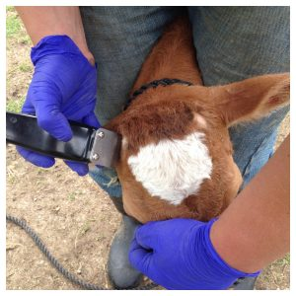
Area preparation
1. Clip/ shave the area overlaying horn buds.
2. Clean with water and detergent or soap to remove all dirt/ debris.
3. Thoroughly rinse the cleaned area.
4. Allow the area to dry completely.
5. Apply Chlorhexidine, followed by Povidone Iodine and Isopropyl 70% Alcohol, respectively.
Depicts shaving the surgical area prior to dehorning

Slide 14
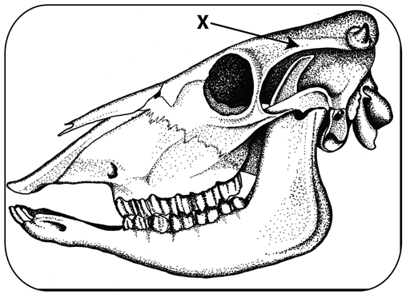
CORNUAL NERVE BLOCK
Palpate the bone below the frontal crest on the lateral aspect of the eye to the horn.
The cornual nerve runs along and under the groove felt. The injection site is in the upper third (closer to the horn bud) between the corner of the eye and the base of the horn.
"X" marks the location on a bovine skull of the midpoint between the horn base and the outside corner of the eye. Anaesthetic is injected beneath the ridge of bone shown with the X and arrow in the figure.

Slide 15
CORNUAL NERVE BLOCK
The diagram shows the location of the cornual nerve in the bovine skull and indicates proper placement of the needle.

Slide 16
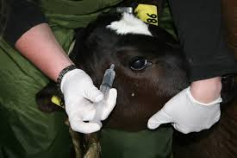
CORNUAL NERVE BLOCK
2. While holding the head steady, insert the 18-20G needle through the skin at the injection site (halfway between the eye and the horn), aspirate and slowly inject the calculated volume of lidocaine just below the frontal crest.
Repeat on the other side.
Allow 3-5 minutes for local anaesthetic to take effect and assess anaesthetic depth before proceeding with surgery.
Depicts holding the head steady while injecting local anaesthetic

Slide 17
VETERINARY-CLIENT COMMUNICATION
Veterinary-client communication is integral as:
1. It can increase after-care compliance
2. It enhances client satisfaction and more importantly, better patient health outcomes.

Slide 18
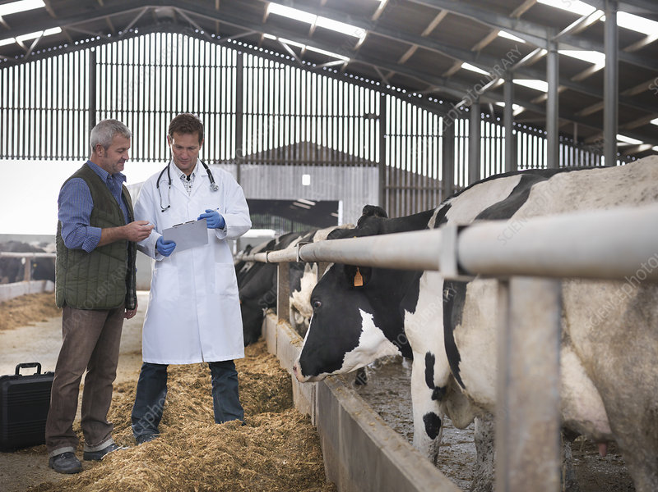
VETERINARY-CLIENT COMMUNICATION
Inform the client to keep the animal as calm as possible and decrease environmental stressors such as clean housing, proper sanitation, clean drinking water and food etc.
Inform client as to what drugs should be given after the surgery and why these drugs are to be given as well as their dosages and dosage intervals.
State what side effects can be seen if any drugs are to be administered post-op.
Inform the client of any complications or effects that may occur post-op.
Inform the client to keep the patient as comfortable as possible and if possible isolated from other animals as it will help with the recovery time of the animal.
Inform the client of expected recovery time.
Ensure that the client and vet exchange contact information making you, as the veterinarian, easily reachable.
If the animals are to be used as food animals, ensure that withdrawal times of the drugs with relation to slaughter time is discussed.
Depicts veterinary-client communication

Slide 19
CONSIDER POSSIBLE COMPLICATIONS of ANAESTHESIA
Problems associated with anaesthesia:
1. Ruminal tympany
2. Regurgitation of rumen contents
3. Aspiration of both rumen contents and saliva
4. Hypoventilation
5. Fluid and electrolyte imbalance

Slide 20
MINIMISATION OF COMPLICATIONS
Minimize risks by:
Starving the animal for 24 hours. This reduces the rate of fermentation and consequently, the risk of bloat. Any longer leads to increased fluidity of the rumen contents.
Restricting the animal’s access to water for 12 to 18 hours prior to induction.
Carrying out tracheal intubation with a cuffed endotracheal tube prior to surgery.

