Slide 1
Drug List For Water Buffalo
Drug volumes (mL) to be administered would be calculated by:
Dose (mg/kg) x Weight of bull (kg)
---------------------------------------------------------
Concentration of Drug (mg/mL)

Slide 2
Sedatives
Xylazine is typically used as a form of chemical restraint.
When doing standing procedures in cattle, it is often given together with butorphanol and ketamine
Doses:
Butorphanol @ 0.01-0.025 mg/kg IM
Ketamine @ 0.04-0.1mg/kg IM
Xylazine @ 0.02-0.05 mg/kg IM.
This drug combination also provides some analgesia.
When opted to give Xylazine by itself, the dose is 0.02-0.2 mg/kg IM.

Slide 3
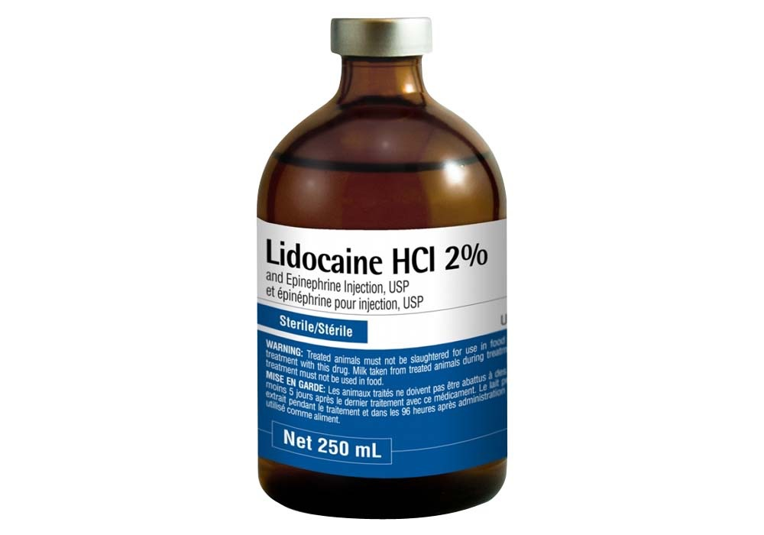
Anaesthetics
Lidocaine is typically used for local anaesthesia of the corneal nerve. Generally, 5mL’s of 2% Lidocaine are given. It would be injected directly into the spermatic cord.

Slide 4
Analgesics
Only FDA approved NSAID analgesic for food animals is Flunixin meglumine (Dose: 1.1-2.2 mg/kg IM when used as an analgesic), though this may not provide adequate analgesic effects.
Other noteworthy analgesics that have been used with success are Meloxicam (Dose: 1.0mg/kg PO) and Ketoprofen (Dose 3mg/kg IM).

Slide 5
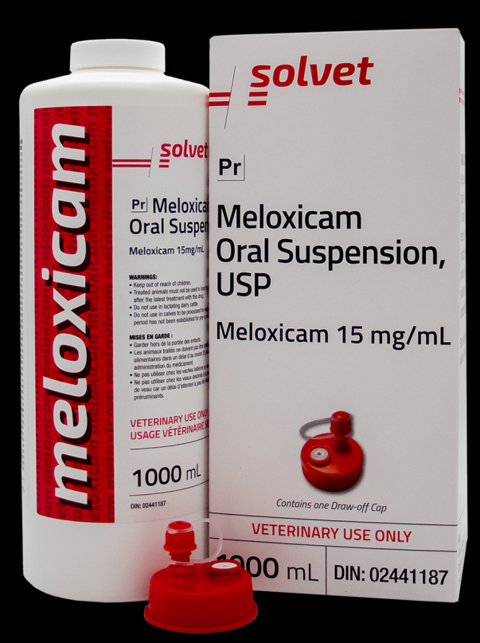
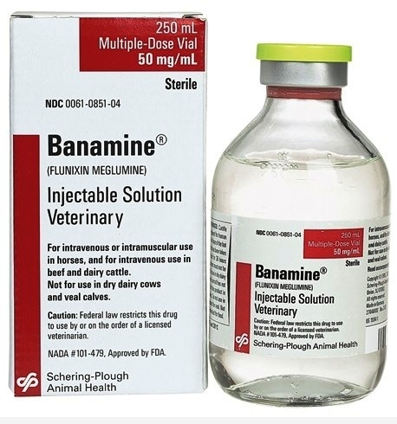
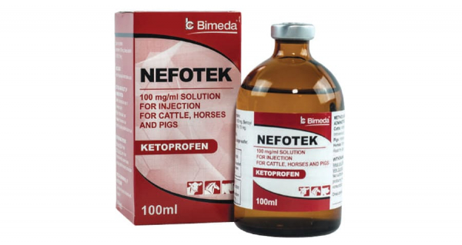

Slide 6
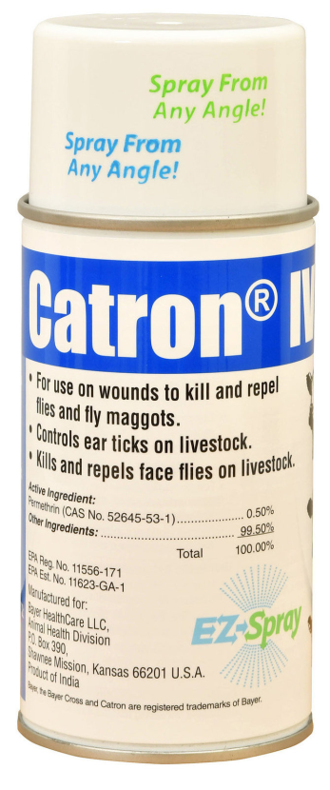
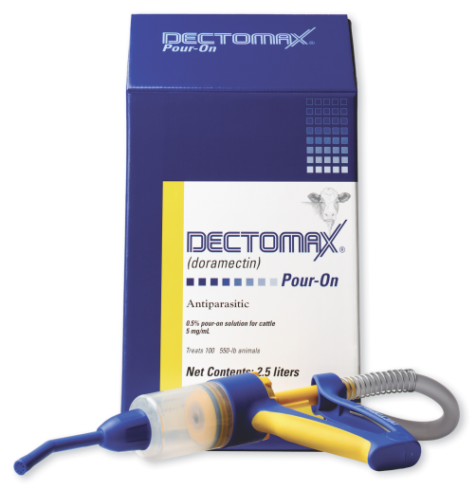
Anti-myiasis drugs
Antiamyiasis drugs are applied after the procedure to prevent complications due to fly strike.
Eg Pour on Doramectin, Fly spray (Permethrin)

