Slide 1
INGUINAL APPROACH
CRYPTORCHIDISM

Slide 2
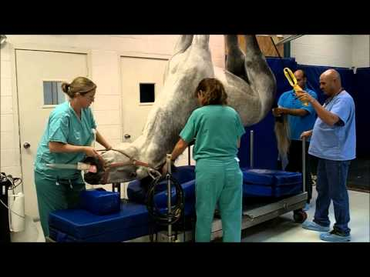
PRE-OP
https://www.youtube.com/watch?v=DiKYiv85dtk&ab
PREPARING THE PATIENT

Slide 3
GENERAL ANESTHESIA
Xylazine and Ketamine maintained using the triple drip technique
POSITIONING
Dorsal recumbency using limb supports, inflatable cushions, foam wedges
PREPARATION OF SITE
Aseptic preparation of
Inguinal area (Inguinal Approach)
Ventral abdomen (Para-inguinal Approach

Slide 4
Withhold food for approximately 4 to 8 hours before surgery except in foals (Do not withhold water)
Perform a complete physical examination with emphasis on cardiorespiratory function
Determine body weight using a scale or a girth weight estimator tape (note body type e.g., lean/racing, conditioned, draft)
Groom the horse and wipe with a moist cloth to remove dander and debris
Clean the feet before induction; pull or pad shoes to prevent injury
Prepare (clip and scrub) the surgical site
Place and secure an IV catheter in a jugular vein before induction

Slide 5
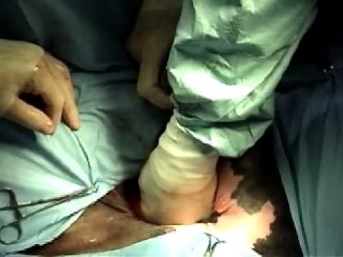
INTRA-OP
INGUINAL
CRYPTORCHID
https://www.youtube.com/watch?v=bbsy_L5MPt0&has_verified=1&ab_channel=ThomazCoelho

Slide 6
INSTRUMENTATION
General surgery pack
Sponge forceps
Emasculator

Slide 7
TECHNIQUE:
Make a 12-15cm skin incision over the external inguinal ring
Continue through superficial fascia and bluntly dissect with fingertips to separate the subcutaneous inguinal fascia and expose the external inguinal ring.
Continue dissecting beyond the external inguinal ring
Dissect through the inguinal canal until the vaginal ring is located
Isolate the common tunic and remove the testis using a close castration technique
Close the external inguinal ring with a large-diameter synthetic absorbable suture material in a preplaced interrupted pattern
Close the dead space using a no. 2-0 synthetic absorbable suture material
Suture the skin with a synthetic absorbable suture with simple interrupted sutures with long ends.

Slide 8
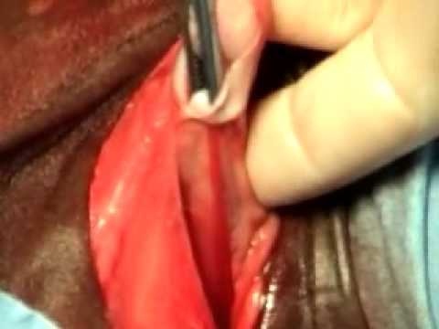
INTRA-OP
ABDOMINAL CRYPTORCHID
https://www.youtube.com/watch?v=lfGxnA04tMc&ab_channel=ThomazCoelho

Slide 9
The intra-op procedure for an abdominal cryptorchid surgery is similar to steps 1-4 of the aforementioned Inguinal approach to the inguinal cryptorchid.
Make a 12-15cm skin incision over the external inguinal ring
Continue through superficial fascia and bluntly dissect with fingertips to separate the subcutaneous inguinal fascia and expose the external inguinal ring.
Continue dissecting beyond the external inguinal ring
Dissect through the inguinal canal until the vaginal ring is located

Slide 10
5. Introduce a curved sponge forceps carefully through the inguinal canal, advancing it through the vaginal ring into the vaginal process
6. Press the partially opened jaws of the forceps against the vaginal process, when the forceps close against the vaginal process grasp the vaginal process and gubernaculum testis
7. Withdraw the forceps carefully, without rupturing the vaginal process
8. Palpate the gubernaculum within the everted vaginal process by rolling it between thumb and forefinger
9. Using a Metzenbaum scissors open the vaginal process, graps the gubernaculum with Ochsner forceps.

Slide 11
10. Apply traction to the gubernaculum to exteriorize the tail of the epididymis, pulling the testis through the vaginal ring
11. Emasculate the testis (nut to nut) after identifying the structure.
12. If the testis cannot retracted for emasculation ligate the cord and sharply amputate the testis
13. Close the external inguinal ring with a large-diameter synthetic absorbable suture material in a preplaced interrupted pattern
14. Close the dead space using a no. 2-0 synthetic absorbable suture material
15. Suture the skin with a synthetic absorbable suture with simple interrupted sutures with long ends.

Slide 12
PARAINGUINAL APPROACH
CRYPTORCHIDISM

Slide 13
INTRA-OP
PARAINGUINAL APPROACH

Slide 14
INSTRUMENTATION
General surgery pack
Sponge forceps
Emasculator
Spay hook (parainguinal approach)

Slide 15
TECHNIQUE:
Make a 10cm incision through the skin parallel to and 4cm axial to the inguinal canal
Explore the inguinal canal to assess the presence of an inguinal testis.
If no inguinal testis is present make a 10cm incision into the external rectus sheath (no deeper)
Bluntly divide the rectus abdominus muscle and bluntly penetrate the internal rectus sheath along with the peritoneum
Place a spay hook through the incision into the peritoneal space
Sweep the tip of the spay hook through the region of the vaginal ring, picking up the gubernaculum

Slide 16
7. Remove the gubernaculum from the abdomen and place traction | until the testis is removed from the abdomen
8. Emasculate the testis
9. Close the external rectus sheath in a simple continuous pattern using no.1 polyglyconate
10. Close the subcutaneous tissue and skin using a no. 2-0 synthetic absorbable suture material in a simple continuous pattern

Slide 17
POST-OP
Post-op management of the patient is similar in the Inguinal Approach
(inguinal and abdominal cryptorchid) and the Para-inguinal Approach.
Administer tetanus immunization
Routine post castration management
Clean any blood or discharge around incision
Hospitalize for 72 hours if the inguinal canal was closed with sutures
Exercise the horse after 2 weeks

