Slide 1
Drugs Used for mammary gland surgery

Slide 2
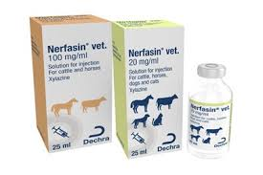
Teat Amputation/ Laceration Repair
Sedation is induced via use of XYLAZINE
Dose: 4mg/500kg (0.008mg/kg)
Route of Administration: Intramuscular injection
-Provides a stature of calmness without recumbency
Calculation:
Using formulation of 100mg/mL concentration:
Volume= (Dose x Weight)/(Concentration)
= (0.008 x 500)/100
=0.04mL

Slide 3
Topical Anesthetic
Local anesthesia is provided using 2% Lidocaine.
- Done by teat infusion into teat canal
Supplements pain management using ring block
10mL of the local anesthetic injected into the teat canal.

Slide 4
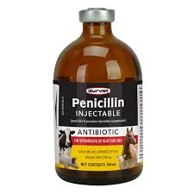
Antimicrobial Therapy
Intramammary Antibiotic Infusions
Commercial preparations commonly contain:
  Amoxicillin
  Penicillin
  Cephalosporins
  Procaine Penicillin (combination of anesthetic and antibiotic treatment)
  Dose: 22 000 IU/kg
  Route of Administration: Intramuscular Injection
  Calculation:
  Volume= (Dose x Weight)/(Concentration)
  = (22 000 x 500)/(300 000)
  = 36 mL
  Note that large volumes must be split and given in different sites.

Slide 5
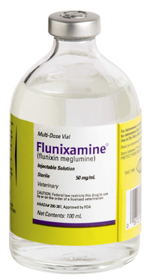
Anti-inflammatories
Use of NSAIDs may be used before and after surgery to reduce swelling as well as pain.
Drug most commonly used: Flunixin meglumine
Dose: 1mg/kg
Route of Administration: Intravenous Injection
Formulation: Flunixamine 50mg/mL
Calculation:
Volume= (Dose x Weight)/(Concentration)
= (1 x 500)/(50)
= 10mL

