Slide 1
Soft Systems Methodology
Mark Westcombe

Slide 2
Modelling Purposeful Activity
I
T
O
Input
Output

Slide 3
SSM’s Learning System
1i) Enter the problematic situation
1ii) Find out about it and any relevant worldviews
2 Build activity models based on worldviews
3 Use models to:
  Question real world
  Structure discussion
  Find accommodations re action-to-improve
4 Take the actions
Continually iterate!
Cf Checkland 2006 pp xix & 13 – Learning Cycle

Slide 4
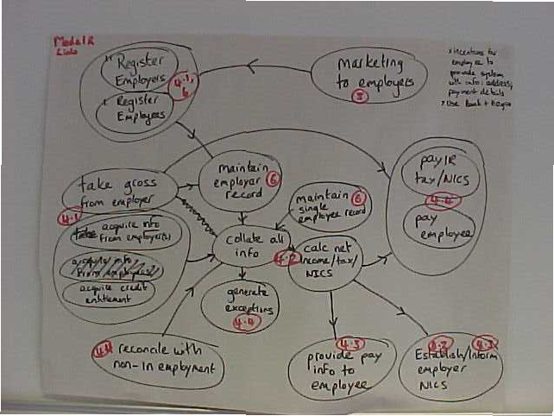
Activity Modelling

Slide 5
Exercise
You’ve been newly appointed as the project manager of the Equipment Direct initiative. You are due to have your first meeting with your line manager, a member of the Equipment Direct board.
Prepare some notes to take into that meeting to help you get the project started.
Decide together on a few priorities and first steps

Slide 6
Exercise
Equipment Direct project
The Hampshire Coalition of Disabled People, in partnership with Hampshire County Council and the NHS, are embarking on an exciting and innovative project, which will greatly improve access to equipment for disabled people. The project will provide disabled people in Hampshire with improved access to and greater choice in equipment services. Funded by a Government ‘Invest to Save’ grant it will pioneer the development of the country’s first internet based equipment service, Equipment Direct. The new service will use the latest website technology to give disabled people more choice and faster access to a wide range of equipment for daily living direct from independent suppliers or through specialist social and healthcare services.

Slide 7
Rich Pictures
A rich picture is a representation of the problem situation.
It generally captures (where appropriate):
  ... main entities / factual features
  ... current and potential issues
  ... the key stakeholders and their perspectives
  ... any structures
  ... any processes
  ... expected outputs and desired outcomes
  ... the climate: cultural norms and values
  and any other relevant aspects, including potentially:
  ... the inputs / resources (human, time, £, material)
  ... any monitor and control activities
  and the relationships between them.
Cf Checkland 2006 pp 26 – Standard RP
pp 76 – RP of objectives
pp 100 – Abstract RP

Slide 8
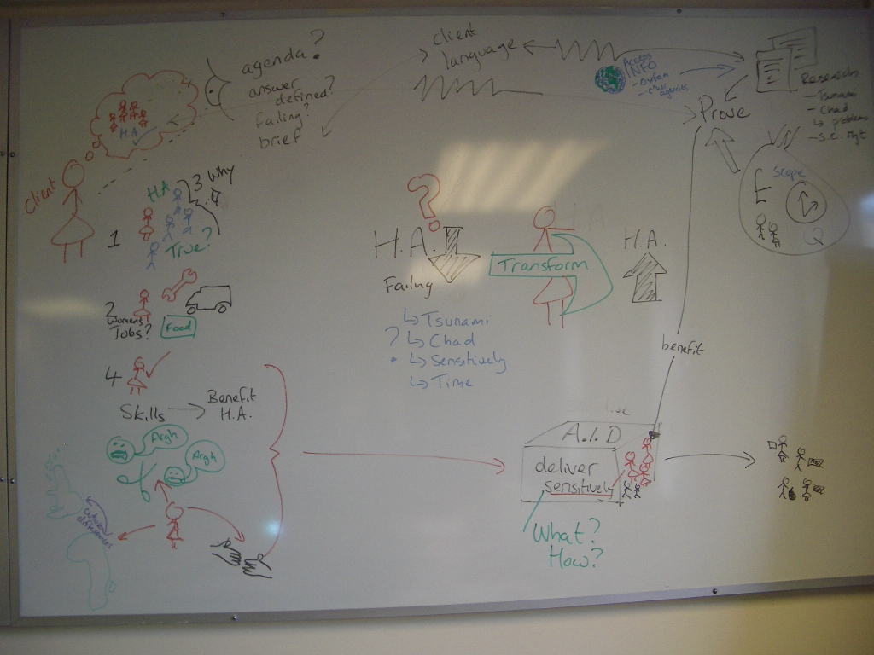

Slide 9
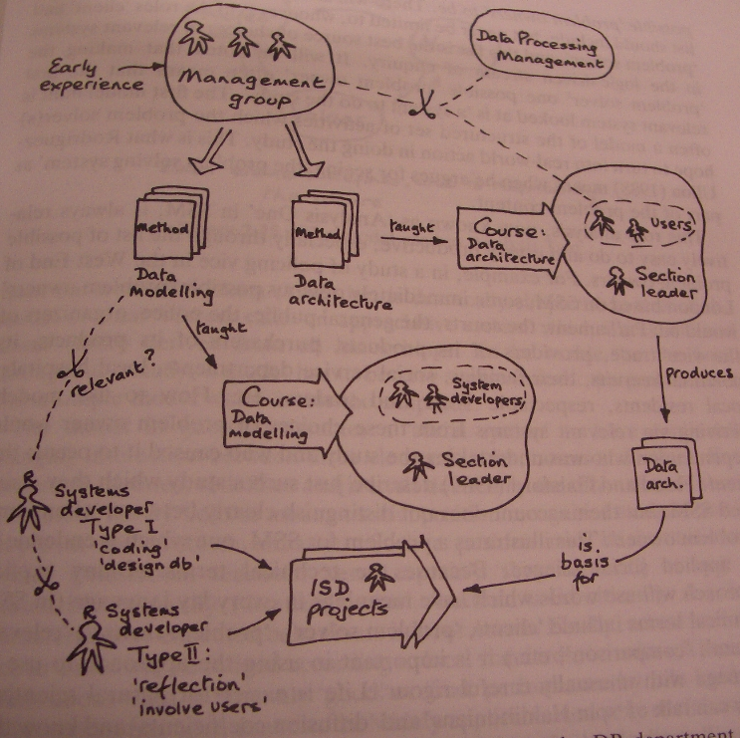
© Checkland and Scholes (1990)
Soft Systems Methodology in Action pp47

Slide 10
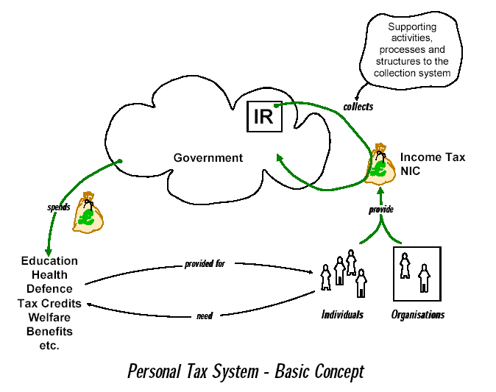
Relevant systems are:
A system to collect….
A system to provide…
A system to support the collection system....

Slide 11
PQR Analysis
What does the client of the project want done/accomplished?
i.e. What is the focus of the intervention / project to achieve?
Why is this a worthwhile thing to do?
i.e. What is the project/intervention’s objective or desired outcome?
Potentially consider: How the ‘what’ could be done.
Additionally:
Identify any relevant stakeholders, including the ‘owner’ of the organisational system/operation/process.
Consider their perspectives on the project, i.e. ‘whats’ and ‘whys’.
And:
Consider what the system/operation/process itself is intended to achieve; why and how from any relevant stakeholder perspectives.
What insights have you gained?
Cf Checkland 2006 pp 38 – 48: Modelling
pp 181 – 187: Fully Worked Example
pp 189 – 194: Modelling Summary

Slide 12
PQR Statements
(P) What does stakeholder x believe needs to be accomplished (by the project or system)?
  The output or deliverable
(R) Why is this (‘P’) a worthwhile thing to do? important?
  The outcome or longer term benefit?
(Q) How will you do this?
  Resource implications.
Check for internal coherence and logic:
  Can you do Q?
  By doing Q, will you substantially achieve P?
  By doing P, will you substantially achieve R?
Consider:
  Whether R is a good thing to do; and
  Whether any other assumptions are being made.
Why (R)
What (P)
How (Q)
Cf Checkland 2006 pp 39 – Guidelines
pp 181 – 187: Fully Worked Example
pp 73 – Example
pp 94 – Example

Slide 13
PQR Statements
(P)
(Q)
(R)
A system to...
by ...
in order to ...
“A system to identify those changes which might be expected to alleviate a problem situation within human affairs [by] using the concept of notional systems of human activity [in order ] to orchestrate debate about change”
Woodburn (1991)

Slide 14
Framing the Issue
Consider:
Why does this issue exist?
What worldview or perspective legitimises these activities?
i.e. Why does someone think this is a good thing to do?
What other assumptions are there?
What influences are there on this situation?
Shift thinking a layer upwards
Capture any insights

Slide 15
Analysis One: The Intervention
Identify the roles of:
Client
Analyst(s)
  And stakeholders (issue owners)
  Beneficiaries
  Victims
Consideration of these stakeholders’ worldviews and aspirations leads to ideas regarding which perspectives are relevant to model
Cf Checkland 2006 pp 27

Slide 16
Analysis Two: Social
What interacting:
Roles (formal and informal)
Norms
And Values
characterise this situation?
Record notes in project log
Cf Checkland 2006 pp 31

Slide 17
Analysis Three: Political
Consider:
How power is expressed in this situation;
What the commodities of power are;
What the processes of using power are; and
This informs changes that are culturally feasible
  Preserved
  Obtained
  Used
  Defended
  Passed on
  Relinquished
Cf Checkland 2006 pp 35

Slide 18
Models of Purposeful Activity
Current situation
Improved situation
I
T
O
Input
Output
‘T’ - The Transformation - transforms I into O
I must be present in O, but in a changed state
Notes
1. Transformations can be physical or abstract
2. Input is always an entity and not an activity
3. An abstract input produces abstract output
4. A physical input produces a physical output

Slide 19
CATWOE
TRANSFORMATION: the purposeful (transforming) activity based on the worldview W
WORLDVIEW: the assumptions that ‘T’ is based on
  The worldview / perspective that legitimises the activity ‘T’
  Why R is believed to be a good thing to achieve
ACTOR: those who will do the activities that make up ‘T’
CUSTOMER: directly affected by the transformation ‘T’ as beneficiaries or victims
ENVIRONMENTAL CONSTRAINTS: those things ‘T’ takes as given
OWNERSHIP: those who can stop the process ‘T’
I
T
O
Input
Output
Cf Checkland 2006 pp 39

Slide 20
Root definitions
Combines the ideas of the PQR statement: the ‘what, why and how’ with elements from CATWOE
A system to...
by ...
in order to ...
Can be Primary Task models or Issue Based models
Cf Checkland 2006 pp 43

Slide 21
How do projects fail?
Cf Checkland 2006 pp 42

Slide 22
Business Benefit
Effectiveness
Outputs
specification/quality
Outcomes
value/benefit
Outputs
specification/quality
Cost
budget/funding
Time
plan/schedule
Outputs
specification/quality
Resources
cost/time/people
Efficacy
Efficiency

Slide 23
Assessing ‘T’: The 3 E's
Efficacy
  Is T working?
  Is it producing the intended output?
Efficiency
  Is 'T’ using the minimum resources?
  Does the ‘Owner’ judge the resources well used?
Effectiveness
  Is this the right thing to do?
  Is 'T' contributing to the wider, longer term objectives?
Cf Checkland 2006 pp 42

Slide 24
Activity Modelling

Slide 25
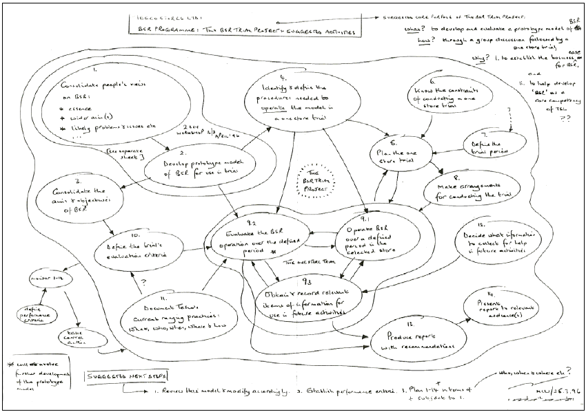
© Mark Winter

Slide 26
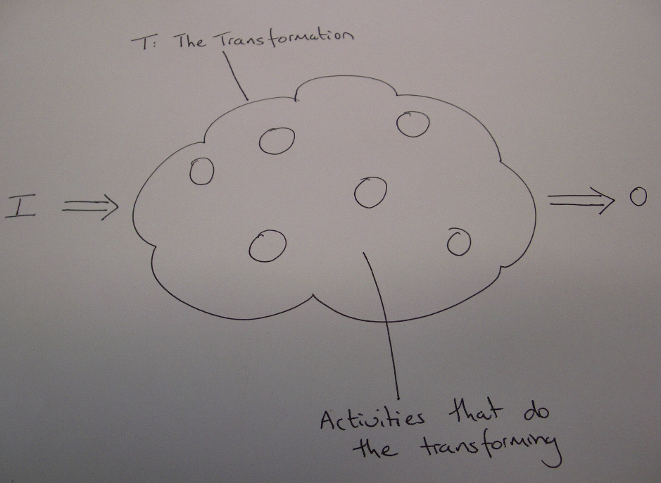

Slide 27
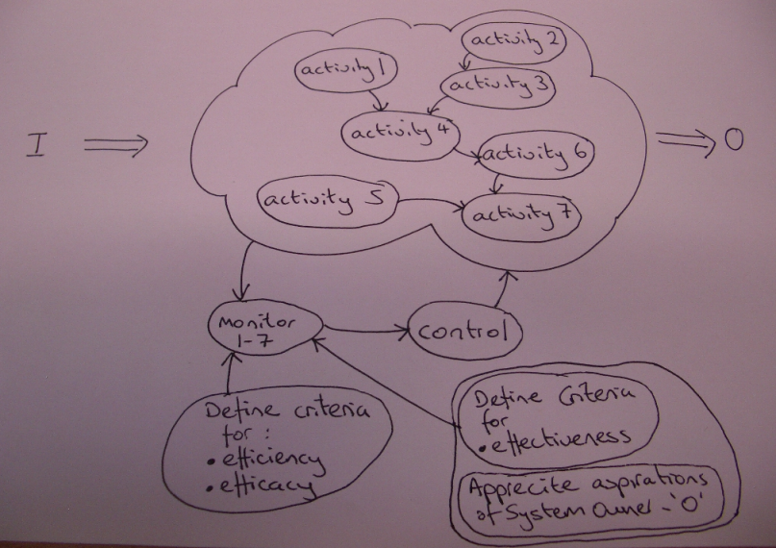

Slide 28
Activity Modelling
Structure the activities of the transformation process. These include:
  Activities relevant to acquiring the inputs, including the entity itself
  Activities that do the transforming
  (If necessary) activities relevant to dealing with the outputs; including the transformed entity
Show the dependencies by using links
Use the minimum necessary activities

Slide 29
Activity Modelling
Using verbs in the imperative write down activities necessary to:
  Procure inputs;
  Perform T;
  Dispose of outputs.
Select activities that could be done at once, i.e. not dependent on others; and
Write these out on a line.
Write the activities dependent on these below; and
Continue until all activities are accounted for.
Note: add only the minimum activities that are logically necessary to represent the Root Definition (not to represent ‘real world’ activities).
Indicate the dependencies using arrows.
Redraw to avoid overlapping arrows where possible; and
Add monitoring and control activities.
Check every activity relates to the RD
and that every aspect of the RD is represented.
Aim for 7 + 2 activities.
Cf Checkland 2006 pp 73, 94, 117 - examples
pp 45 - 48 and 190 - 194 - guidelines
pp 181 - 187 - full exemplar

Slide 30
Exercise
A dag-owned gor tonking system which, within legal constraints, tonks those gors which meet criteria gog

Slide 31
Questioning the Situation
Compare the models with the real world
  For each activity, dependency and performance measure ask:
  Does this currently happen?
  Who does it?
  Could someone else do it?
  How is it done?
  How else could it be done?
  Does it need to be done?
  When and where is it done?
  How do we judge it?
Log ideas, potential actions, options and ‘insights’
Cf Checkland 2006 pp 49 & 77

Slide 32
Discussion
Identify:
Ideas regarding potential outputs; and
Potential improvements the client/sponsor may desire (outcomes);
Assumptions that need questioning;
Ideas for activities that will potentially lead to improvement;
Criteria to judge the success of any implemented activities;
Questions to raise for discussion.
Cf Checkland 2006 pp 49-60
pp 120-124, esp 121
pp 162-163

Slide 33
Change: Action to Improve
Explore which combination of change is desirable and feasible, by assessing the ideas / options:
Does the option embody the logic of the modelling?
Does it deal with the issues?
Does it contribute to the wider, longer term objectives?
Is it culturally and politically feasible?
For each agreed action:
Consider
  Why is it being done?
  How can it be achieved?
Assign:
  Who will do it; When; and it’s delivery date;
  The enabling actions required, eg resources and sponsor;
Decide:
  Who to consult? And inform?
  What criteria will be used to judge it’s completion and successful implementation?

Slide 34
SSMp – Intervention Planning
SSMc – what you might do regarding the problem
SSMp – what you might do regarding thinking about tackling the problem, i.e.
– deciding how to carry out the consultancy intervention
Cf Checkland 2006 pp 30-31

