Slide 1



Human Environment Analysis Reasoning Tool (HEART)
Integrating the Human Dimension into Operational Planning and Analysis
Phil Jones, Tim Bacon, Sofi Blazeski, Abigail Davison-Jenkins, Laurie Fenstermacher, Gemma Warren, Nina Hellum , Mikael Lundin, Albert “Bull” Mitchum, Eric Ouellet, Thomas Peters, Luminita Stemate, Anders Tavemark, Peter Tikuisis, Tony van Vliet
NATO Research Task Group
System Analysis and Studies (SAS) 074
June 2011
1
Notes:
1
NATO RTG 074 has developed a visual reasoning tool – HEART - for incorporating human and social sciences into NATO operational planning and analysis.
NATO's approach to conducting operations currently and in the foreseeable theatres of asymmetrical/non-conventional conflict demands a comprehensive approach to achieve desired effects from the use of lethal and non-lethal means involving armed forces and other levers of coalition influence.
Successful application of a comprehensive approach requires an evolution of military capability in concert with an improved understanding of the human environment in theatres of conflict.

Slide 2
Overview
Motivation and purpose
Approach
Description of tool (including summary examples of Use Cases)
An example of using the tool on a fictitious case of avoiding food crisis among minorities in a conflict zone
Current Status of Tool
Potential Future Developments
Recommendations
2

Slide 3
HEART: Motivation and purpose
Motivation for this work:
The observation that although the human is central to operations, most operational planning currently does not use social science to its full potential.
Purpose of the tool:
To facilitate understanding of the human environment in an operational context, and assist the development of appropriate courses of action that take into account the human aspect.
Potential users of the tool:
Operational planners and analysts
Scenario developers
Trainers (for the two categories above)
3
Notes:
Emphasis placed on helping users to think about the human environment and plan accordingly, rather than providing a prescriptive process.

Slide 4
A Simplified Representation of the Planning and Execution Cycle
(no explicit integration of human aspects)
Actual State
start →
Desired State
Mission Effectiveness
Mission Objective
Gap represents difference between states
Orientation
Observed Physical Effects
Concept Development
Course of Action
Notes:
Here is a simple stylized outline of the planning-execution cycle, without explicit emphasis on consideration of the human environment

Slide 5
Explicit Integration of Human Aspects into the Simplified Representation of the Planning and Execution Cycle
Actual State
start →
Desired State
Mission Effectiveness
Mission Objective
Gap represents difference between states
Orientation
Observed Physical Effects
Desired
Behavioural Change
Observed Behavioural Change
Concept Development
Course of Action
Notes:
In this version there is explicit emphasis on the human environment. We now consider the behavioural changes we wish to induce

Slide 6
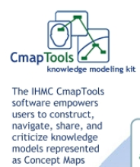
Approach
1) Architecture
Free to download at
www.cmap.ihmc.us
Notes:
The tool has been developed using the Cmaptools software, which is freely available from the web site shown.

Slide 7
Approach
2) Aligned with Orientation and Concept Development phases of NATO’s Operational Planning Process
But can be used with national planning processes
or as a general knowledge resource!
Notes:
The tool may be used to support early stages of NATO’s Operational Planning Process, or similar national planning processes.
Ref: NATO AJP-5 Allied Joint Doctrine for Operational Planning 2006: Chapter 4 Section-IV-Stage II-Orientation & -Stage III-Concept Development
Two highly relevant statements:
“An operations estimate will evaluate the probable effects of operational manoeuvre and the employment of lethal and non-lethal force capabilities.” (0433 b)
“A Civil-Military Co-operation (CIMIC) estimate provides an evaluation of the likely effects of the civil environment on the military operation as well as the potential consequences of the effects of the military operation on the civil environment.” (0433 h)

Slide 8
Simplified View
Understand the human
and social environment
Integrating this understanding into the development of courses of action
Orientation
What needs to be accomplished?
Concept Development
How best to do it?
8
Supporting guidance
and resources
Notes:
This is a simplified view of the HEART tool.
It helps users to understand the human environment and then uses this knowledge to help develop appropriate courses of action.
It also contains a wide range of supporting guidance and reference material.
Now for the guided tour …

Slide 9
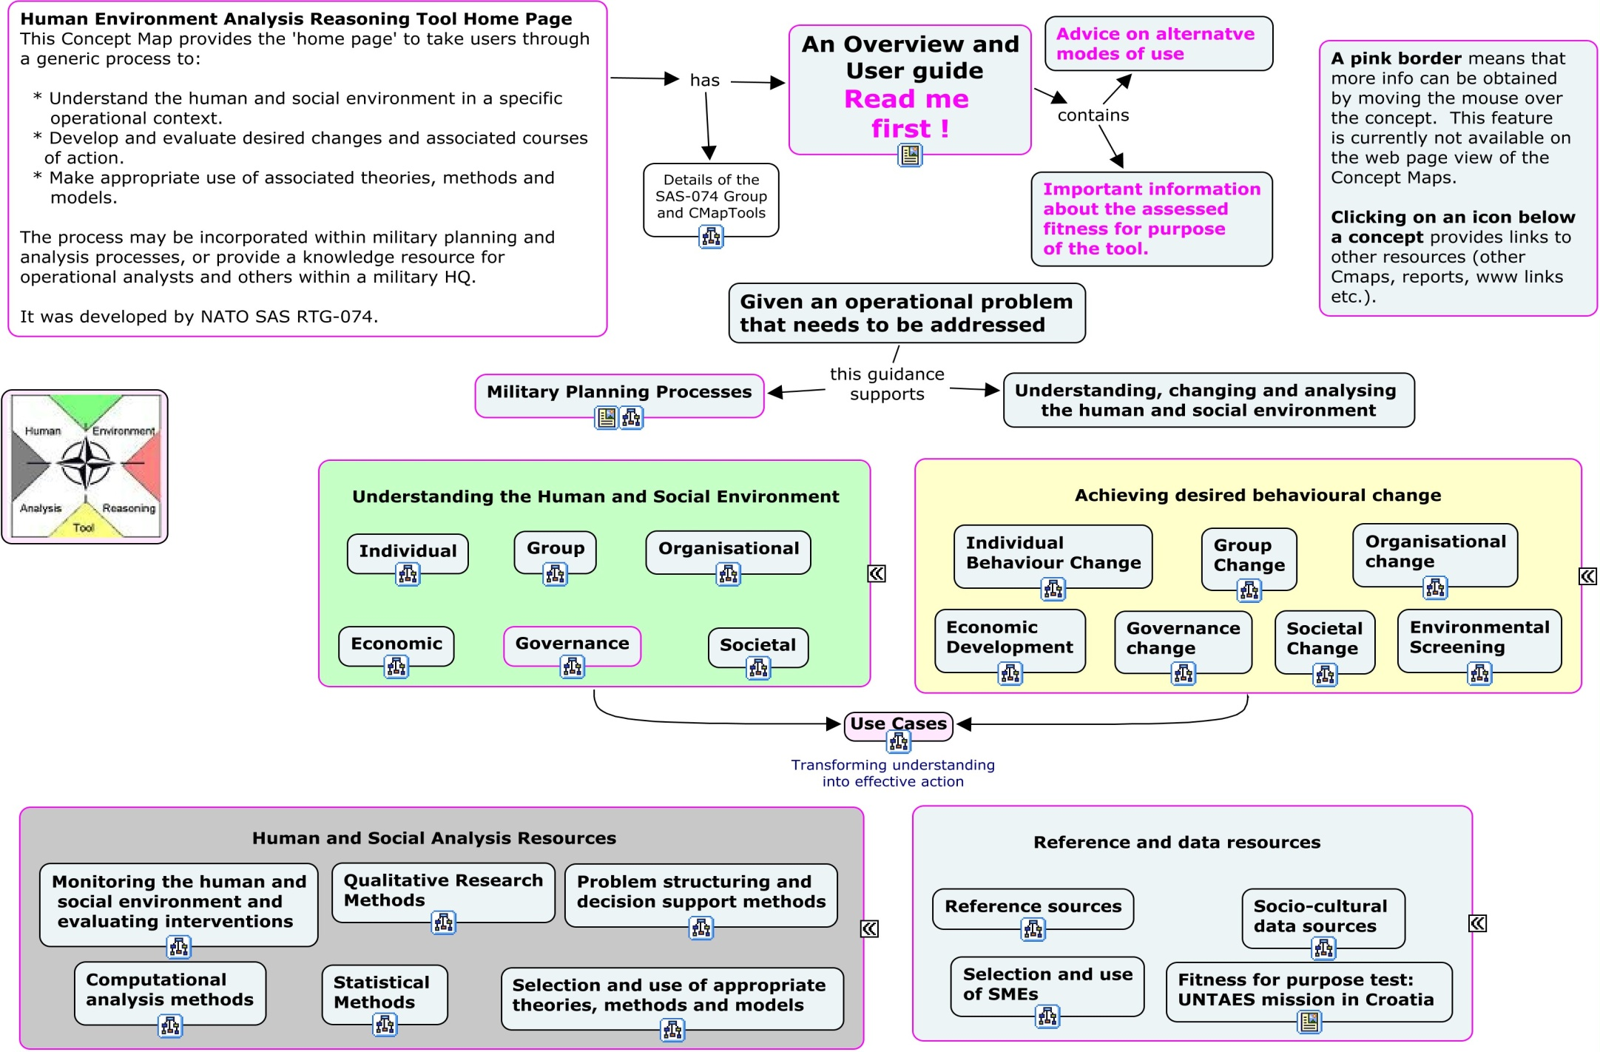
HEART Home Page
Reports, presentations, & related material
e.g., avoid food crisis among minority groups in a conflict zone
Notes:
This is a screen shot of the top of the HEART home page.
Please take the time to read the user guide. This presentation is one of the resources linked from the Overview and User Guide box.

Slide 10
HEART Home Page
“Orientation”
e.g., avoid food crisis among minority groups in a conflict zone
10
Notes:
The Undersanding the Human and Social Environment Concept maps help users to understand the human environment. We’re going to click on the Cmap icon at the bottom of the Organisational box to open the associated Cmap.

Slide 11
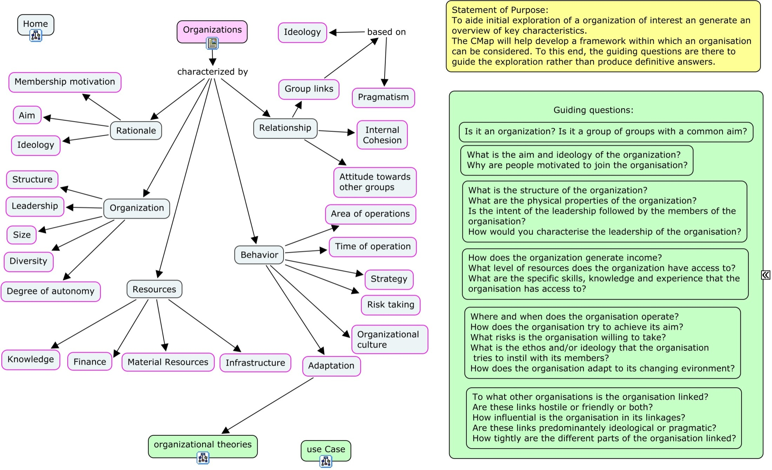
Organisational Orientation
Notes:
This example demonstrates how concept maps can be used as a graphical tool for organizing and representing knowledge. They include concepts, herein enclosed in boxes, and relationships between concepts indicated by connecting lines. Linking phrases on these lines specify the purpose of moving from one concept to another.
Let’s look at some of the individual components of the map.

Slide 12
Organisational Orientation
A description of purpose
Guiding questions to increase understanding
Key
characteristics
Links to other concept maps & resources
Notes:
In this map we have:
A description of its purpose
Key characteristics which we need to consider to get an understanding of a specific organization.
Guiding questions that could be asked to improve the users understanding (this is not intended a prescriptive approach, in some contexts each question will provide more insights than others).
The concept maps can also contain links to other concept maps, references and internet resources.

Slide 13
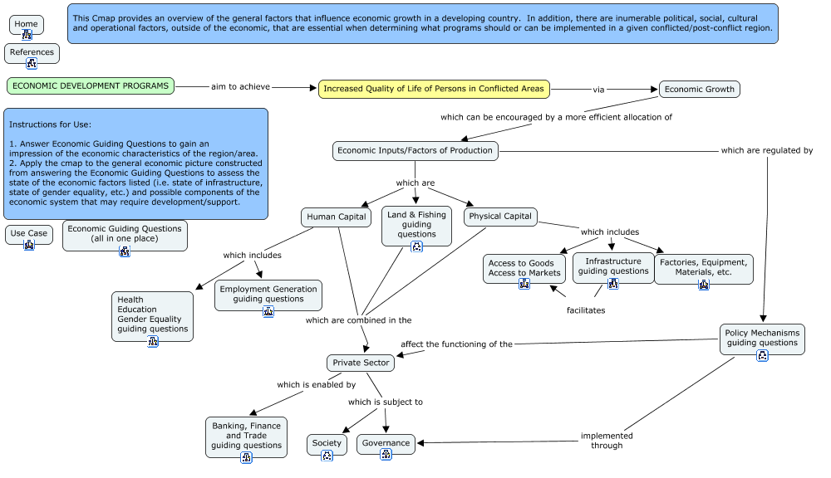
An example: The Case of Avoiding Food Crisis in a Conflict Zone
Notes:
Here we’ve taken a hypothetical humanitarian crisis scenario. The Economic Development Concept map is shown here. We can use the Land and Fishing Guiding questions to identify some key characteristics of land and sea use.

Slide 14
An example: The Case of Avoiding Food Crisis in a Conflict Zone
The country, given its desert climate, has limited arable land, fragmented into very small units that have limited efficiency. Hence, the country can only meet about 25% of its food demand. Fishing options are also limited. The net result is that the country imports most of its food.
Food imports are mostly financed through income generated directly and indirectly by the oil industry (which used to be almost 95 % of the country’s export income). Since the conflict started, the oil industry is only functioning at 1/3 of its capacity, in part due to the violence and in part due to the foreign expertise and labor fleeing the country. The deteriorating economic situation of the country may cause food shortages, and may affect more adversely minority groups.
Notes:
Here’s our summary.

Slide 15
An example: The Case of Avoiding Food Crisis in a Conflict Zone
The country has 2 key minority groups, namely the Blue (up to 10% of pop), and the Red foreigner (up to 20% of pop). In both cases, the regime, which is mostly Martian, has shown various forms of discriminatory attitudes towards these minorities. However, the Blue population has a diverse attitude towards the regime.
Among the key Blue tribes, the Azur have sided with regime while the Navy Blue tribe has sided with the opposition. The Azur are mostly employed in trade and transport industry and their loyalty with the regime has been long standing, while the Navy Blue are mostly engaged in farming in rural areas. The foreigners are usually found in urban areas in low paying employment.
Notes:
Similarly, we can look at employment issues.

Slide 16
Achieving Behavioural Change
“Concept Development”
e.g., avoid food crisis among minority groups in a conflict zone
16
Notes:
Coming back to the Home Page, the next group of concept maps consider how to achieve behavioural change at the different levels.
We’ll take a look at the Societal Change Cmap.

Slide 17
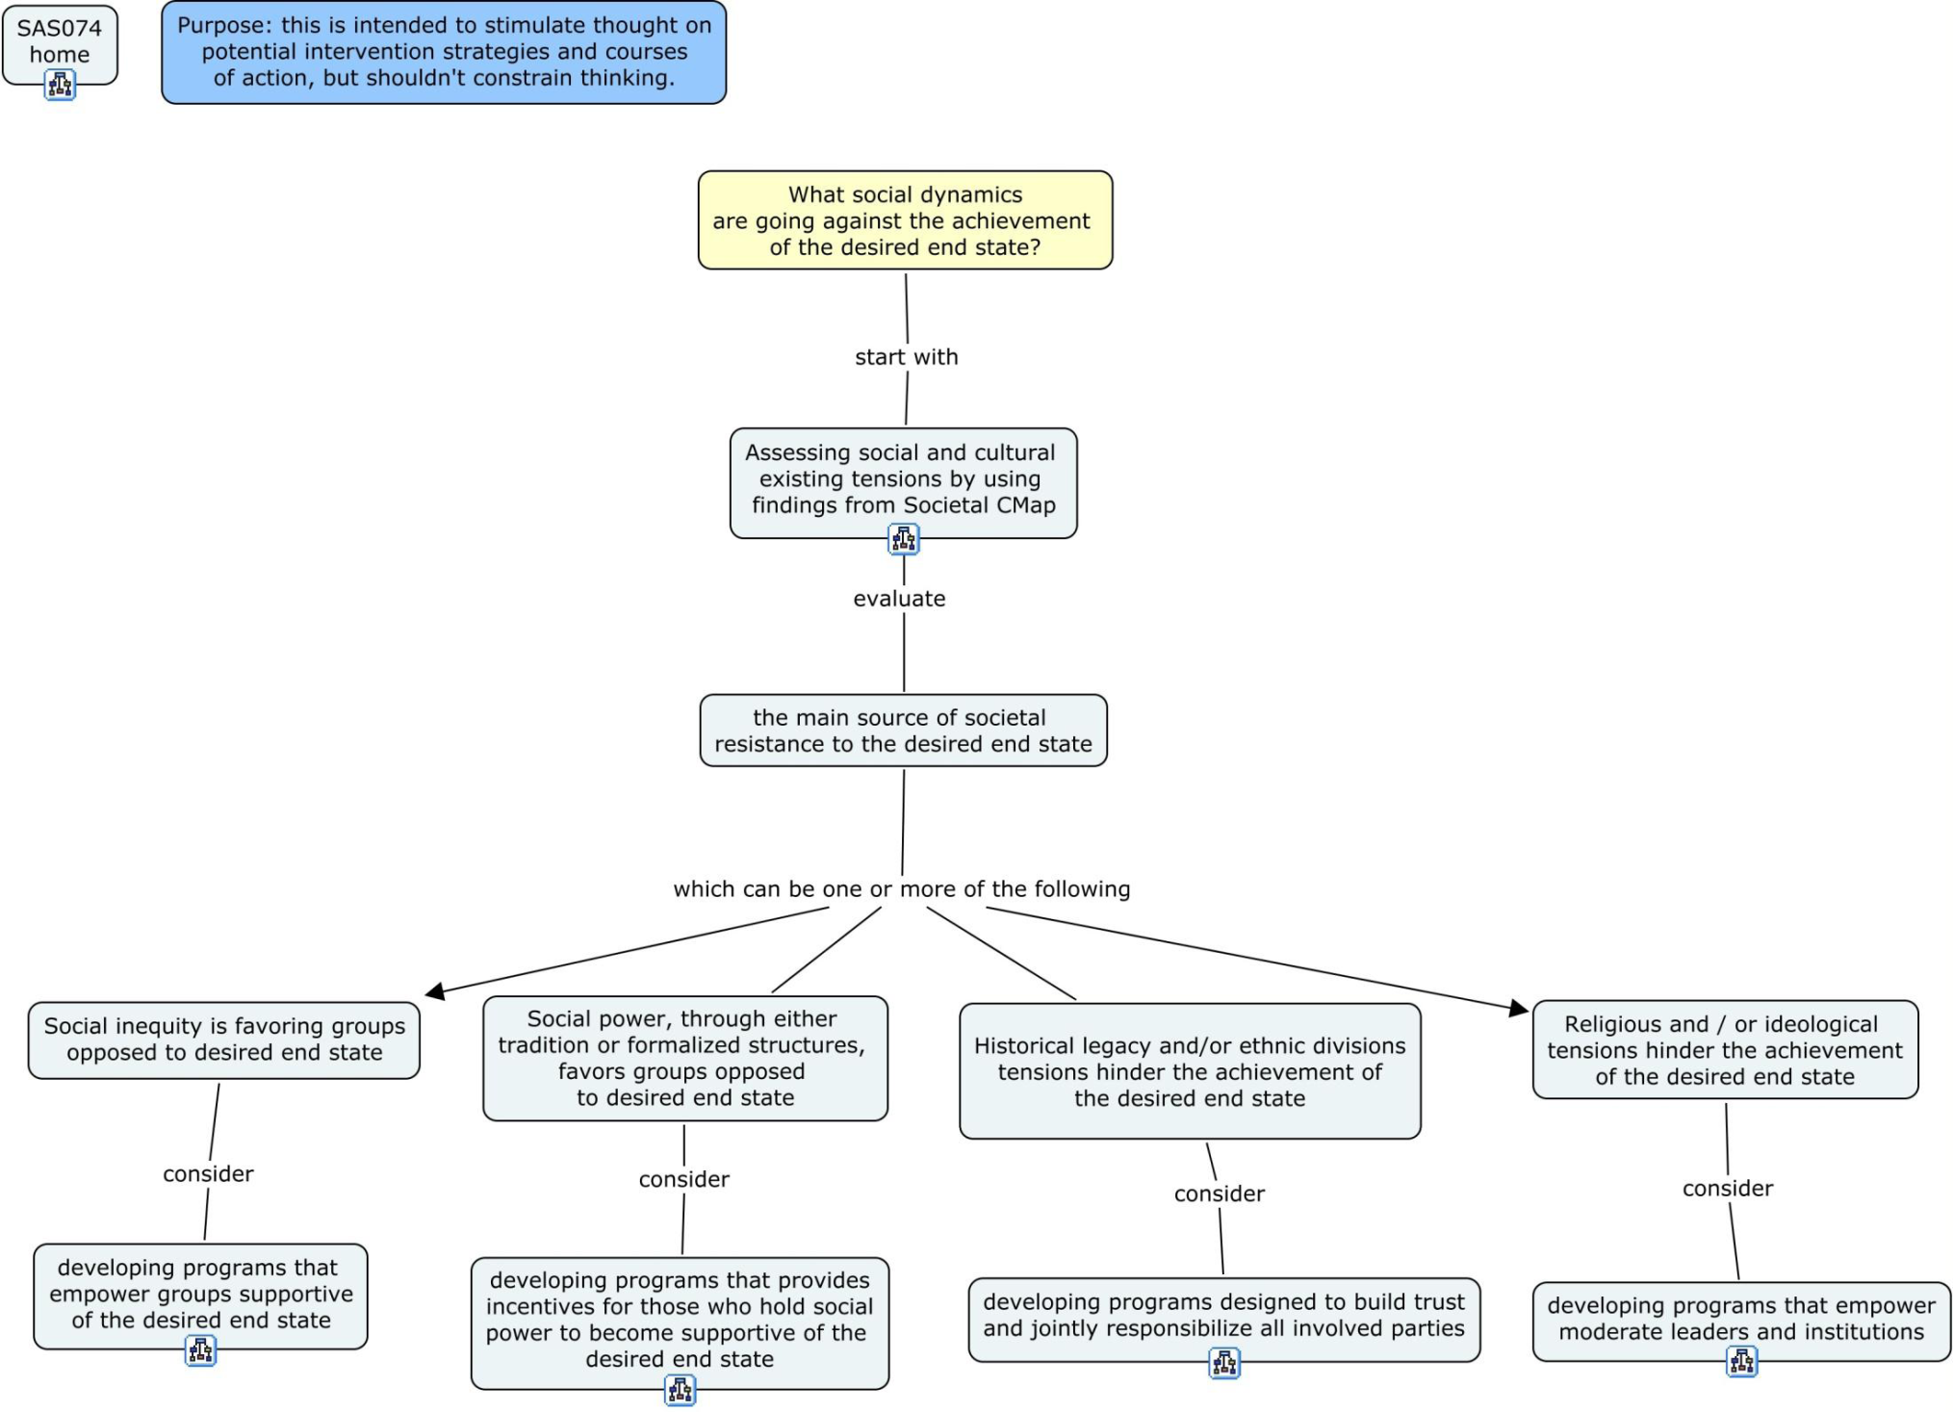
Societal Change
Notes:
Here we use the knowledge we’ve gained from the Societal Cmap to think about what kinds of societal change programs could be appropriate.
We can follow the lower level maps to identify possible approaches.

Slide 18
Achieving Behavioural Change
“Concept Development”
e.g., avoid food crisis among minority groups in a conflict zone
18
Notes:
Coming back to the Home Page, we’ will take another look at our hypothetical example. This time thinking about organisational change.

Slide 19
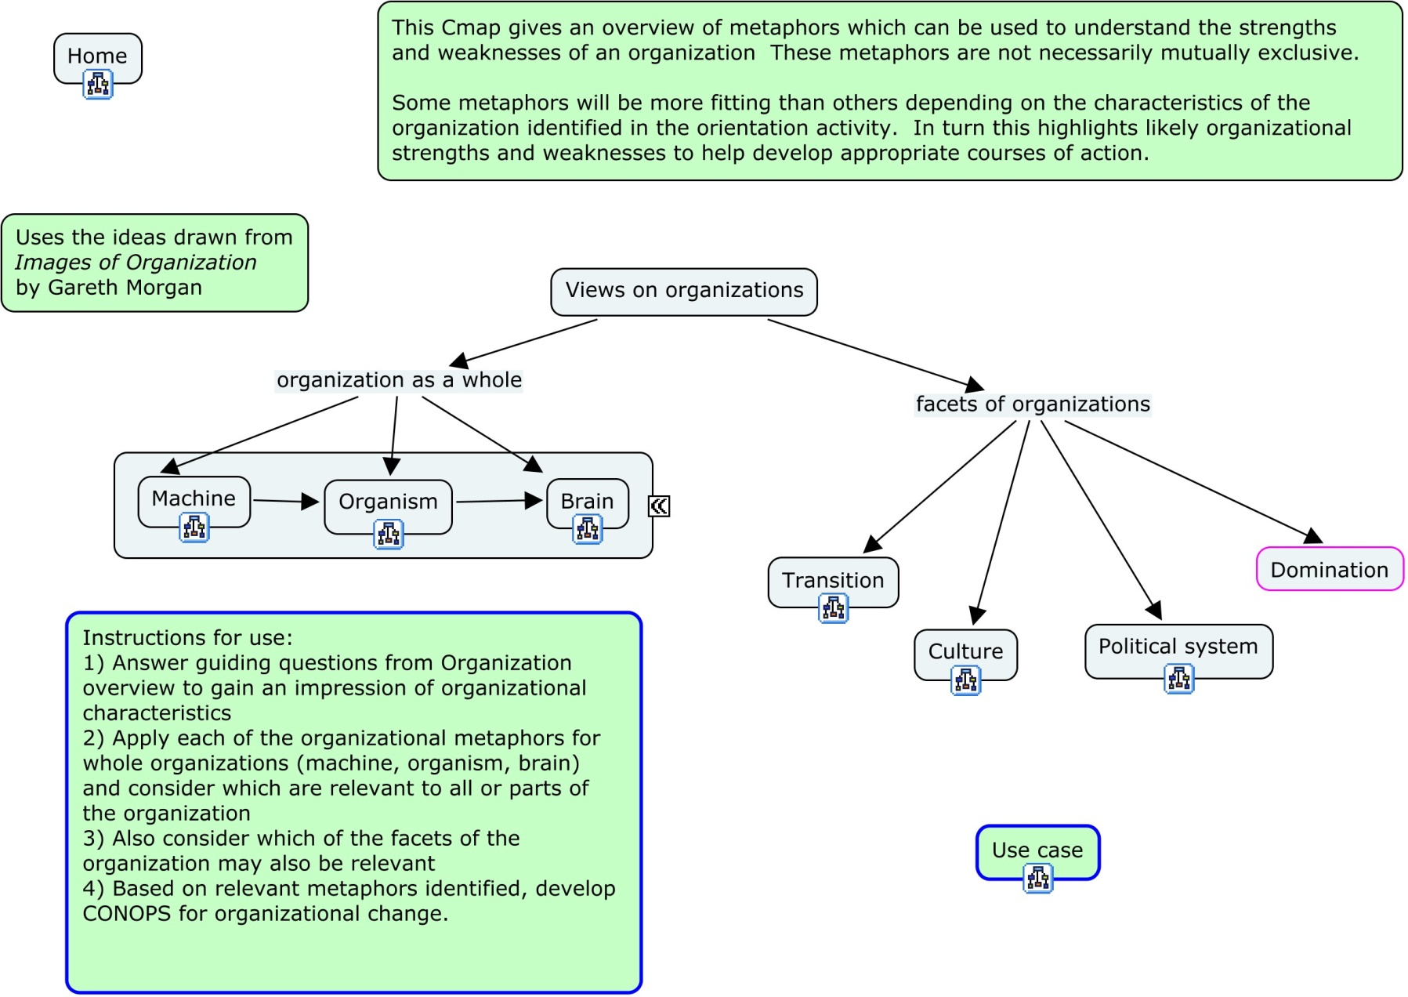
An example: The Case of Avoiding Food Crisis in a Conflict Zone
For foreigners and non-Azur Blue in government held areas, the international community could use the regime’s seized funds in foreign banks to purchase food and deliver it in coordination with the naval interdiction policy (i.e. ensure that only humanitarian is coming through). However, a fair distribution of food in these areas will be difficult to implement given that the international community has limited leverage.
Notes:
Here we think about how domination of some groups in the country may affect distribution of food.

Slide 20
An example: The Case of Avoiding Food Crisis in a Conflict Zone
The regime has been constructed over the years as a dynamic system where various factions are continually played against each other to the benefit of the leader and his close circle. The regime remains determined to stay in power in spite of the substantial opposition supported by the international community. As well, religion does not play a crucial role in the political life of the country and cannot be used for creating an effective mean of influence. Hence, intra-regime disruption does not appear to be an effective path for action at this time.
An area of weakness for the regime is its will to ensure some sort of survival, even if it is through exile. Survival in turn requires that it keeps a degree of international legitimacy, especially if exile becomes the only option left.
A possible course of action is to “trade” some international legitimacy (for future use by the regime) for a fair distribution of food. Given the leader’s long involvement with the Venusian Union (VU), an VU led-mission in government held areas could ensure that minorities would receive a fair share of the food distribution.
Notes:
Again, we use the contextual knowledge we’ve gained to think through possible courses of action.

Slide 21
Use cases
e.g., avoid food crisis among minority groups in a conflict zone
21
Notes:
Back to the home page again: we have provided a number of Use Cases to illustrate how the tool can be used. Let’s take a look at the Economic Development Use Case.

Slide 22
e.g., Economic Development Use Case
Notes:
This use case shows gaining understanding of the humancontext, in this case economics, can help the user to identify appropriate economic development strategies.
This is the top half of the use case…

Slide 23
Economic Development Use Case (cont’d)
Notes:
… and this is the bottom, showing some of the actual programmes undertaken by the Canadian Development organisation, CIDA

Slide 24
Human & Social Analysis Resources
e.g., avoid food crisis among minority groups in a conflict zone
24
Notes:
The sets of Cmaps at the bottom of the home page, provide links to a whole series of resources. On the left hand side they focus on analysis methods.
Let’s open the monitoring Cmap.

Slide 25
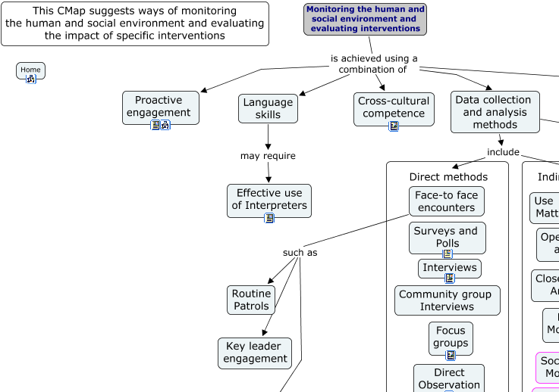
An Example of Drill-Down Capacity in HEART
First level of drill-down from the “Monitoring of human and social environment and evaluation of intervention strategies” sub-module of the “Resources” module.
Notes:
We can drill down further to get tips about using interpreters.

Slide 26
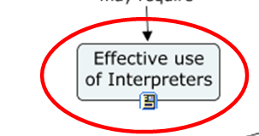
An Example of Drill-Down Capacity in HEART
(continued)
USE OF INTERPRETERS: BEST PRACTICE
KNOWLEDGE OF LANGUAGE AND INTERESTS. Ideally interpreters should not only have the required linguistic abilities, but also be trained in the research field so that they might best understand the line of thought or objectives of the researcher.
CONTINUED TRAINING. Training is not something to be done at the outset and then dispensed with: it should be understood as lasting throughout the research. Discussions and debriefings after interview sessions should be a regular practice, where difficulties of translation can be discussed.
BACK TRANSLATING. For quality assessment. This involves having one interpreter translate a text from the investigator’s language into the local language, and thereafter have another interpreter translate it back again. The two versions are then compared and the discrepancies discussed with the interpreters.
…
Second level of drill-down...

Slide 27
References & Data Resources
e.g., avoid food crisis among minority groups in a conflict zone
27
Notes:
On the right hand side there are other open source reference and datat resources.

Slide 28
e.g., Reference Sources
Notes:
This site highlights a range of reference sources, from key documents to web sites.

Slide 29
References & Data Resources
e.g., avoid food crisis among minority groups in a conflict zone
29
Notes:
That concludes our tour of HEART’s main features.
Now for some information about how to access it.

Slide 30
How to Access HEART
As Concept Maps
The tool can be viewed using the CMaptools program which is available for free from www.cmap.ihmc.us. General help and advice on using CMaptools are also available from this site.
Once CMaptools is opened, the SAS 074 CMaps are held in 'Shared Cmaps in Places', in sub-folder IHMC Public Cmaps (3) > Users (create your own folder) > SAS 074.
You will then be asked to supply a user name and password. Read-only access is available using user name ‘visitor’ and password ‘gateway’.
The ‘home page’, illustrated in Figure 3, can be accessed by clicking on ’00 SAS-074 Process View Shortcut’.
Users are strongly encouraged to read the user guide before proceeding further.
As HTML Pages
The tool may also be viewed as Internet-based html pages using the url: SAS 074
You will be requested for a user name and password: ‘visitor’ and ‘gateway’.
The main disadvantage of viewing the pages in this manner is that the ‘mouse over’ feature used to gain more information about individual concepts does not work. The SAS 074 Concept Maps make extensive use of this feature: concepts that have extra ‘mouse over’ information are identified with a pink border.
Notes:
Full functionality is gained by using the Cmaptools software – which can be downloaded for free.
However, all the maps and associated resources can also be viewed as Internet html pages.

Slide 31
Status of the tool
A concept demonstrator
The Netherlands have already taken the idea further with their ADAPT tool
  In a simulated Brigade HQ planning experiment it was beneficial in improving the planning process
Evaluation was undertaken with several sets of potential users during development
Was awarded the Ken Bowen Award (DSTL) for innovation
Notes:
HEART is a concept demonstrator, but it has already benefited from some user testing.
An experiment using the TNO ADAPT tool (which takes HEART further with addition of a background wiki to make it fully stand-alone and includes other enhancements) has demonstrated how such tools can enhance the quality of planning.

Slide 32
Potential Future Developments
Improve usability of tool (make it more intuitive and user-friendly through development of new user interfaces)
Further in-depth testing and evaluation of tool
Enhance visual representation by using additional software packages (e.g. a wiki back-end and topic-centered mind maps)
Increase portability of the tool (e.g. as an executable on an external disk drive or USB stick)
Produce a video (or online tutorial) on how to use the tool
Tune the tool to national and NATO requirements

Slide 33
Recommendations of SAS-074 RTG
Socialization of HEART by means of a NATO Lecture Series
  NATO Defense College in Rome
  US National Defense University
  Other National Defense Colleges
HEART should be hosted on, or advertized from, the NATO Research and Technology (RTO) and Allied Command Transformation (ACT) websites
Further technical enhancements to the tool would be better achieved through a full-time effort that could be undertaken by NATO ACT, potentially supported by NC3A. An RTG could be created to provide direction and oversight of such developments

Slide 34
Contact Information
Point of Contact | Country | Email
Philip Jones (SAS RTG-074 Lead) | UK and other nations | prjones@dstl.gov.uk
Peter Tikuisis | Canada | Peter.Tikuisis@drdc-rddc.gc.ca
Tony van Vliet | Netherlands | tony.vanvliet@tno.nl
Nina Hellum | Norway | nina.hellum@ffi.no
Anders Tavemark | Sweden | anders.tavemark@foi.se
Laurie Fenstermacher | USA | Laurie.Fenstermacher@wpafb.af.mil
Notes:
Many thanks for taking the time to go through these familiarisation slides.
If you have further questions about the tool, please contact the national leads within the group.

Slide 35
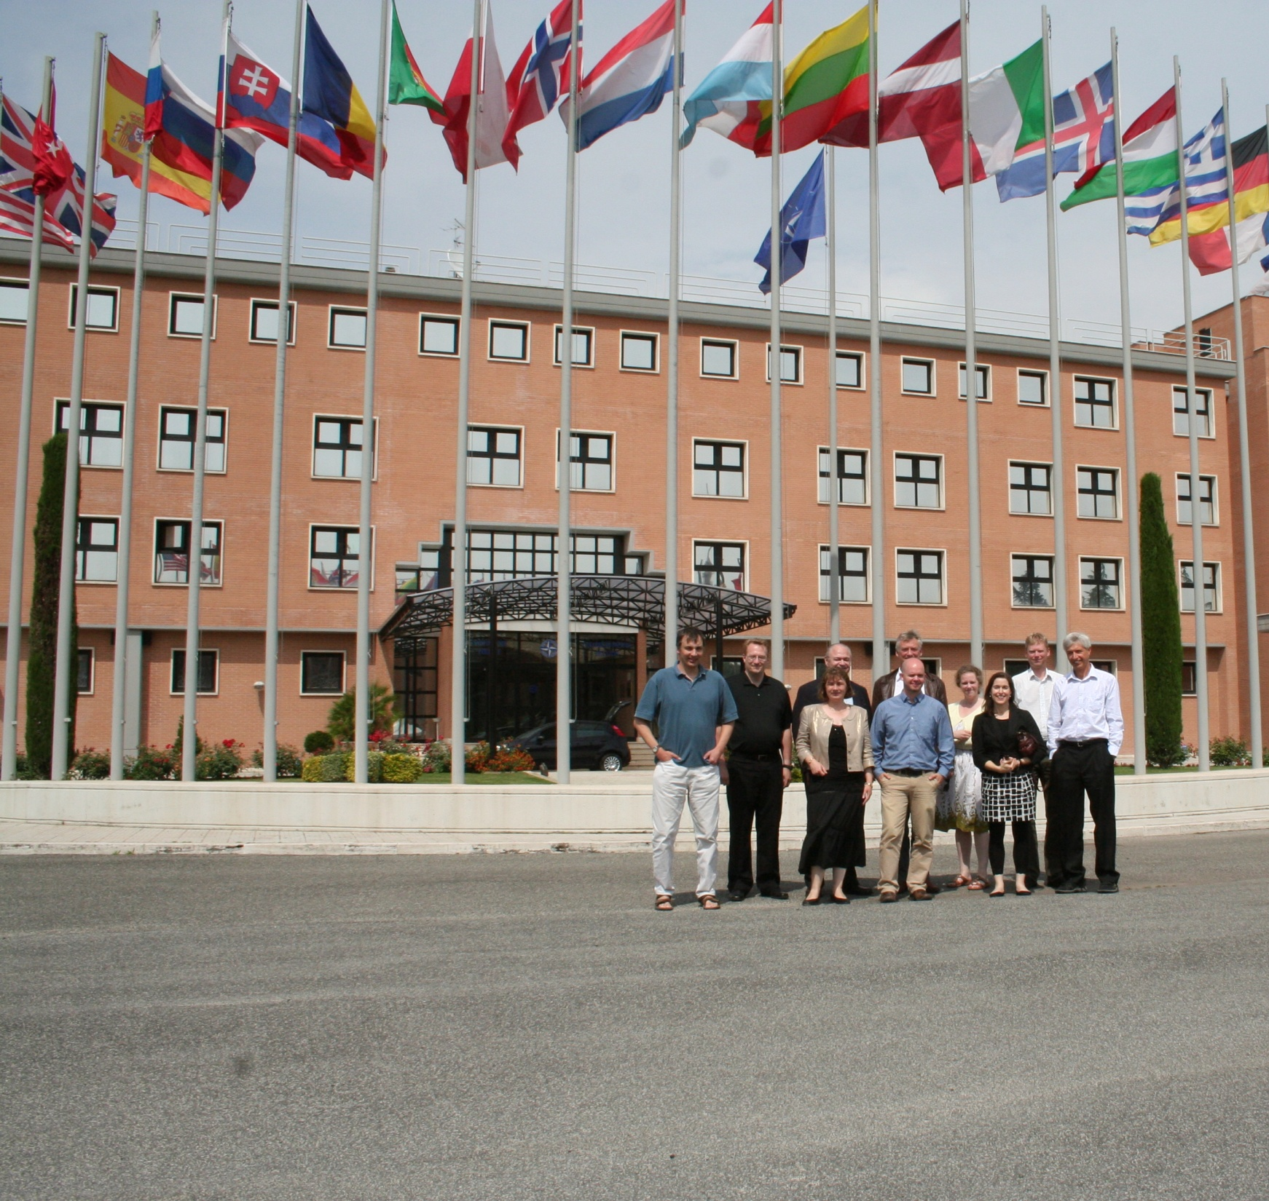
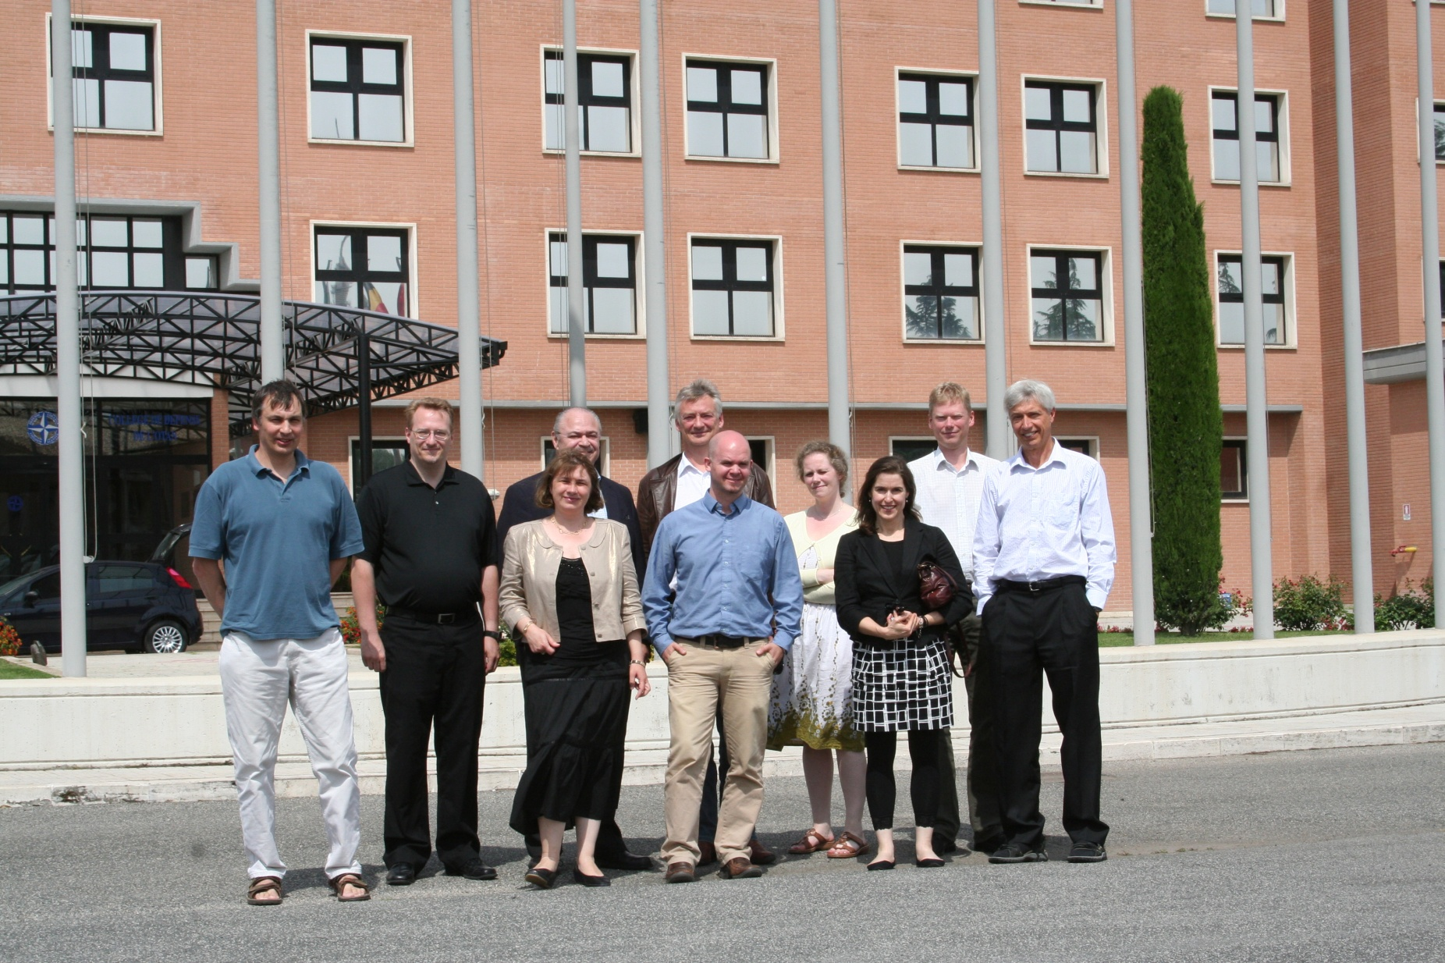



The SAS RTG-074 group at the
NATO Defense College Rome
Notes:
1
What a lovely bunch!

