Slide 1
Mammary Surgery
Introduction

Slide 2
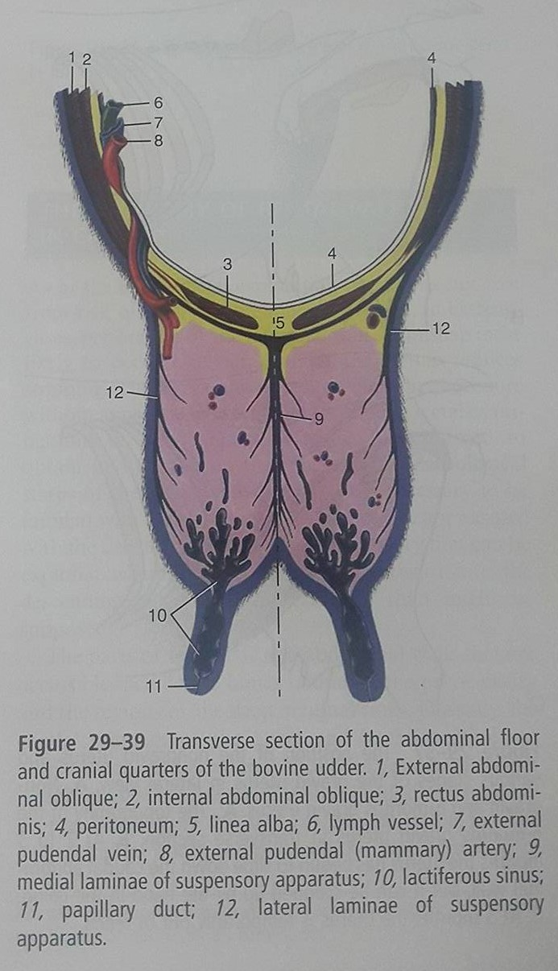
Basic Anatomy

Slide 3
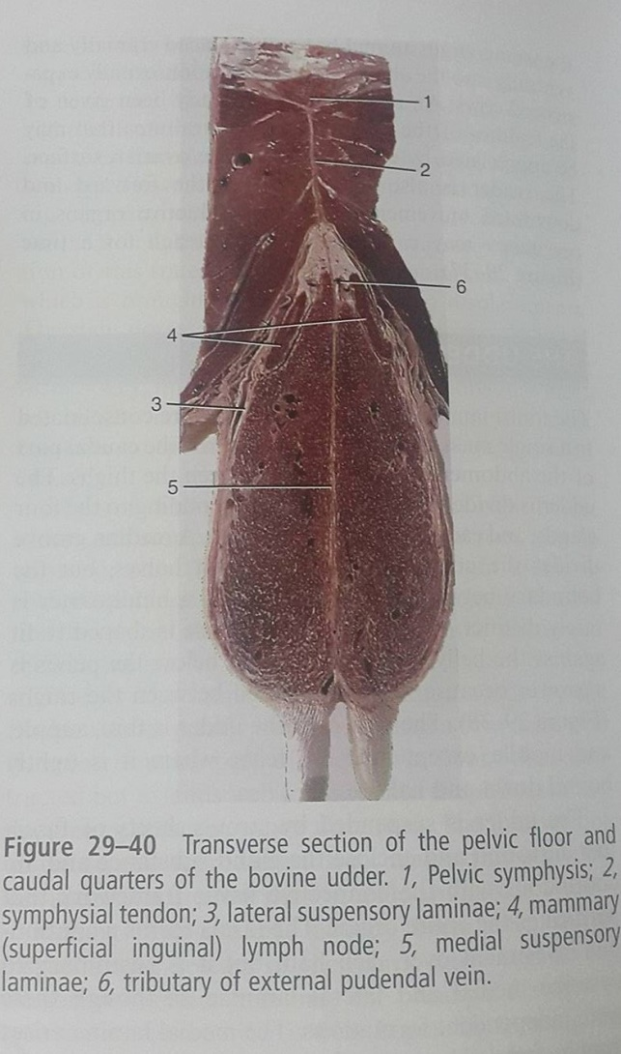
Basic Anatomy

Slide 4
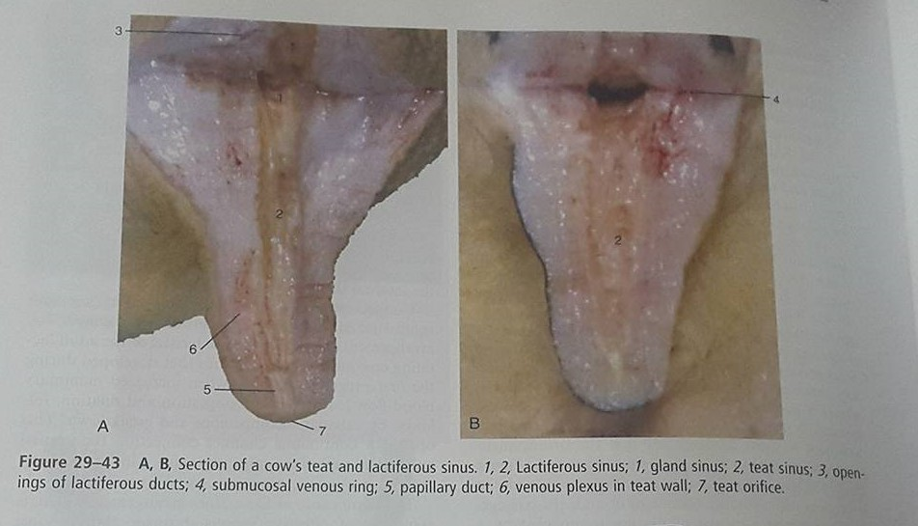
Basic Anatomy

Slide 5
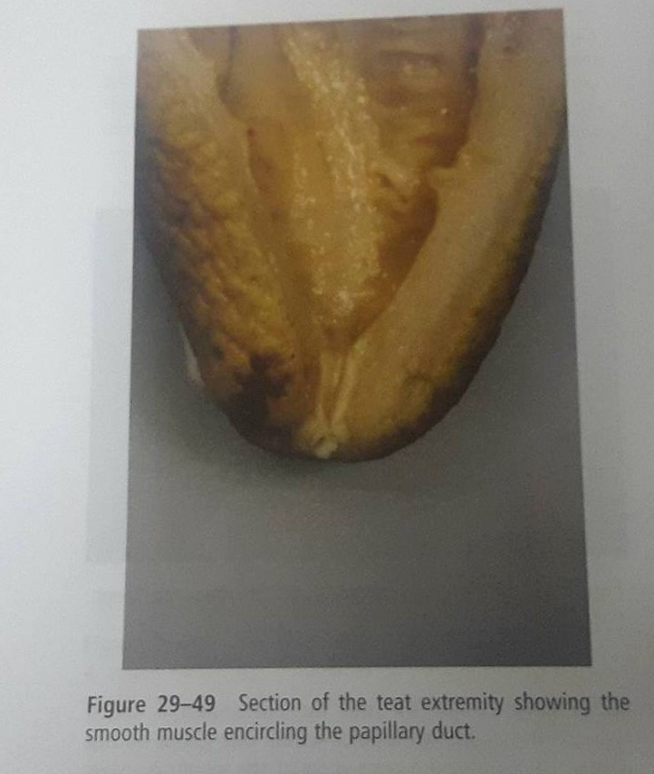
Basic Anatomy

Slide 6
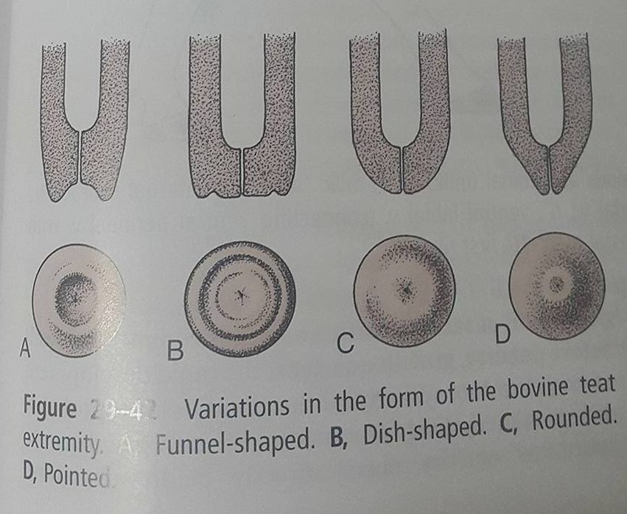
Basic Anatomy

Slide 7
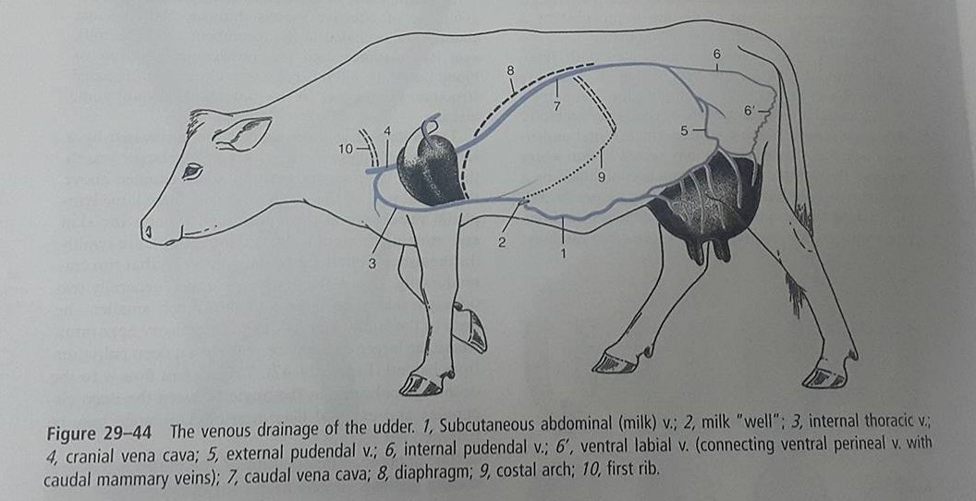
Basic Anatomy

Slide 8
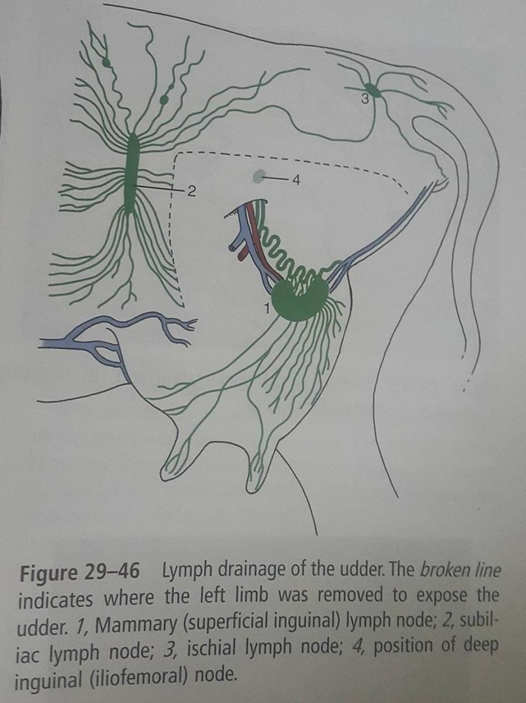
Basic Anatomy

Slide 9
Introduction
Teat laceration is a catastrophic injury, affecting the production of the animal.
Classification of teat injury is based on:
Duration: Acute/Chronic ( >12 hours). Surgical intervention is recommended for those lacerations less than 12hours.
Localization and conformation: Lacerations can be simple/ complexed ( inverted Y or U), longitudinal or transverse and proximal or distal.

Slide 10
Introduction
Note the blood supply runs in a longitudinal manner. Therefore transverse laceration are more severe.
Distal injuries have a poor prognosis, affects the defense mechanism and injuries may lead to avascular necrosis of the distal end of the teat. Also reconstruction of the streak canal is difficult and may cause obstruction (partial or complete) of the milk flow.

Slide 11
Introduction
Thickness of the laceration: These are either partial (skin to submucosa) or full (skin to mucosa with the milk leaking out of the incision) thickness. Prompt surgical reconstruction is needed to protect the quarter against environmental pathogens.

Slide 12
Prognosis
Prognosis of a teat laceration is based on:
Involvement of streak canal
Direction of wound: Longitudinal wounds heal better than transverse.
Integrity of blood supply
Presence of infection
Amount of skin loss.

