Slide 1
Mammary: Tools

Slide 2
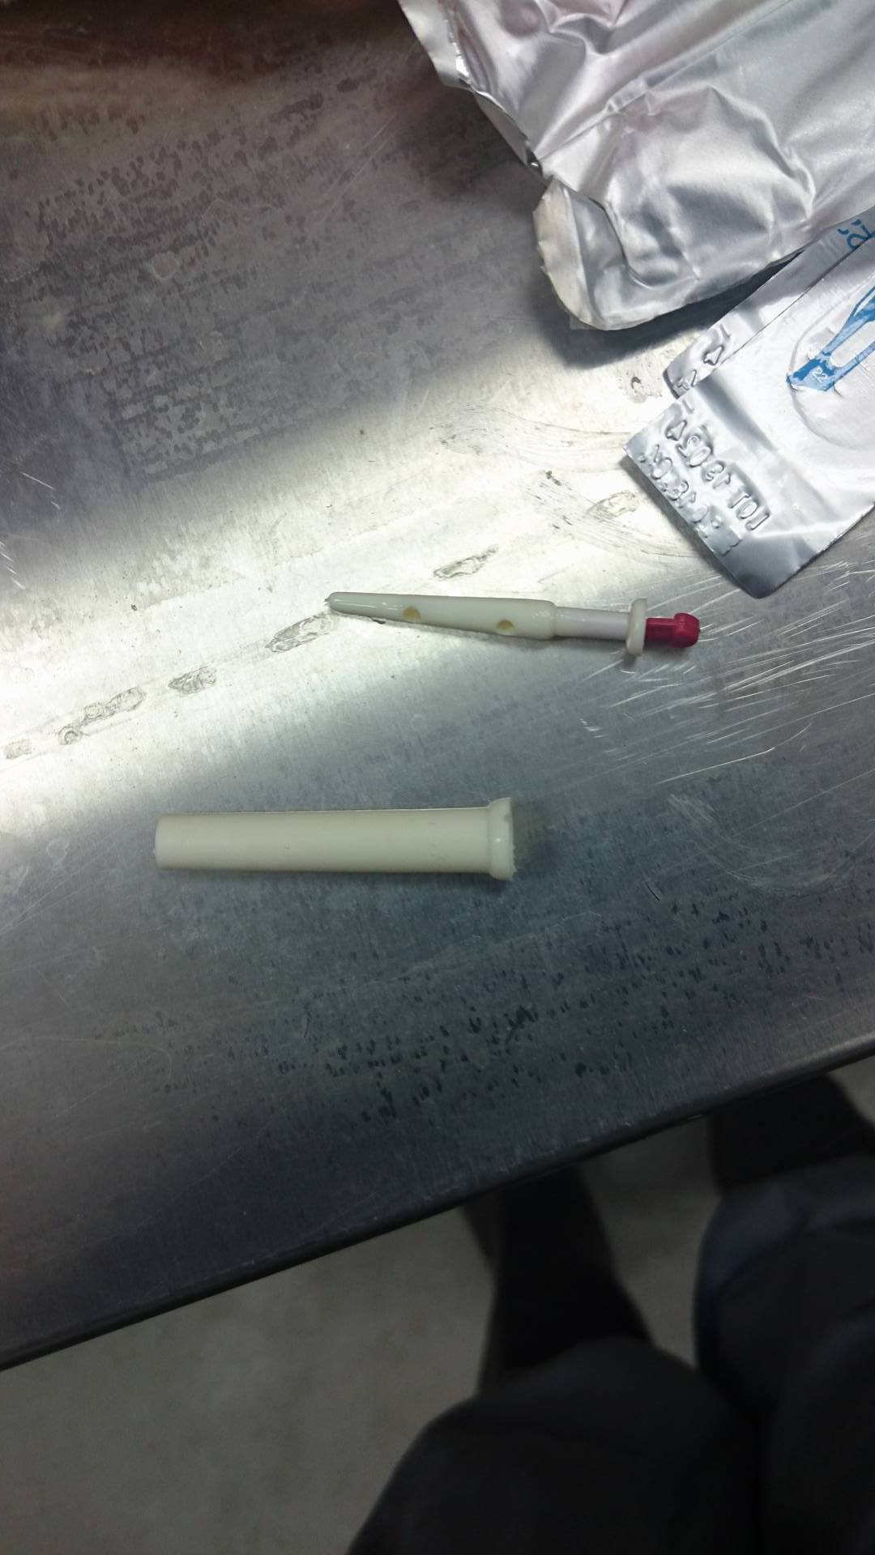
Self Retaining Cannula
Function: To open the teat canal . Note that the stopper can be removed and the cow is allowed to be milked .

Slide 3
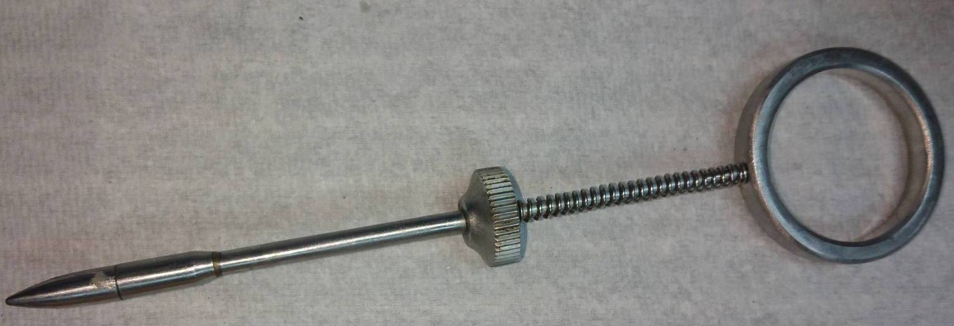
Tumor Extractor
Function: to remove tumors/ soft tissue masses.
The blunt tube is slipped into the canal. The blade in hidden within the shaft. After which the tips is extended forward the blade comes out, while working the tumor against it. The tip is brought back cutting small pieces off. The process is repeated until all is removed.

Slide 4
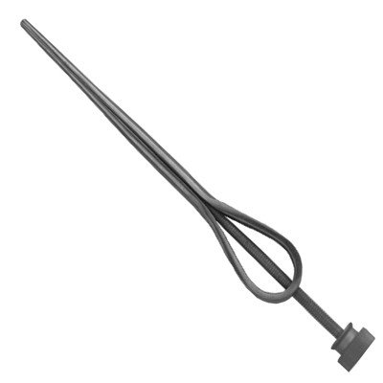
Teat Dilator
Function: To facilitate the flow of fluid from the tear. The elongated tubular portion extends into the duct, removing and obstruction and promoting the flow of milk

Slide 5
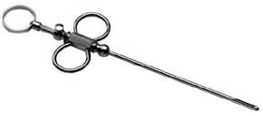
Teat Slitter.
Teat Slitter – Double blade, 3-ring, chrome plated dairy instrument. The blade I hidden in the shaft. The teat slitter makes an incision from inside to outside. It opens teat sphincter for better milk flow. Useful for follow-up surgery and mastitis.

