Slide 1
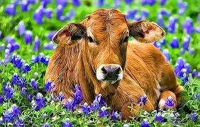
DEHORNING
This process is the removal of the horns and tissue that produces horns ( the corium)thus preventing the formation of horns, on cattle, sheep, and goat, after the horns have formed. This process is common management practice on dairy farms as diary cattle are not naturally polled animals. Dehorning is done when the calves are over 2 months of age after the horn has formed and in kids it is done after 2 weeks of age.
Video-
http://www.thebeefsite.com/articles/2261/dehorning-of-calves/

