Slide 1
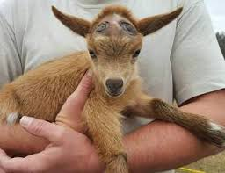
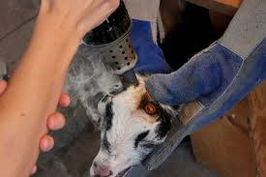
Video- https://www.youtube.com/watch?v=oWLAVPpXO4E

