Slide 1
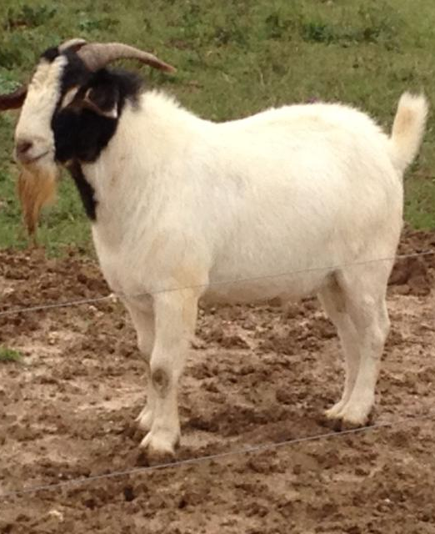
CORNUAL NERVE BLOCK
COSMETIC DEHORNING IN GOATS

Slide 2
SEDATION
Xylazine is the drug of choice for sedation
Wait 10 minutes for it to take effect if it is given IM and 5 minutes if it is given IV
Xylazine is an alpha 2 agonist and if given alone, lasts for a few hours
A mixture of xylazine and butorphanol can also be given for both sedation and analgesia.
Xylazine 0.025 to 0.05mg/kg mixed with Butorphanol 0.05 mg/kg
If Butorphanol is not use, use the recommended Xylazine dose and double the Ketamine to compensate
The combined mixture of a sedative (xylazine), local anesthetic and NSAID would control pain for a longer period of time

Slide 3
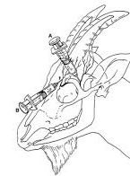
LOCAL ANALGESIA
Blocking of the cornual branches of the infratrochlear and lacrimal (zygomatico-temporal) nerves
Done by making a ring bock using 2% Lidocaine.
Lidocaine lasts roughly 45 minutes and wait 10 minutes after injection before making an incision
Goats are very sensitive to Lidocaine toxicity, therefore the maximum dose (Toxic dose) would be 10mg/kg. Recommended dose is between 2 to 4 mg/kg
Can also use Valium/Ketamine mixture in a 1:1 ratio, 1cc is given per 20kg

Slide 4
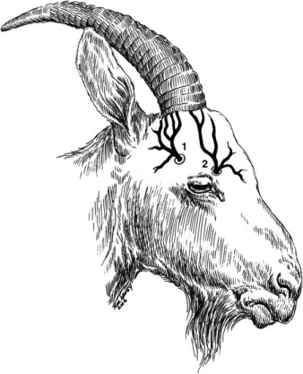
Landmarks
For the lacrimal nerve : To desensitize the area, use a 22-gauge, 1-inch needle and inject 2 to 3 ml of 2% Lidocaine half way between the lateral canthus of the eye and the lateral base of the horn. The needle is inserted 1 to 1.5 cm deep, going as close as possible to the ridge of the supraorbital process.
For the infratrochlear nerve: to desensitize the area, use a 22-gauge, 1-inch needle and inject 2 to 3 ml of 2% Lidocaine halfway between the medial canthus of the eye and the medial base of the horn. The needle is inserted 0.5 cm deep, dorsal and parallel to the dorsomedial margin of the orbit.

Slide 5
References
Common surgical procedures in small ruminants (Proceedings) [Internet]. DVM 360. [cited 2020Sep27]. Available from: https://www.dvm360.com/view/common-surgical-procedures-small-ruminants-proceedings
Zygomaticotemporal Nerve [Internet]. Zygomaticotemporal Nerve - an overview | ScienceDirect Topics. [cited 2020Sep27]. Available from: https://www.sciencedirect.com/topics/veterinary-science-and-veterinary-medicine/zygomaticotemporal-nerve

