Slide 1
Pre-operative

Slide 2
Physical exam
A complete physical exam should always be performed before these procedures to ensure that the animal is healthy and has no detectable issues that can complicate the procedure or that needs to be rectified before the procedure is done.

Slide 3
Testicular and scrotal exam
The Buck is held in a standing position. Place one hand on each side at the base of the scrotum. The spermatic cords can be felt between the thumb and fingers and gradually move down to the epididymis. Without excessive pressure, most abnormalities can be felt for such as swelling or hardness. A comparison between the testicles (testis) can be made by simultaneously using both hands, one on each side.

Slide 4
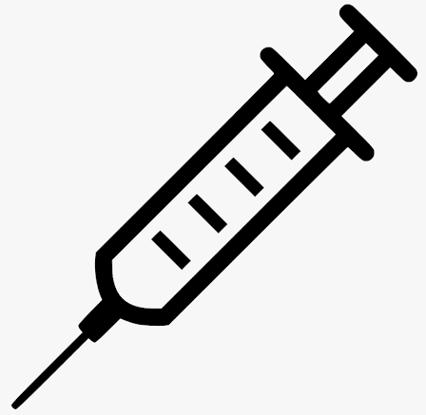
Vaccination history
A complete history of the animal should be obtained with information including vaccination history as tetanus is a major concern when castrating goats, and if the animal has been vaccinated for tetanus, then a booster must be administered. If the goat has not been previously been vaccinated, then the animal should receive tetanus antitoxin, in this case the kid would receive 150 to 250 units of tetanus antitoxin before the procedure.

Slide 5
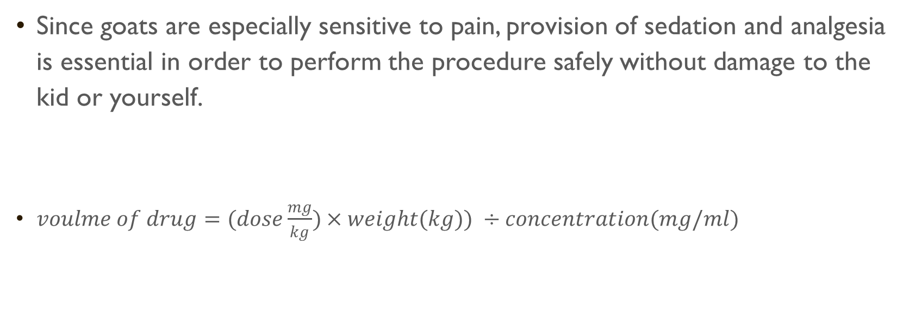
Since goats are especially sensitive to pain, provision of sedation and analgesia is essential in order to perform the procedure safely without damage to the kid or yourself.
$voulme of drug=(dose\frac{mg}{kg})×weight(kg)) ÷concentration(mg/ml)$

Slide 6
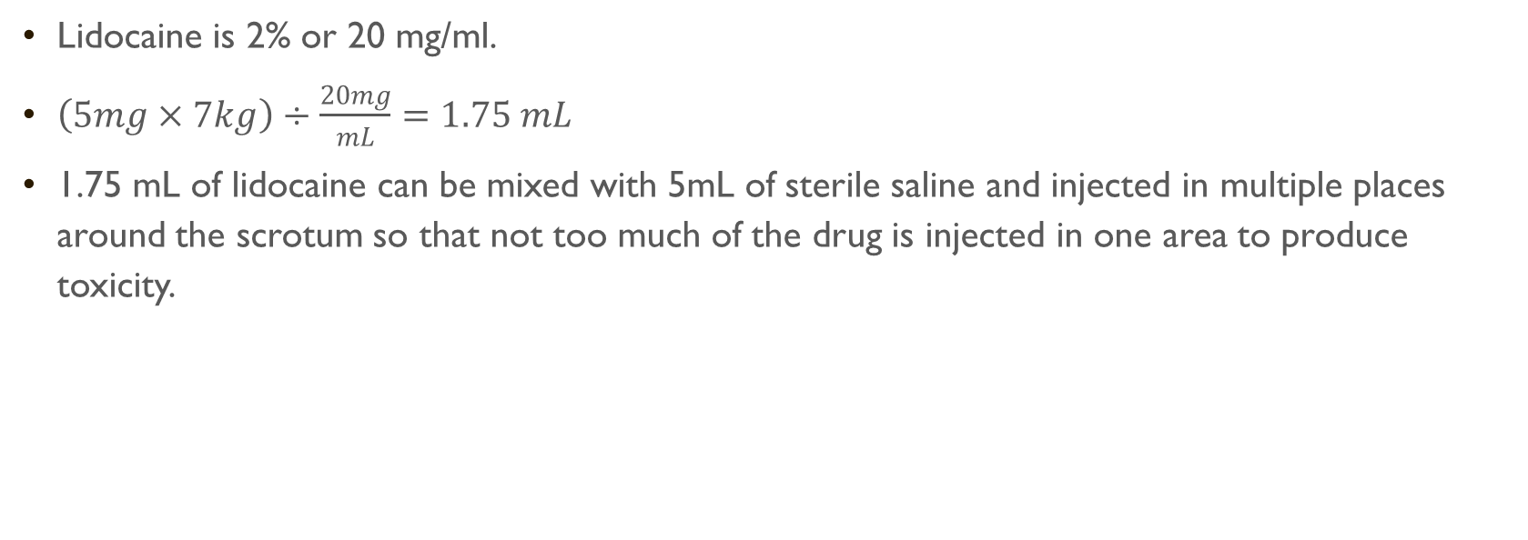
Lidocaine
Lidocaine is 2% or 20 mg/ml.
$\left(5mg×7kg\right)÷\frac{20mg}{mL}=1.75 mL$
1.75 mL of lidocaine can be mixed with 5mL of sterile saline and injected in multiple places around the scrotum so that not too much of the drug is injected in one area to produce toxicity.

Slide 7

Flunixin meglumine
For the preoperative NSAID include flunixin meglumine I,V.
$\left(1.1mg×7kg\right)÷\frac{50mg}{mL}=0.154mL$

Slide 8

Xylazine
For the sedative option, Xylazine (I.M.) with tolazoline as the reversal agent.
$\left(0.1mg×7kg\right)÷\frac{20mg}{mL}=0.035mL$

