Slide 1
Equipment used for Castration of Food Animals

Slide 2
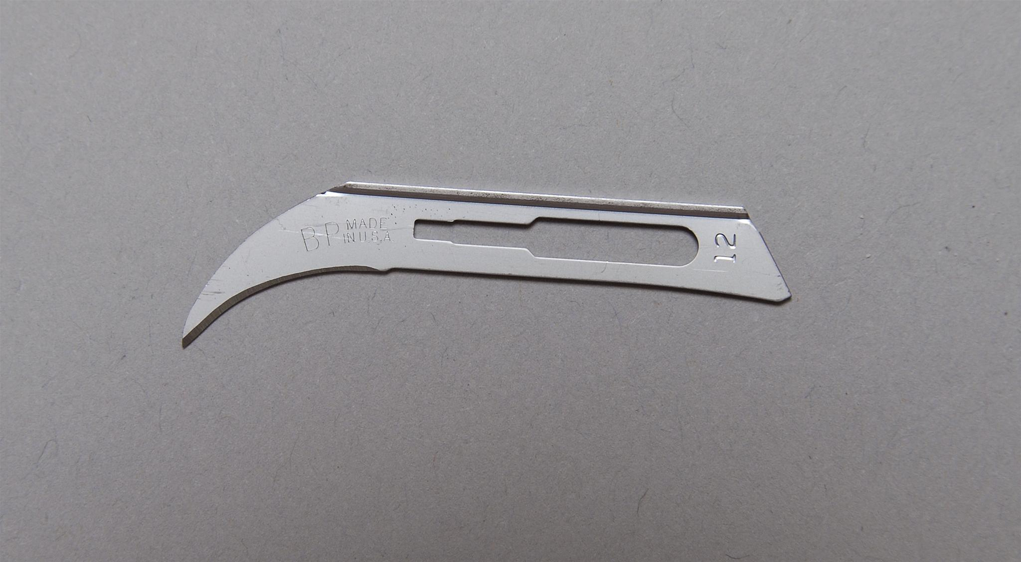
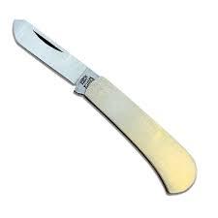
Equipment used for TESTECTOMY
1.) Scalpel or Castration Knife
No.12 Bard Parker blade is often preferred and used for Testectomy in cattle

Slide 3
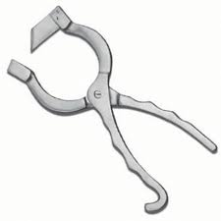
2.) New Berry Castration Knife
Used to make incisions in the scrotom of young bulls
Technique: Close knife and pull downward to slice scrotom

Slide 4
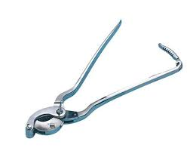
3.) Emasculator
Used to simultaneously crush and cut the spermatic cord
Prevents hemorrhage
Blade is located on the side of the tool held in place of a nut
Placed against the testicle in a “nut to nut” way to allow crushing or the spermatic artery
Can be locked in place using the ratchet to allow hemostasis

Slide 5
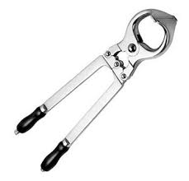
Use of the Emasculatome
Used for Bloodless castration
Eliminates the potential for infection
Commonly used on young bulls and rams (immature males)
NOT recommended for use on boars.
Crushes the vasculature of the spermatic cord to result in avascular necrosis and atrophy of the testicle

Slide 6
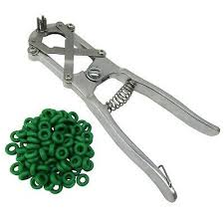
Equipment used for Elastration
Elastrator bands and Application pliers
Bands are placed at the base of the scrotum, above the testicles
Application allows restriction of blood supply to testicles and scrotom that results in scrotal and testicular atrophy
Bands should be replaced often to prevent deterioration and loss of elasticity
Used for young lambs and calves less than 2 weeks old as well as older bulls and ram lambs

