Slide 1
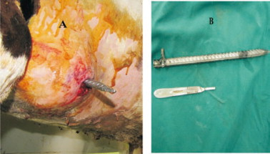
INGESTION OF FOREIGN OBJECTS POSED A HUGE ECOMNOMICAL RISK TO THE FARMER
It can cause ruminal impaction or traumatic reticuloperitonitis

Slide 2
ANATOMY IS IMPORTANT TO KNOW

Slide 3
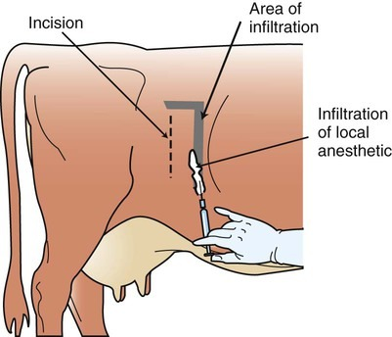
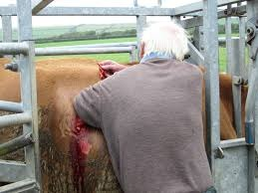
The L nerve block is the most common nerve block used in exploratory laparotomy

Slide 4
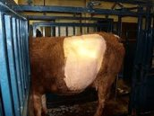
Clip the hair on the area where the surgery is to be perform to reduce the risk if infection.
Clean Contaminated surgery

Slide 5
VIDEOS
https://www.youtube.com/watch?v=vNlJW9VuX5E&t=83s
I was unable to find any exploratory laparotomy videos in cattle but this video shows the layers that u have to go through to reach the rumen which is stated on the scroll over.

