Slide 1
System Dynamics using Vensim
Andrew Hill – Ventana Systems UK Ltd
15th-16th September 2011
DSTL

Slide 2
Course Schedule
Day 1
  System Dynamics Methodology
  Using Vensim Software
  Tutorial Model building
Day 2
  Building a Rework Model
  Using Lookup Tables
  Delay Functions
  Subscripts

Slide 3
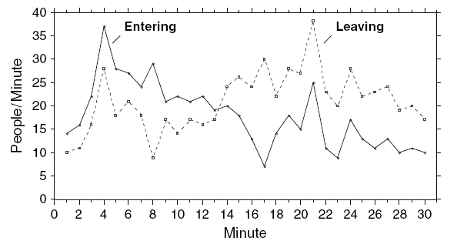
A Simple System Dynamics Problem
This graph shows the number of
People entering and leaving a
Department store over a 30
minute period
At which minute did most people enter ?
At which minute did most people leave ?
Estimate when most people in the store ?
When are the fewest people in the store ?
Taken from: All Models are Wrong: Reflections on Becoming a Systems Scientist, written by Prof. John Sterman, director of the MIT System Dynamics Group

Slide 4
The One Hour Course
(Understanding diagrams like this)

Slide 5
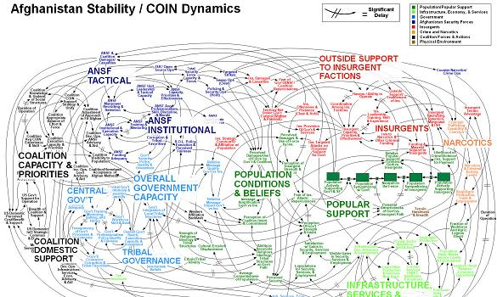
and this...

Slide 6
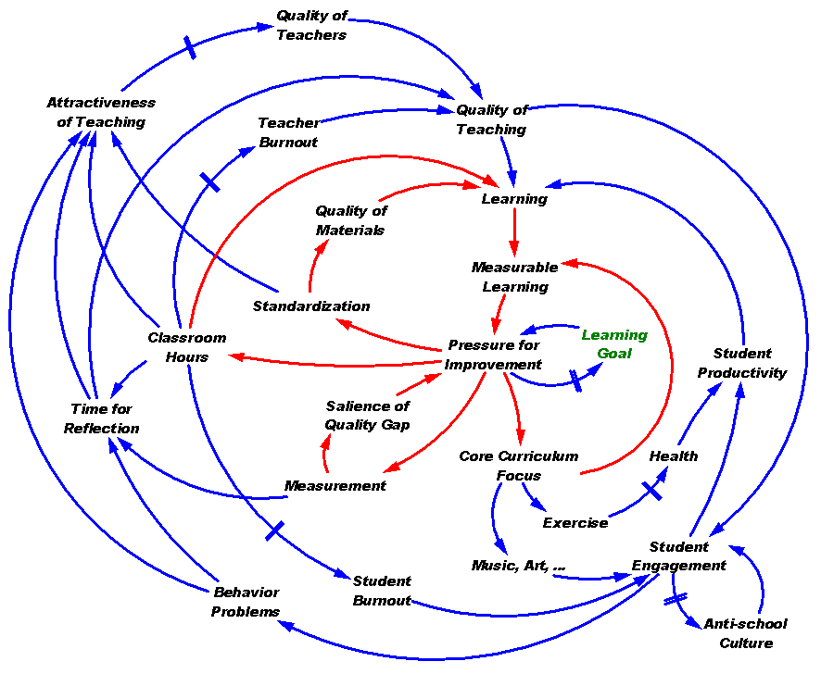
...but more often this

Slide 7
How do you calculate Revenue ?
Item Sales x Item Price = Revenue

Slide 8
Inputs - Output
Item Sales | Item Price | Revenue
1 | £10 | £10
3 | £10 | £30
2 | £10 | £20
5 | £10 | £50
3 | £10 | £30
2 | £10 | £20
1 | £10 | £10

Slide 9
Cause and Effect
Changes to the Item Price (Cause) or Item sales (Cause) will change (Effect) the amount of Revenue
Direction of arrow shows the direction of the effect.

Slide 10
Type of Effect
What happens if the price is higher ?
Item Sales | Item Price | Revenue
1 | £10 | £10
3 | £10 | £30
2 | £10 | £20
5 | £20 | £100
3 | £20 | £60
2 | £20 | £40
1 | £20 | £20

Slide 11
Type of Effect
What happens if the price is lower ?
Item Sales | Item Price | Revenue
1 | £10 | £10
3 | £10 | £30
2 | £10 | £20
5 | £1 | £5
3 | £1 | £3
2 | £1 | £2
1 | £1 | £1
Same type “+” of change

Slide 12
Opposite Type of Change
What if coupons are available for 10% Discount ?
Opposite type “-” of change

Slide 13
What are the other missing pieces of information ?
Time Units ? (daily, week, month ?)
Dimensions ?
Day | Item Sales | Item Price | Revenue
Monday | 1 | £10 | £10
Tuesday | 3 | £10 | £30
Wednesday | 2 | £10 | £20
Thursday | 5 | £10 | £50
Friday | 3 | £10 | £30
Saturday | 2 | £10 | £20
Sunday | 1 | £10 | £10

Slide 14
Measurement Units
Sales
Price
Revenue
Items/Day
£/Item
£/Day
Revenue = Sales x Price
£ = Items x £
Day Day Item

Slide 15
Weekly Profit
 | Item Sales | Item Price | Revenue | Discount | Net Daily Revenue | Cumulative Profit
Monday | 1 | £10 | £10 | 10% | £9 | £9
Tuesday | 3 | £10 | £30 | 10% | £27 | £36
Wednesday | 2 | £10 | £20 | 10% | £18 | £54
Thursday | 5 | £10 | £50 | 10% | £45 | £99
Friday | 3 | £10 | £30 | 10% | £27 | £126
Saturday | 2 | £10 | £20 | 10% | £18 | £144
Sunday | 1 | £10 | £10 | 10% | £9 | £153

Slide 16
What are the new equations ?
Net Revenue = Daily Revenue x Discount
Cumulative Profit = ∑ Daily Revenue

Slide 17
Accumulation in System Dynamics
System Dynamics uses the term STOCK for a variable that accumulates values over time.
STOCKS are also known as LEVELS.
A Stock is a collection of values.
‘Cumulative Profit’ would be a Stock.
SD Convention places Stocks in boxes
Cumulative
Profit

Slide 18
Stocks
Imagine a bath tub
You fill it up (Inflow)
And let it drain (Outflow)
The water in the bath is the Stock
Inflow
A Stock is the accumulated difference between the Inflow and the Outflow
Outflow

Slide 19
System Dynamics Diagrams
A System Dynamic diagrams are called:
  “Stock & Flow” Diagrams or
  “Influence Diagrams” or
  “Causal Loop Diagrams (CLD)”
A diagram is made of five main elements:
  Stocks,
  Flows,
  Auxiliaries,
  Constants
  And Arrows.

Slide 20
Variable Types
A Stock (Level) is a accumulation.
A Flow (Rate) brings things into, or out of a Stock.
An Auxiliary is a variable used to calculate Flows or other Auxiliaries.
A Constant remains at a fixed value.
Arrows make a value from one part of the diagram available to another.

Slide 21
Calculating Cumulative Profit
Stock
Flow
Constant
Auxiliary Variable
Constant
Constant
Constant

Slide 22
Identifying Stocks and Flows
Key skill is to identify the stocks and flows in a system.
People are often confused between stocks and flows.
People say "deficit" (a flow) when they mean "debt" (a stock)
Or statements such as:
  "inflation (a flow into a stock) is lower so therefore prices (a stock) are falling"
  In fact, decreasing inflation to a lower value means that prices are rising but at a slower rate.

Slide 23
Common Misconceptions
Inflation:
The overall general upward price movement of
goods and services in an economy
Deficit:
excessive amount spent: the amount by
which expenditure exceeds income or budget

Slide 24
Integration
Stocks are the integration of Flows
How often the integration is preformed is called the TIME STEP.
In the “Profit Model” we were integrating daily.
Time Step = 1 (Day)
Reducing the Time Step will:
  Improve Accuracy
  Increase calculations required

Slide 25
Time Step
Equivalent of a Binary Fraction 1, ½, ¼, ...
For example, looking at Profit on a quarterly basis
  Time Measure in Years
  Time Step = ¼ of a Year (0.25)
Time | Date | Net Revenue | Profit
0 | 1st Jan | -- | £0
0.25 | 1st Jan -31st March | £20 | £20
0.5 | 31st March -30th June | £0 | £20
0.75 | 30th June-30th September | -£10 | £10
1.0 | 30th September -31st December | £10 | £20
Time Step

Slide 26


Bath Tub
Inflow
Water Volume
Outflow

Slide 27
Bath Tub
Time (Mins) | Inflow (Litre/Min) | Outflow (Litre/Min) | Water (Litres)
0 | -- | -- | 0
0.25 | 5 | 0 | 1.25
0.5 | 5 | 0 | 2.5
0.75 | 5 | 0 | 3.75
1.0 | 5 | 1 | 4.75
1.25 | 3 | 3 | 4.75
1.5 | 0 | 3 | 4
1.75 | 0 | 8 | 2
2.0 | 0 | 8 | 0

Slide 28
t | In | Out | Vol
0.25 | 5 | 0 | 1.25
0.5 | 5 | 0 | 2.5
0.75 | 5 | 0 | 3.75
1.0 | 5 | 1 | 4.75
1.25 | 3 | 3 | 4.75
1.5 | 0 | 3 | 4
1.75 | 0 | 8 | 2
2.0 | 0 | 8 | 0
Water volume (stock) in bath is the integration
of the inflow and outflow (rates) over time.

Slide 29
That’s System Dynamics !
Vensim is just a tool to build System Dynamics Models
As Excel is to building Spreadsheets

Slide 30
So now you can build something like this !

Slide 31
Tea Break
10-15 mins

Slide 32
Overview
System Dynamics Method
Complex Systems
Stock and Flow Diagrams
Feedback Loops
Vensim

Slide 33
What is System Dynamics ?
System Dynamics is one approach to modelling the dynamics of complex systems such as population, ecological and economic systems, which usually interact strongly with each other.
Systems Dynamics was founded in the early 1960s by Jay W. Forrester of the MIT Sloan School of Management.
Stocks and flows are the basic building blocks of a System Dynamics model. They help describe how a system is connected by feedback loops which create the nonlinearity found so frequently in modern day problems.
What makes using System Dynamics different from other approaches to studying complex systems is the use of feedback loops.
Computer software such as Vensim is used to simulate a system dynamics model of the situation being studied. Running "what if" simulations to test certain policies on such a model can greatly aid in understanding how the system changes over time.

Slide 34
System Dynamics Method
Identify Problem
Develop a Dynamic Hypothesis
Build a computer simulation model
Validate the model
New Problem Issues
Implement solution
Use the model to analyse policies

Slide 35
Fundamentals
System Dynamics is the study of the dynamic behaviour of systems, in order to improve understanding.
The behaviour of a system is determined by it’s structure.
We need to understand the structure(s) governing system behaviour.

Slide 36
System Structure
Structure is defined by cause-and-effect relationships between elements of the system.
These relationships form feedback loops, stock-and-flow structures, and non-linearitys.
The Holistic appreciation of the connected structures in a system lead to better understanding and greater confidence in decision making.

Slide 37
Cause and Effect
+
-
Birth Rate
Population
Death Rate
+
Same type of change at arrow head to changes at arrow
tail assuming everything else is constant.
Eg if Death Rate is constant, then reducing Birth Rate will
reduce the population
-
Opposite type of change at arrow head to changes at arrow
tail assuming everything else is constant.
Eg if Birth Rate is constant, then increasing Death Rate will
reduce the population

Slide 38
Feedback
+
-
Income
Bank Account
Expenditure
-
-
+
Bank Charges
Overdraft
+
Interest %
Feedback is where you can follow the line of cause & effect arrows back to where you started,
ie re-affecting the start point

Slide 39
Feedback
Two types of Feedback loops :
  Positive Feedback
  Negative Feedback
Positive feedback drives growth and change.
Negative feedback adapts to change and controls the systems.

Slide 40
Positive Feedback
Self reinforcing
If left unchecked, can grow/decline exponentially

Slide 41
Negative Feedback
Controlling Loop / Goal Seeking
Often minimising difference between “target” and “actual”

Slide 42
-
Representation of Basic
Macro Economic Scheme
By Valentino Piana

Slide 43

-
Positive
Feedback

Slide 44
-
Negative
Feedback

Slide 45
-
Negative
Feedback

Slide 46
-
Negative
Feedback

Slide 47
-
Positive
Feedback

Slide 48
-
Positive
Feedback

Slide 49
-
Positive
Feedback

Slide 50
System Behaviour
Endogenous Factors - Forces on system behaviour from within the system.
Exogenous Factors - Forces on system behaviour from outside the system
Robustness - Ability to minimise adverse effects of external shocks

Slide 51
Principle of Robustness
Room
Temp
Circumstances
Desired Temperature
Too Hot
Desired
Temp
Too
Cold
Too
Cold
+
Endogenous
Factors
_
Discrepancy
+
Room Temperature
Feedback Loop
Heat
Policy
+
+
Weather
Exogenous Factor
Central Heating System

Slide 52
Stock & Flow Diagram of Heating System

Slide 53
Stock and Flow Structures
A Stock and Flow structure is defined by a Stock and Flow Diagram (SFD)
An SFD is created using Stocks and Flows.
A STOCK is an accumulation in the system and represents the current state; e.g. current population
A FLOW changes the values in a level, over time; e.g. births, deaths.
It is the interaction of all levels and rates in a system which govern the overall behaviour of the system.

Slide 54
Example
Population: STOCK
Population Growth Rate: FLOW
Birth Rate, Initial Population: CONSTANTS

Slide 55
Influence Diagrams
Also known as Causal Loop Diagrams (CLD)
“Spending” flows out in SFD
“Spending “ is input influence in CLD
Both model approaches would give the same results
Stock & Flow
Causal Loop

Slide 56
Influence Diagram Conventions
Physical Flow
Information/Control Flow
Delay in Physical Flow
Constraint
ALL CAPS
Stock/Level
Flow or Auxilliary
External Data
D
PARAMETER ONE
Parameter Two
parameter three
PARameter four

Slide 57
Creating Influence Diagrams
There is not one correct method, but some people use one or more of the following:
List Extension
Entity/State Transition
Common Modules
Experience

Slide 58
List Extension
Salary
Income
Interest
%
Interest
Bank
Balance
Overdraft
%
Bank
Charges
Expenditure
Desired
Spending
Spending
Economising

Slide 59
State /Entity Method
What are the entities in the system (eg people, money, books,…)
What are ALL the possible STATES each entity can be in (eg Alive, Dead, Unborn)
What are the flows which move ENTITIES from one STATE to another (eg Birth Rate, Death Rate)

Slide 60
Example : Population Model
Entity : People
States : Alive, Dead, Unborn, Potential Immigrants, Expats
Flows : Birth Rate, Death Rate, Immigration, Emigration
Identify controlling/information influences

Slide 61
Common Modules
Modules of Structure
Similar dynamic behaviour
Rename variables

Slide 62
Experience
Mixture of previous methods
More model you build the more modules you can reuse

Slide 63

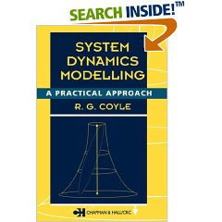
Recommended Reading
BUSINESS DYNAMICS –
  Systems Thinking and Modeling for a Complex World
  Prof J D Sterman
  ISBN 0-07-231135-5
SYSTEM DYNAMICS MODELLING
  A Practical Approach
  Prof R G Coyle
  ISBN 0-412-61710-2

Slide 64
Archetypes
Frequently recurring structures resulting from various combinations of Positive & Negative feedback loops.
Based on work in the book “Fifth Discipline” by Peter Senge (1990)
Can be downloaded from :
  http://www.systems-thinking.org/arch/vensim/archv.zip
  Accidental Adversaries
  Balancing Loop
  Drifting Goals
  Escalation
  Fixes That Fail
  Growth and Underinvestment
  Limits to Success
  Reinforcing Loop
  Shifting the Burden
  Success to the Successful
  Tragedy of the Commons

Slide 65

Introduction to Vensim

Slide 66


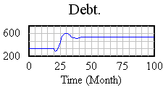
Vensim
Vensim is a visual modelling tool that allows you to:
conceptualise
document
Debt =
Income –
expenditure
£
simulate
analyse
optimise
Vensim provides a simple and flexible way of building simulation models from causal loop or stock and flow diagrams.

Slide 68
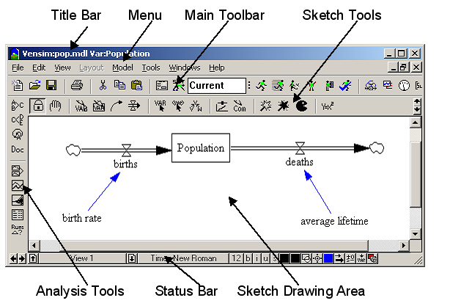
Vensim User Interface

Slide 69
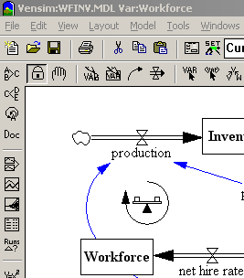
Title Bar
Displays the name of the model WFINV.MDL
Displays the name of the workbench variable: Workforce
The Workbench Variable is the currently selected model variable.
The Workbench Variable is selected clicking on a variable

Slide 70
Menu Bar
File menu contains common functions such as Open Model, Save, Print, etc.
Edit menu allows you to copy and paste selected portions of your model. You can also search for a variable in your model.
View menu has options for manipulating the sketch of the model and for viewing a model as text-only
Layout menu allows you to manipulate the position and size of elements in the sketch.
Model menu provides access to the Simulation Control and the Time Bounds dialogs, the model checking features, and importing and exporting datasets.
Tools menu sets Vensim's global options and allows you to manipulate Analysis tools , Sketch tools and set global options.
Windows menu enables you to switch between open windows.
Help Menu provides access to the on-line help system.
Next>>

Slide 71
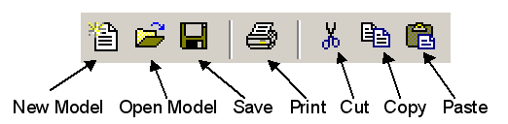
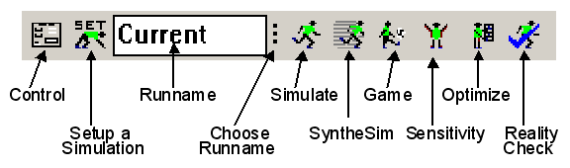
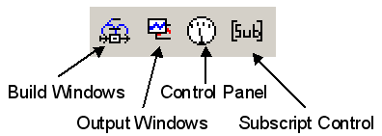
Tool Bar
Can be thought of in 3 sections
Standard Window Icons
Simulation control
Output control

Slide 72
Classes of Windows
Vensim contains several types or classes of windows:
Output Windows are created by Vensim's Analysis tools, and include graphs, tables and lists.
Build Windows are used for constructing new models, or for modifying, navigating, and simulating existing models.
Control Windows include the Control Panel, a tab dialog box used to control Vensim's internal settings, and the Subscript Control, used for defining and selecting subscripts.

Slide 73
Moving Among Window Classes
When a window is first selected or created, that window moves to the top and is active while all other windows become inactive. You can only work in the active window.
Four different methods allow you to move between the window classes:
  Click on the appropriate window button on the Toolbar.
  Press Ctrl + Shift + Tab to cycle among the window classes.
  From the Windows menu, select Pop Build Forward, Pop Output Forward, Control Panel, or Subscript Control.
  Use the mouse and click on the appropriate window (this only works if the window is visible).

Slide 74
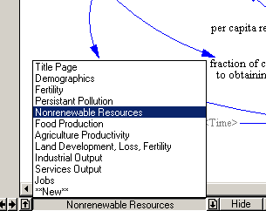
Build Window
Build Windows are used to create models in Vensim.
Models can be built from several different sketches or sketch views.
Each sketch view shows a part of the model, much like each page in a book tells part of a story.

Slide 75
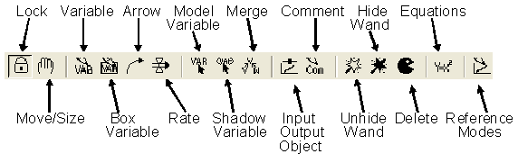
Sketch Tools
Sketch tools are grouped into a Sketch toolset.
Configurations allow you to choose and modify your Sketch toolsets by adding, moving and changing the actions of the different tools.
Customized toolsets can be saved to files and reopened for later use.
The built in Sketch toolset (default.sts) contains most of the Sketch tools needed for building models.

Slide 76
Lock — sketch is locked. Pointer can select sketch objects and the Workbench Variable but cannot move sketch objects.
Move/Size — move, sizes and selects sketch objects: variables, arrows, etc.
Variable — creates variables ( Constants, Auxiliaries and Data).
Box Variable — create variables with a box shape (used for Levels or Stocks).
Arrow — creates straight or curved arrows.
Rate — creates Rate (or flow) construct, consisting of perpendicular arrows, a valve and, if necessary, sources and sinks (clouds).
Model Variable — adds an existing model variable and the causes of that variable to the sketch view.

Slide 77
Shadow Variable — adds an existing model variable to the sketch view as a shadow variable (without adding its causes).
Merge — merges two variables into a single variable, merges Levels onto existing clouds, merges Arrows onto a variable to split an Arrow, and performs other operations.
Input Output Object — adds input Sliders and output graphs and tables to the sketch.
Sketch Comment — adds comments and pictures to the sketch.
Unhide Wand — unhides (makes visible) variables in a sketch view.
Hide Wand — hides variables in a sketch view.
Delete — deletes structure, variables in the model, and comments in a sketch.
Equations — creates and edits model equations using the Equation Editor.
Reference Modes — use to draw and edit reference models

Slide 78
Status Bar
The Status Bar shows the state of the sketch and objects in the sketch.
The Status Bar contains buttons for changing the state of selected objects, and moving to another View.
A number of sketch attributes can be controlled from the Status Bar, including:
Change characteristics on selected variables; font type, size, bold, italic, underline, strikethrough.
Set the hide level.
Variable colour, box colour, surround shape, text position, arrow colour, arrow width, arrow polarity etc.

Slide 79
Build Window
In addition to building models, you can use the build window to perform simulation tasks.
Most importantly, you can enter Simulation Setup mode and SyntheSim mode from the build window.
In Simulation Setup mode all model Constants and Lookups will be highlighted.
.

Slide 80
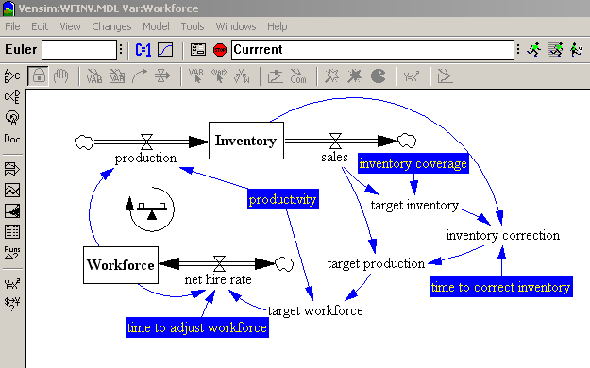
Simulation Setup Mode
By clicking on them you can make temporary changes to the values to be used for a simulation.

Slide 81
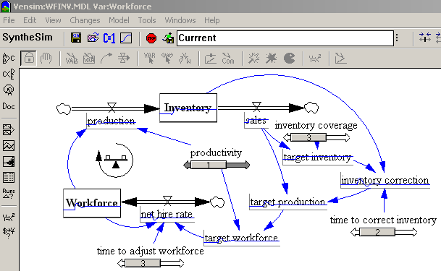
SyntheSim Mode
In SyntheSim mode each model Constant will have a slider attached that you can use to adjust values

Slide 82

Analysis Tools
The Analysis tools are used to show information about the Workbench Variable, either its place or value in the model, or its behaviour from simulation datasets.
Analysis tools are grouped into toolsets.
In Vensim Pro & DSS configurations the Analysis toolsets can be modified
The built in toolset (also named default1.vts) and the more complete toolset default2.vts contain many of the Analysis tools needed for investigating models.

Slide 83
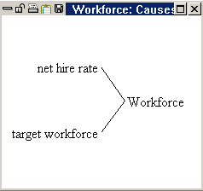
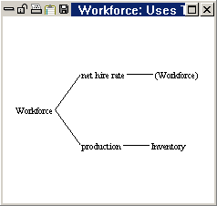
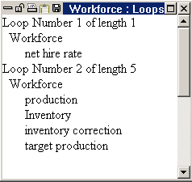
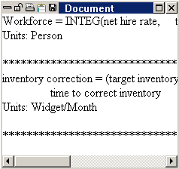
Structural Analysis Tools
Causes Tree — creates a tree-type graphical representation showing the causes of the Workbench Variable.
Uses Tree — create a tree-type graphical representation showing the uses of the Workbench Variable.
Loops — displays a list of all feedback loops passing through the Workbench Variable.
Document - equations, definitions, units of measure, and selected values for the Workbench Variable.

Slide 84
Dataset Analysis Tools
Causes Strip Graph — displays simple graphs in a strip, allowing you to trace causality by showing the direct causes (as shown) of the Workbench Variable.
Graph — displays behaviour in a larger graph than the Strip Graph, and contains different options for output than the Strip Graph.
Sensitivity Graph — creates a sensitivity graph of one variable and its range of uncertainty generated from sensitivity testing.
Bar Graph — creates a bar graph of a variable at a specific time, or displays a histogram of variables over all times or across sensitivity simulations at a time.
Table — generates a table of values for the Workbench Variable.
Table Running Down — table with time running down.
Runs Compare — compares all Lookups and Constants in the first loaded dataset to those in the second loaded dataset.
Statistics — provides summary statistics on the Workbench Variable and its causes or uses.
Dimension Checker – Checks units of equations correctly match

Slide 85
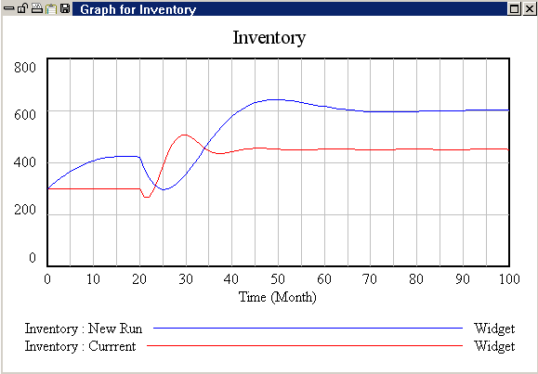
Graph Output
Close
Print
Save
Lock
Copy
Units
Variable Name
Run Name

Slide 86
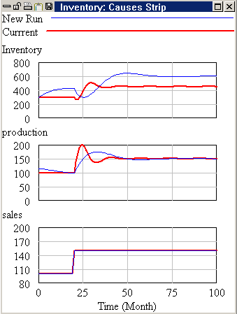
Causes Strip Graph
displays simple graphs in a strip
allows you to trace causality by showing the direct causes of the Workbench Variable
Workbench
Variable
Direct Causes

Slide 87
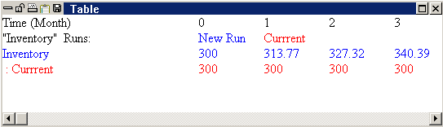
Table Output
Workbench
Variable
Simulation Runs
The Table tool displays numerical values for the Workbench Variable
Optionally can be configured to display its causes or uses.

Slide 88
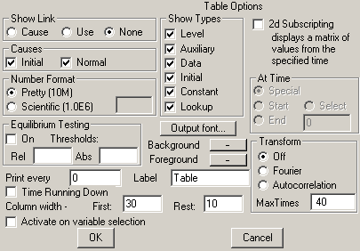
Configuring Analysis Tools
Check to display causes in table
All analysis tools can be customised.
Right-click on the tool icon to display the tool options.

Slide 89
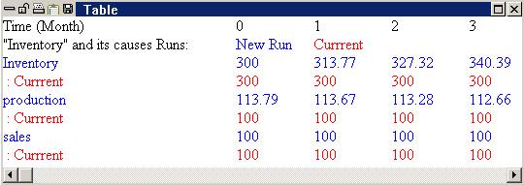
Causal Table
Simulation Runs
Workbench
Variable
Direct
Causes
displays simple table of Workbench variable
allows you to trace causality by showing the direct causes of the Workbench Variable

Slide 90
Customising & Saving Toolsets
Toolsets are saved as files and you can open them, save them, and create new ones just as with any file.
Vensim will only allow you to open one Sketch Toolset and one Analysis Toolsets at a time.
Opening or starting a new toolset closes the old one.
When you exit Vensim, it remembers the toolsets you were working with and next time Vensim starts with these toolsets loaded.
If Vensim cannot find the toolset you were last using, it will open the default toolset.

Slide 91
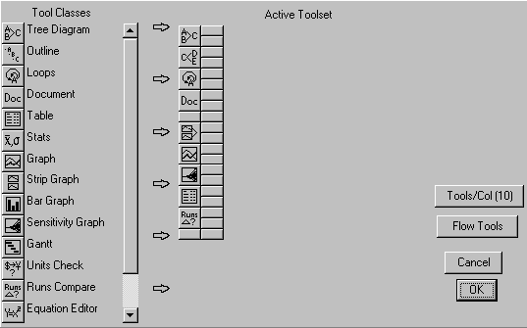
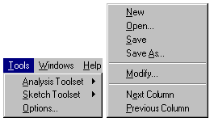
Modifying Toolset
Tool Classes shows a list of the available tools to work with
Active Toolset shows you the tools in the currently active Toolset.

Slide 92
Modifying Toolset
You can drag the tools from one location to another by positioning the mouse over the tool, pressing the left mouse button and moving the mouse.
If you drop the tool on top of a tool it will be inserted above the tool. If you drag a tool away from the active Toolset, it will be removed.
Change no. Slots in Active Toolset
flows the tools together getting
rid of extra spacing and short columns

Slide 93
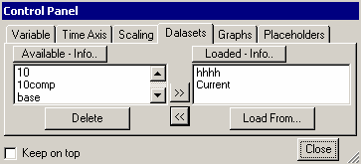
Control Panel
The Control Panel allows you to change internal settings that govern the operation of Vensim, eg which Workbench Variable is selected or what Datasets are loaded.

Slide 94
Control Panel
Variable allows you to choose a variable in your model and select it as the Workbench Variable.
Time Axis allows you to change or focus the period of time over which Analysis tools operate.
Scaling enables you to change the scales of output graphs.
Datasets allows you to manipulate the stored datasets (runs).
Graphs brings up the Custom Graph Control.
Placeholders is a control that sets Placeholder Values

Slide 95
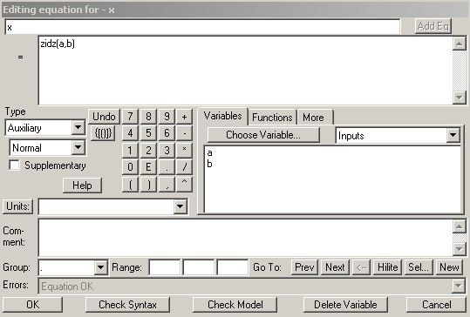
Specifying Variable Units
The units of measure are used to check a model for dimensional consistency.
Type the variable's units of measurement in the editing box.
Units of measure are restricted to using only * / and ( ) operators.
In addition to being able to type in Units, a list of the existing units of measure is available (this list also include the commonly used Dmnl)

Slide 96
Dimensions
Each Variable should be assigned dimensions
Vensim will check dimensional consistency of all equations written
Units on left of “=“ sign, match those derived from the equation elements on the right of “=“
  Speed = Distance Covered / Time Taken
  Speed : km / hour
  Distance Covered : km
  Time Taken : Hour

Slide 97
Units Checking
When you check the units in a model, Vensim will report a list of errors that have been found.
Units check errors do not prevent simulation, but fixing units problems can sometimes find problems that might otherwise have been overlooked.
If you do not specify units of measurement for model variables, checking the units will simply report the name of each variable that has not had its units specified.

Slide 98
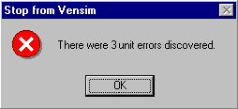
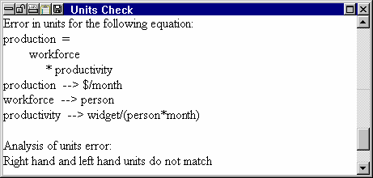
Unit Checker Output
Two types of messages:
  Errors indicating dimensional inconsistency.
  Warnings indicating that you have not defined the units of measure for a variable, or that you are using a dimensioned variable as input to a Lookup table.

Slide 99
Common Dimension Errors
The left and right hand side of an equation do not have the same units of measure.
Addition, subtraction, and comparison (<, = and so on) are performed on variables (or expressions) having different units of measure.
Functions are called with arguments having units of measure inconsistent with what the function requires. See Chapter 4 for details on individual functions.
Unit synonyms : Miles -> Mile

Slide 100
Vensim Inbuilt Constants

Slide 101
Vensim Modelling Tutorial
Putting System Dynamics Methodology together with Vensim

Slide 102
Exercise 1
Consider a simple bank account where 10 Swiss Francs are deposited each year. Sketch the expected behaviour of the balance over time.
  Initial bank balance = 0
  Amount of money deposited each year = 10
  NO spending or interest
How much money will there be after 10 years in the account ?

Slide 103
Exercise 1 – Sketch Reference Mode

Slide 104
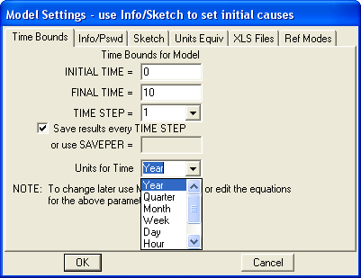
Creating New Vensim Model
Open Vensim
File > New Model
Click OK

Slide 105
Time Step
The interval between calculations
Must be equivalent to a binary fraction
  1, 0.5, 0.25, 0.125, 0.0625… (1, ½ , ¼ , …)
Small enough to capture smallest delay of significance
Stock(t + Δt)
Stock(t)
Inflows in Δt
Outflows in Δt
time
Time Step
t
t + Δt

Slide 106
Calculation Sequence
Initial Stock Values
Stock Values (t)
Increment time t = t + Δt
Calculate Flows for within (t + Δt)
Stock Values (t + Δt )
  Vensim calculations based on 3 time points : Previous, Now, Next
  After each Δt :
    Now becomes Previous
    Next becomes Now
    New Next assigned

Slide 107
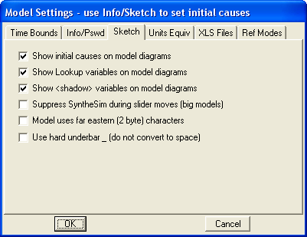
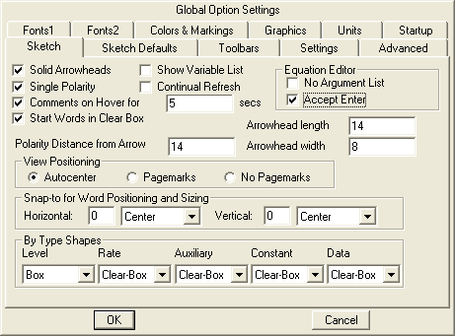
Vensim Starting Conditions
Model>Settings>Sketch
Tools>Options>Sketch

Slide 108
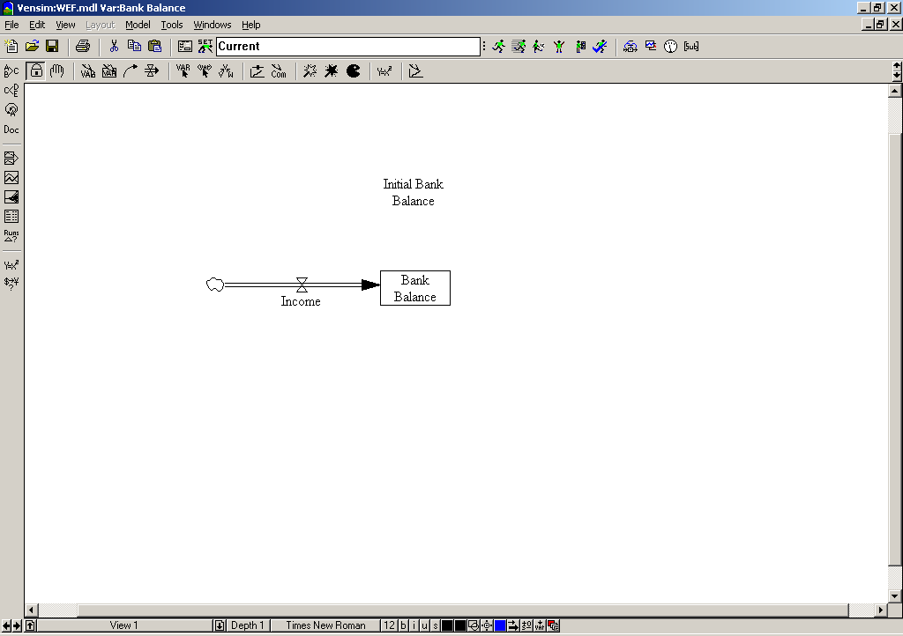
Blank Model
Sketch Tools
Analysis Tools

Slide 109
Blank Model
Sketch Tools
Analysis Tools
Select tool
Click in middle of window
Click One
When prompted, enter ‘Bank Balance’ as name

Slide 110
Blank Model
Sketch Tools
Analysis Tools
Select tool
Click once to left of Bank Balance
Click One inside Bank Balance
When prompted, enter ‘Income’ as name
If you make a mistake, use PacMan to delete

Slide 111
Blank Model
Sketch Tools
Analysis Tools

Slide 112
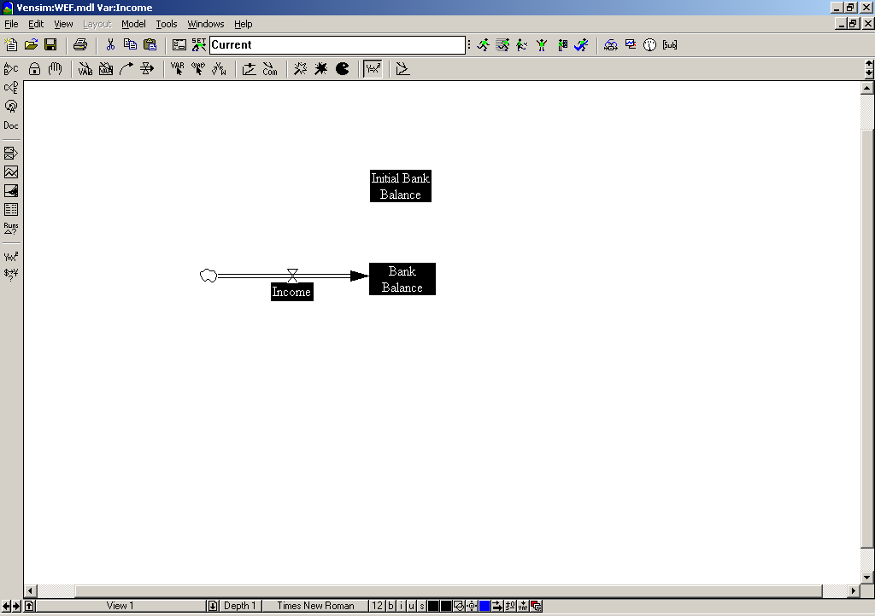
Bank Model
Select Equation Editor tool
Undefined variables are highlighted in black
Once equations have been written, black
highlight will disappear
Click on ‘Initial Bank Balance’

Slide 113
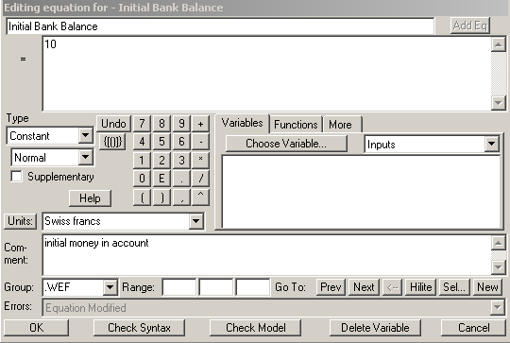
Bank Model
0
Select Equation Editor tool
Undefined variables are highlighted in black
Once equations have been written, black
highlight will disappear
Click on ‘Initial Bank Balance’

Slide 114
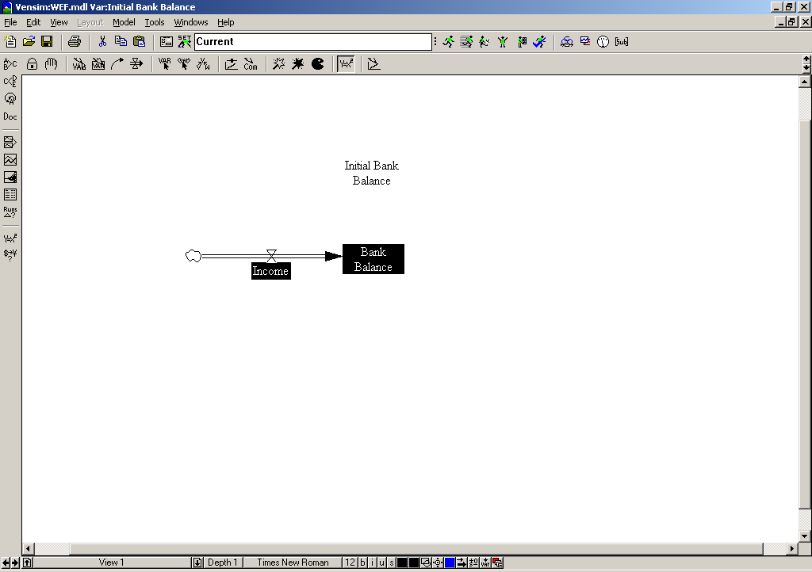
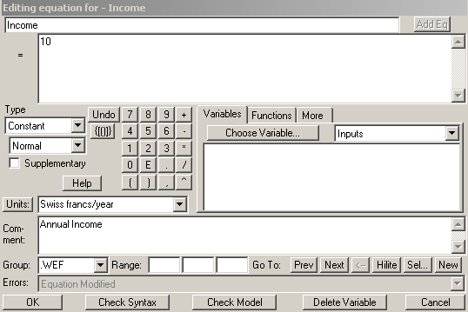
Bank Model
Initial Bank Balance un-highlighted
Select Equation Editor tool
Click on ‘Income’
Enter Value, Dimensions & Description
Select Equation Editor tool
Undefined variables are highlighted in black
Once equations have been written, black
highlight will disappear
Click on ‘Initial Bank Balance’

Slide 115
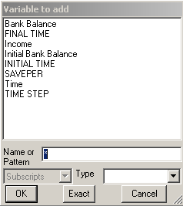
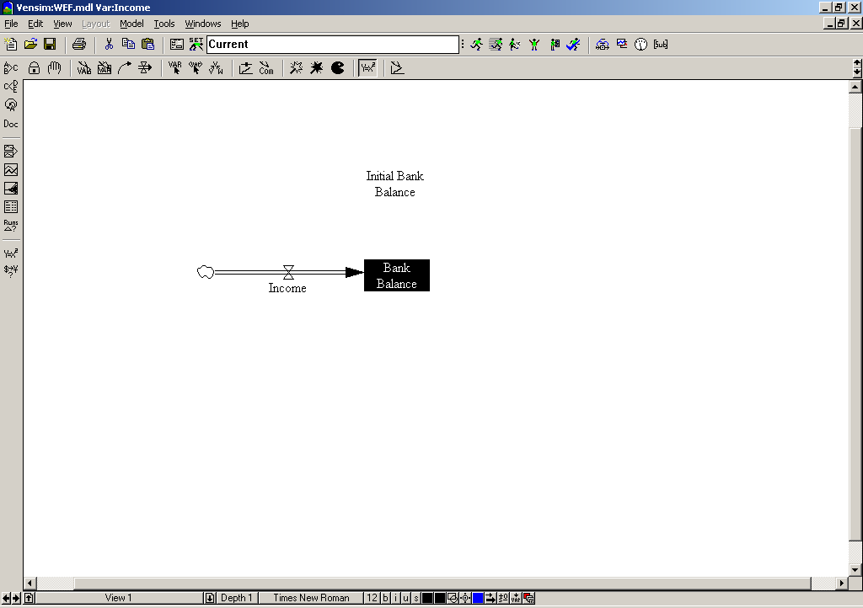
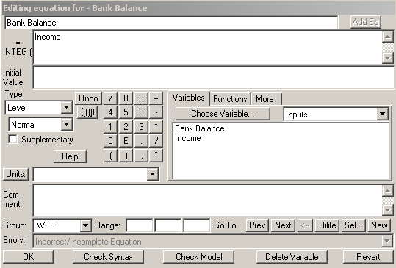
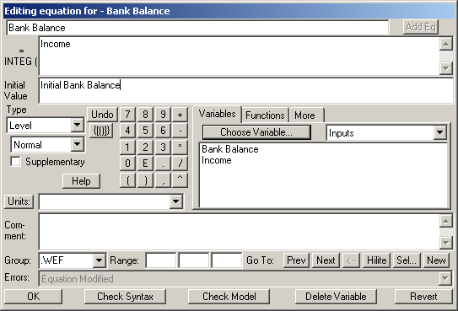
Bank Model
Initial Bank Balance un-highlighted
Select Equation Editor tool
Click on ‘Income’
Enter Value, Dimensions & Description
Select Equation Editor tool
Click on ‘Bank Balance’
Different “style” editor box : two windows
Upper window already has ‘income’
Lower window is for Initial Value
Click in lower window
Click on Choose Variable
Select ‘Initial Bank Balance’
Enter Dimensions and Description
Select Equation Editor tool
Undefined variables are highlighted in black
Once equations have been written, black
highlight will disappear
Click on ‘Initial Bank Balance’

Slide 116

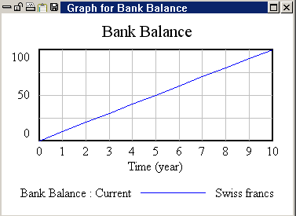
Bank Model
Select ‘Run Simulation’ Button
If prompted to over-write Current.VDF, say Yes
Click on Bank Balance to make it the workbench parameter
Select Graph Tool

Slide 117
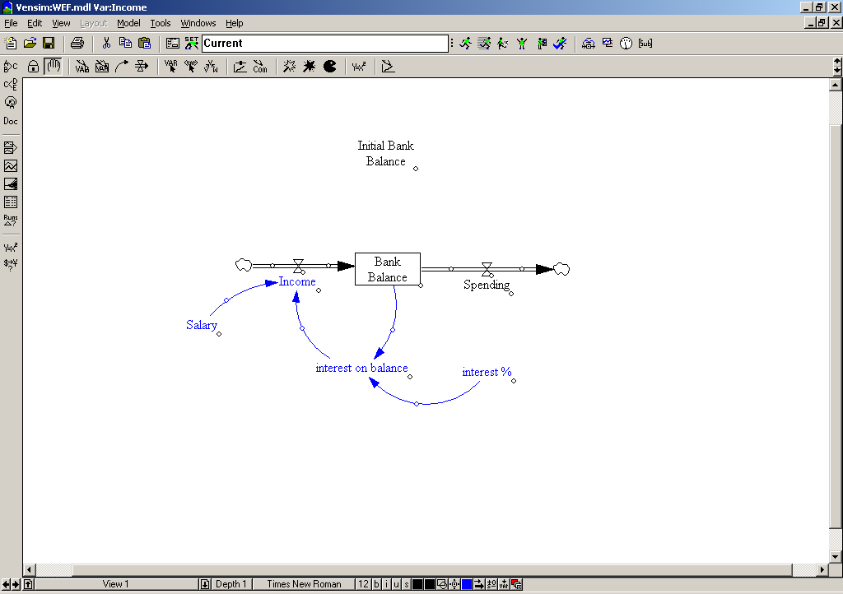
Bank Model
Add new blue structure
Interest 4%
Salary 10 SwissFrancs
Formulate new equations
What if bank balance is negative ?

Slide 118
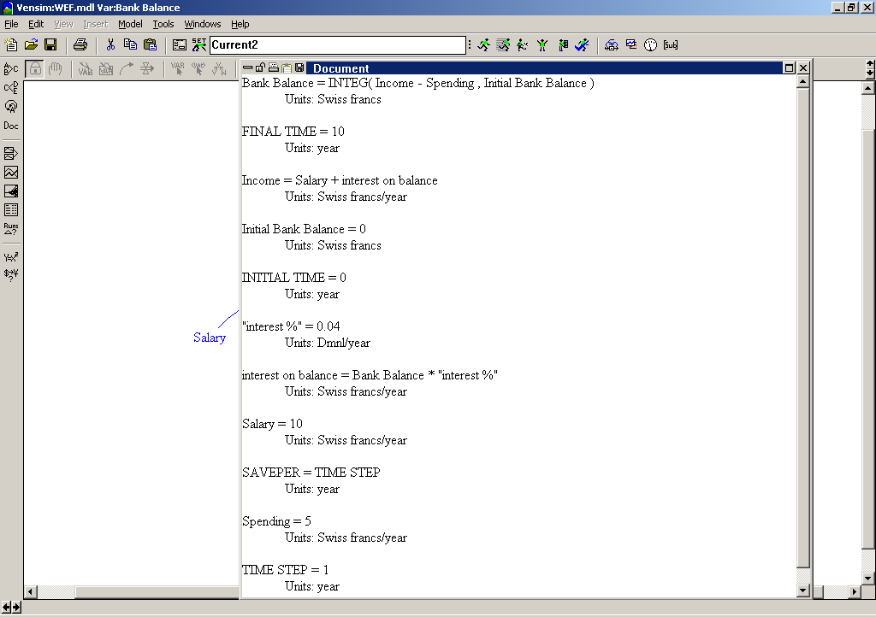
Documented Equations

Slide 119
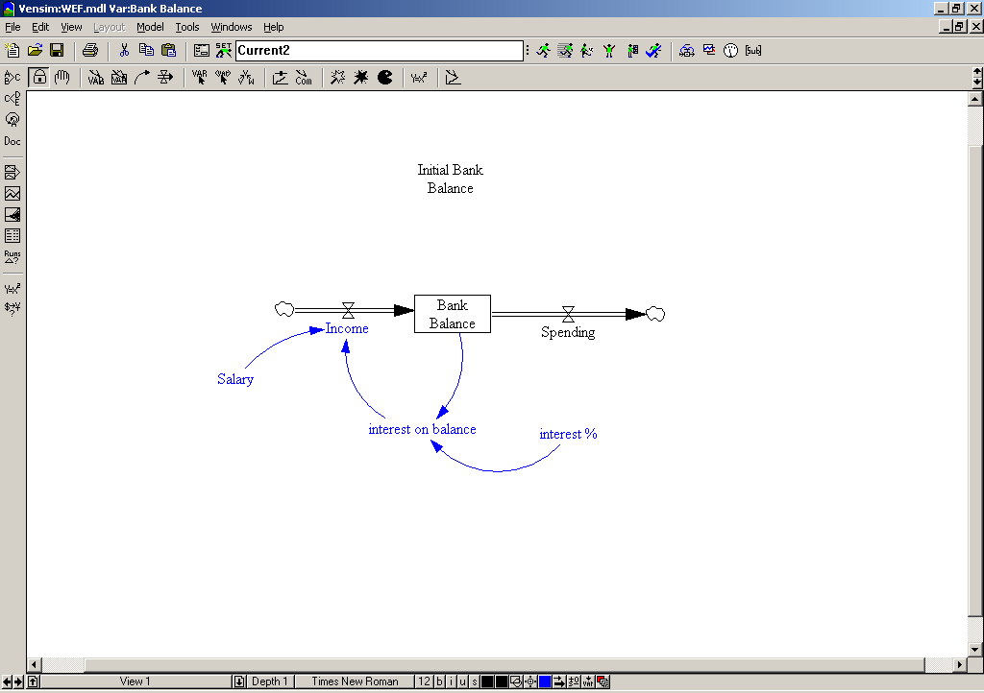
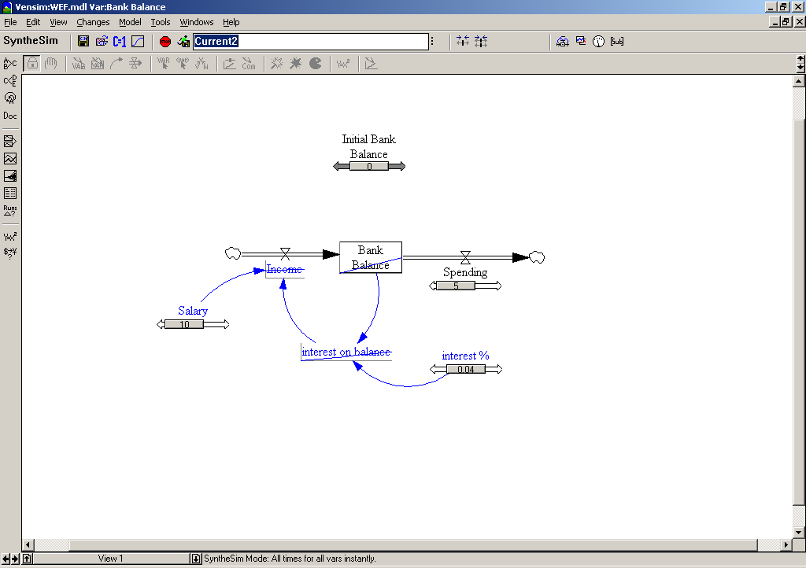
Synthesim
Click on Synthesim button
Sliders appear next to constants
Mini graphs appear on other variables when you hover over them
Move sliders to see changes

Slide 120
Common Functions
Min / Max
If then else
Zero if divide by Zero
STEP
PULSE

Slide 121
Minimum & Maximum
Model Structure
Model Equations
X = MAX(a,b)
X = MIN(a,b)

Slide 122
If Then Else
Model Structure
Function
X = IF THEN ELSE(condition,if true,if false)
Model Equations
X = IF THEN ELSE(a>b,a,b)

Slide 123
ZIDZ – Zero if Divide By Zero
Model Structure
Function
X = ZIDZ(nomiator,denominator)
Model Equations
X = ZIDZ(a,b)

Slide 124
STEP
Model Structure
Function
X = STEP(step height,step time)
Model Equations
X = STEP(a,b)
A=10
B =20

Slide 125
PULSE (creates pulse of value 1)
Model Structure
Function
X = PULSE(start , duration )
Model Equations
X = PULSE(a,b)
A=10
B =20

Slide 126
Available Function Libraries
Common functions are the most often used and this is the default list the Equation Editor presents.
Simple functions have no inherent dynamics. They determine the value of output based solely on the current values of inputs. A function, in mathematical usage, usually refers toa simple function.
All lists all the built-in and external functions - essentially everything in this chapter plus any external function that might have been created. It does not list Lookups or User Macros.
Dynamic functions impart some dynamics, so that the output depends on more than the current value of inputs. Dynamic functions in Vensim are implemented as Macros to enable complete causal tracing.
Discrete/Delay functions are functions that introduce delays and are useful for tracking discrete elements including attributes in queues.
Financial functions are functions that allow the adding up and manipulation of things within a fiscal period that might be different from the Time Step of the model. These functions operate like both Dynamic and Simple functions at the same time.
Lookup functions are those that have been defined for the model.
Reality Check functions are those that relate to writing Reality Check Equations. These can only be used in Reality Check equations.
Data Only functions are only used with data. Data equations relate to vectors of values over time, and the data-only functions allow some additional manipulation of those vectors.
Array functions are those that relate to arrays (SUM and so on).
Macros are Macros that you have entered into the model using :MACRO: definitions.
User Defined‡function are ones that have been added through the use of an external function DLL.

Slide 127
Summary of Predefined Functions
ABS(A) Returns the absolute value of A.
ACTIVE INITIAL(A,N) Defines an Auxiliary with distinct active and initial values.
ALLOCATE AVAILABLE(r,pp,a) † Allocates a scarce resource based on the request r, the amount available a and a preference profile pp.
ALLOCATE BY PRIORITY(req,prio,siz,wid,sup)† Allocates a scarce resource based on the request, priority and supply over size elements with width determining sharing.
ALLOC P(req,prio,wid,mp)† Like ALLOCATE BY PRIORITY but using mp from MARKETP.
:AND: Logical AND (Chapter 2).
ARCCOS(X) Arc-cosine of X in radians.
ARCSIN(X) Arc-sine of X in radians
ARCTAN(x) Arc-tangent of X in radians.
:AT LEAST ONCE: Relation must be true at least once for a Reality Check.
COS(X) Cosine of X.
COSH(X) Hyperbolic cosine of X.
:CROSSING: Lines must cross for Reality Check Consequence.
CUMULATE(A) Cumulates values for the data series A.
CUMULATEF(A) Cumulates data series A and stores only the final value as the result.
DELAY BATCH(X,S,T,IS,IT,IB) Holds the input X till S cumulates then delays T. First batch IS output at IT with IB already cumulated for the next batch.
DELAY CONVEYOR(X,T,L,IP,I,IT) Delays the input X on a conveyor for time T with leakage L. IP is the time profile of the initial material I which will has an initial convey time IT.
DELAY FIXED(X,T,I) Delays the input X for a fixed time T starting with I.
DELAY INFORMATION(X,T,I) Delays the input X for a variable time T starting with I discarding inputs if T decreases and holding inputs if T increases.
DELAY MATERIAL(X,T,I,M) Delays the input X for a variable time T starting with I and conserving X except that M is used if no delayed inputs are available.
DELAY N(X,T,I,N) N'th order exponential delay of the input X starting at I and conserving X.
DELAY PROFILE(P,X,T,I,G) An arbitrary delay of X with average delay time T distributed over a profile P (a Lookup) with initial value I initially growing at rate G.
DELAY1(X,T) First order exponential delay of X for time T conserving X.
DELAY1I(X,T,I) Same as DELAY1 but starting at I.
DELAY3(X,T) A third order exponential delay of X for time T conserving X.
DELAY3I(X,T,I) Same as DELAY3 but starting at I.
DELAYP(X,T:P) Same as DELAY3 but also returning P the amount in the pipeline.

Slide 128
Predefined Functions
DEMAND AT PRICE(q,pp,pr) † The quantity demanded given a satiation demand q, preference profile pp and price pr.
DEPRECIATE BY SCHEDULE(P,S,I,T,FS) † Depreciate a payment stream P over time T according the to schedule S with initial values I and the fiscal period starting at FS.
DEPRECIATE STRAIGHTLINE(P,T,F,I) † Depreciate a payment stream P over time T with Fiscal Period F and having initial output I.
ELMCOUNT(sub)† Returns the number of elements in the Subscript Range sub.
:END OF MACRO: † Marks the end of a macro definition (Chapter 2).
EXP(X) Returns e(2.718...) to the X power.
FIND ZERO(...)† Used to find a zero value for a vector.
FORECAST(I,A,H) Forecast for I over the time horizon H using an averaging time A.
GAME(X) X except during gaming mode when the user input is used.
GAMMA LN(X) Returns the natural log of GAMMA function on X (log of (X-1) factorial for integers).
GET 123 CONSTANTS('f','t','c') Constants from tab 't' of the 123 file 'f' starting at cell 'c'.
GET 123 DATA('f','t','r','c') Data from tab 't' of the 123 file 'f' starting at cell 'c' time in row or column 'r'.
GET DATA AT TIME(D,T) The value for the data variable D at time T or :NA: if not available.
GET DATA BETWEEN TIMES(D,T,M) The value for the data variable D at T using interpolation rule M :NA: if out of range.
GET DATA FIRST TIME(D) The first Time at which the data variable D has a value.
GET DATA LAST TIME(D) The last Time at which the data variable D has a value.
GET DATA TOTAL POINTS(D) The total number of values for the data variable D.
GET XLS CONSTANTS'f','t','c') Constants from tab 't' of the Excel file 'f' starting at cell 'c'.
GET XLS DATA('f','t','r','c') Data from tab 't' of the Excel file 'f' starting at cell 'c' time in row or column 'r' (if 'r' is a number time is read across, if a letter time is read down).
:HOLD BACKWARD: Specifies that data should be used by holding the last value (Chapter 2).
IF THEN ELSE(cond,X,Y) Returns X if condition is non-zero, otherwise Y.
:IGNORE: Separate causes not yet used (Chapter 8). Also used in Reality Check.
:IMPLIES: The implication portion of a Reality Check.
INITIAL(A) Returns the value of A at initialization time and holds it constant.
INTEG(R,N) Performs numerical integration of R starting at N (defines a Level).
INTEGER(X) Returns the integer part of X.
:INTERPOLATE: Specifies that data should be interpolated between points (Chapter 2).
INTERNAL RATE OF RETURN(s,f,I,t) Computes the internal rate of return of stream s with fiscal period f and initial investment/payment I made at time t.

Slide 129
Predefined Functions
INVERT MATRIX(M,n) † Inverts the Matrix M of dimension n.
:IS: Used for assignment of string constants (Chapter 2).
LN(X) Natural logarithm of X.
LOG(X,Y) Base Y logarithm of X.
:LOOK FORWARD: For data look forward to the next value (Chapter 2).
LOOKUP AREA(L,X1,X2) Area under the lookup L between X1 and X2.
LOOKUP BACKWARD(L,X) The y value of L from to the largest x value smaller than or equal to X.
LOOKUP EXTRAPOLATE(L,X) Returns a lookup value determined by extrapolating the extreme entries.
LOOKUP FORWARD(L,X) The y value of L from to the first x value greater than or equal to X.
LOOKUP INVERT(L,Y) The x value that would return Y when used in the Lookup L.
LOOKUP SLOPE(L,X,M) The slope of the lookup L at X interpolating with mode M out of range.
:MACRO:† Begins a macro definition (Chapter 2).
MARKETP(req,prio,siz,wid,sup)† Returns the market priority (mp) for use with the ALLOC P function.
MAX(A,B) The larger of A and B.
MESSAGE('msg',d) Displays the Message 'msg' with display type d.
MIN(A,B) The smaller of A and B.
MODULO(X,B) The remainder resulting from dividing X by B.
:NA: Special symbol denoting the missing value (Chapter 2).
:NOT: Logical NOT (Chapter 2).
NPV(S,D,I,F) Net Present Value of S with discount rate D starting at I multiplied by F.
NPVE(S,D,I,F) End of period net Present Value of S with discount rate D starting at I multiplied by F.
NET PRESENT VALUE(S,D,F,FS,FO) Compute the net present value of S usind discount factor D on fiscal period F starting at FS and discount FO into the period.
:OR: Logical OR (Chapter 2).
POWER(A,B) Raises A to the B power (same as A^B).
PROD( X[r!])† The product of all instances of X in the Subscript Range r.
PULSE(S,D) A pulse of height 1.0, starting at time S and lasting D time units.
PULSE TRAIN(S,D,R,E) A repeated pulse of height 1.0, starting at time S, lasting B time units and repeating every R time unit until time E.
QUANTUM(A,B) Largest number <= A that is an integer multiple of B.

Slide 130
Predefined Functions
QUEUE AGE AVERAGE(Q,X) Average age of oldest X elements in the queue Q.
QUEUE AGE IN RANGE(Q,M,X) Number of elements in a queue between ages M and X inclusive.
QUEUE AGE OLDEST(Q) Age of the oldest element of the queue Q.
QUEUE ATTRIB AVERAGE(Q,X) Average attribute value of the oldest X elements in the queue Q.
QUEUE ATTRIB IN RANGE(Q,M,X) The number of elements of Q with attributes between M and X inclusive.
QUEUE ATTRIB MAX(Q) Returns the maximum value of the attribute in the queue Q.
QUEUE ATTRIB MIN(Q) Returns the minimum value of the attribute in the queue Q.
QUEUE ATTRIB QUANTITY(Q,X) Number of elements in queue Q required to have a total attribute of X.
QUEUE FIFO(I,O,P,N,T) Performs numerical integration of input I and output O tracking age with initial age distribution profile P (a Lookup) of quantity N over time T. The attrib
QUEUE FIFO ATTRIB(I,O,A,R,P,Q,N,M,T) variation adds in an incoming attribute A, a rate R at which existing attributes change, an initial distribution multiplier Q of the initial attribute M.
RAMP(S,T1,T2) 0 till T1 then a ramp with slope S until T2 and then constant.
RANDOM ... Return random variable. Almost all RANDOM functions have the common
RANDOM BETA(m,x,A,B,h,r,s) arguments m -minimum, x-maximum, h-shift relative to the referenced
RANDOM BINOMIAL(m,x,P,N,h,r,s) distribution, r-stretch relative to reference, s-seed. Additional arguments are:
RANDOM EXPONENTIAL(m,x,h,r,s) BETA alpha=A and beta-B. BINOMIAL on N trials of probability P (always
RANDOM GAMMA(m,x,O,h,r,s) an integer). EXPONENTIAL starting at 0 with mean 1. GAMMA of order O.
RANDOM LOOKUP(l,m,x,h,r,s) LOOKUP using the supplied lookup function as a probability density
RANDOM NEGATIVE BINOMIAL(...) function. NEGATIVE BINOMIAL for N successes with probability P (integer
RANDOM NORMAL(m,x,h,r,s) >= N). NORMAL with mean 0 and variance 1. POISSON with mean M
RANDOM POISSON(m,x,M,h,r,s) (always returns an integer). TRIANGULAR between S and T with peak at P.
RANDOM TRIANGULAR(m,x,S,P,T,s) WEIBULL with shape S starting at 0 with mean 1. The obsolete function
RANDOM UNIFORM(m,x,s) RANDOM 0 1 takes no arguments and returns a number uniformly
RANDOM WEIBULL(m,x,S,h,r,s) distributed between 0 and 1.
:RAW: Marks data as raw so :NA: is reported for missing values (Chapter 2).
RC COMPARE('r',var,f[,s[,d]]) Set output to f times var's value in run 'r' with optional start time and d
uration
RC COMPARE CHECK('r',var,g,f[,s[,d]]) After grace period g compare to f times var in 'r'.
RC DECAY(e,t[,s[,d]]) Set output to e decaying over t with optional start time and duration.
RC DECAY CHECK(g,e,t[,s[,d]]) After grace period g compare to e decaying over time t.

Slide 131
Predefined Functions
RC GROW(e,g[,s[,d]]) Set output to e growing at rate g with optional start time and duration.
RC GROW CHECK(g,e,t[,s[,d]]) After grace period g compare to e growing at rate g.
RC RAMP(e,f[,st]) Set output to ramp to f times e over t with optional start time and duration.
RC RAMP CHECK(g,e,f[,st]) After grace period g compare to a ramp to e times f over ramp time t.
RC STEP(e,f[,st]) Set output to f times e with optional start time and duration.
RC STEP CHECK(g,e,f[,st]) After grace period g compare to e times f.
REINITIAL(A) Holds first value of A but, unlike INITIAL, recomputes on resumed run.
SAMPLE IF TRUE(B,X,N) Returns X if B is true otherwise holding the value. Starts with N.
SHIFT IF TRUE(V,B,N,A,I)† Shifts N elements of V if B is true accumulating if A is non-zero. The first element of V is replaced by I.
SIN(X) Returns the sine of X measured in radians.
SINH(X) Returns the hyperbolic sine of X measured in radians.
SINTEG(R,I,m,x,Q,S,T) Performs numerical integration of R starting at I but stays bigger than m, smaller than x, is quantized by Q and is S when within T of S.
SMOOTH(X,T) Returns a first order exponential smooth of X over time T.
SMOOTH N(X,T,I,N) Returns a N'th order exponential smooth of X over time T starting at I.
SMOOTH3(X,T) Returns a third order exponential smooth of X over time T.
SMOOTH3I(X,T,I) Returns a third order exponential smooth of X over time T starting at I.
SMOOTHI(X,T,I) Returns a first order exponential delay of X over time T starting at I.
SQRT(X) Returns the square root of X.
STEP(H,T) Returns 0 till time T and then H.
SUM( X[r!] )† Returns the sum of instances of X in the Subscript Range r.
SUPPLY AT PRICE(q,pp,pr) † The quantity supplied given a capacity q, preference profile pp and price pr.
TABBED ARRAY( a b
x y)† Used to input tab delimited numbers as arrays of constant values.
TAN(X) Returns the tangent of X (radians).
TANH(X) Returns the hyperbolic tangent of X.
:TEST INPUT: Defines a test input equation for use with Reality Check.
:THE CONDITION: Precedes the predicate condition of a Reality Check.
TIME BASE(start,slope) Defines a time base for output customization.
TIME SHIFT(data,shift) Shifts data in time.
TIME TRANSITION(T1,...) Obsolete.

Slide 132
Predefined Functions
TREND(I,H,N) Returns the fractional change rate of I over horizon H starting with N.
VECTOR ELM MAP(vec,offset) Extracts elements of a vector without directly using their subscripts.
VECTOR RANK(vec,dir) Returns the rank values for a vector in increasing or decreasing order.
VECTOR REORDER(vec,svec) Reorders the vector according the specified sort order.
VECTOR SORT ORDER(vec,dir) Returns the sort order for a vector in increasing or decreasing order.
VMAX(X[r!])† Takes the maximum of X over the subscript range r.
VMIN(X[r!])† Takes the minimum of X over the subscript range r.
WITH LOOKUP(x,L#) Returns the y value of the xy pairs L# corresponding to x.
X IF MISSING(expr,X)† Replaces missing data with X specified value.
XIDZ(A,B,X) Returns X if dividing by zero (B =0) otherwise returns A divided by B.
ZIDZ(A,B) Zero (0.0) if dividing by zero (B=0) otherwise returns A divided by B

Slide 133
Exercises

Slide 134
Exercise 1
Consider the re-introduction of wolves into Scotland and sketch the expected behaviour of the population over time.
  Initial number of wolves = 0
  Wolves are introduced at a rate of 5 pairs every year
  NO births and NO deaths
How many wolves will there be after 10 years of this policy?

Slide 135
Exercise 1 - Wolf Model (Wolves1)

Slide 136
First Order Positive Feedback Loop
So called because there is only one level involved in the feedback loop.
Examples of such structures include; bank accounts gaining interest and population growth.
Characterised by a constant doubling time.
  Doubling time is the period required for the level to double in value. It can be approximated to 0.7/growth rate
Exponential growth

Slide 137
Exercise 2
After 2 years the introduced wolves begin to reproduce.
On average, 0.5 wolves are born and survive, each year, for each wolf in the population.
Sketch the population of wolves over the 10 years following the introduction of the initial wolves (I.e. start with the 10 pairs of wolves introduced in the first 2 years).
How long before the population reaches 80?

Slide 138
Exercise 2 - Sketch
0.7/0.5 = 1.4 year doubling time. After 2.8 years, population is 80

Slide 139
Exercise 2 – Computer Model
Use Vensim to create the population growth model.

Slide 140
Exercise 2 – Wolf Model (Wolves2)
Stock and Flow Diagram

Slide 141
First Order Negative Feedback Loop
So called because there is only one level involved in the feedback loop.
Examples of such structures include; bank accounts attracting charges when overdrawn and population decline.
Characterised by a constant halving time.
  Halving time is the period required for the level to halve in value. It can be approximated to 0.7/decline rate
Goal seeking behaviour
Special case: goal = constant = 0 = Exponential decay

Slide 142
Exercise 3
Some years in the future, pressure from farmers and land owners lead to policy change; the wolves have to go (the goal is 0 or negligible wolf population).
One policy under consideration is to make female wolves infertile.
Assume 5% of the population die each year.
Starting with a healthy population of 1000 wolves, how long will the above policy take to reduce the wolf population to a negligible number? (say, ~ <100)
Sketch the behaviour of the wolf population under this policy.

Slide 143
Exercise 3 - Sketch
0.7/0.05 = 14 year halving time. After ~ 56 years, population is “negligible” (75)

Slide 144
Exercise 3 – Computer Model
Use Vensim to create the population decline model.

Slide 145
Exercise 3 – Wolf Model (Wolves3)
Stock and Flow Diagram

Slide 146
Exercise 4 – Computer Model (wolves4)
Create Vensim model combining wolf births and deaths
There are no wolves at the start of the simulation
Fertility factor is 0.5 per wolf
Mortality factor is 5% per annum
2 Wolves are introduced per year from outside the area
How many wolves will there be in 10 years time ?
What mortality fraction per year would be required to have just 100 wolves after 10 years ?

Slide 147
Exercise 4 – Wolf Model (Wolves4)

Slide 148
Mass Balance Check

Slide 149
Mass Balance Check

Slide 150
Lookups

Slide 151
Building a Function with Lookups
It is often easiest to create special functions with the properties or shape that you want.
Lookups allow you to define customised relationships between a variable and its causes.
An equation can be defined with a specially-constructed function:
  y = my function(x)
The output variable y is changed by input variable x through the Lookup function my function, which has a (typically nonlinear) shape that you specify.
Lookups are also known as Lookup Functions, Graphical Functions, Lookup Tables, or simply Tables. They can be constructed as a table of numbers (in the Equation Editor), or as a graph (in the Graph Lookup Editor).

Slide 152
Simple Rabbit Model
Consider the consequences of population growth in an environment with a limited carrying capacity.
The unchecked growth of the model below is unrealistic.
Growth is limited by the size of the population relative to the carrying capacity of the local environment.

Slide 153
More Realistic Rabbit Model
What we want to do in this model is have deaths increase more quickly than Population as population grows to a large size.
This happens because higher populations are nearer resource limits (such as food) and therefore rabbits will, on average, die more quickly.

Slide 154
Rabbit Deaths
Deaths
What we want to do in this model is have deaths increase more quickly than Population as population grows to a large size.
This happens because higher populations are nearer resource limits (such as food) and therefore rabbits will, on average, die more quickly
Population

Slide 155
Normalised Lookups
The graphical function drawn previously has the number of rabbits as its input and the number of rabbits that die per year as its output.
This is a difficult graph to create, and worse, it is very tricky to change.
Suppose, for example, you want to understand what happens when a longer lived breed of rabbits is introduced — the whole function needs to be redone.
Or suppose you want to understand the effects of increasing the carrying capacity of the rabbit's environment — the whole function again needs to be redone.

Slide 156
Normalised Lookups
Normalisation allows us to achieve the desired behavioural relationship with a generalised set of numbers in the Lookup function.
If information about the size or characteristics of the population changes, you can simply change the value of carrying capacity or average lifetime, rather than the whole Lookup function
Death rate
modifier
2
1
0
0
1
2
3
4
Population Carrying Capacity

Slide 157
AVERAGE LIFETIME = 8 Units: Year
BIRTH RATE = 0.23 Units: fraction/Year
births = Rabbit Population * BIRTH RATE Units: rabbit/Year
CARRYING CAPACITY = 1000 Units: rabbit
deaths = normal death rate *
effect of rabbit crowding on deaths Units: rabbit/Year
FINAL TIME = 30 Units: Year
INITIAL POPULATION = 1000 Units: rabbit
INITIAL TIME = 0 Units: Year
normal death rate = Rabbit Population /
AVERAGE LIFETIME Units: rabbit/Year
normalized population = Rabbit Population /
CARRYING CAPACITY Units: Dmnl
Rabbit Population = INTEG( births - deaths , INITIAL POPULATION )
Units: rabbit
saveper = TIME STEP Units: Year
TIME STEP = 0.125 Units: Year

Slide 158
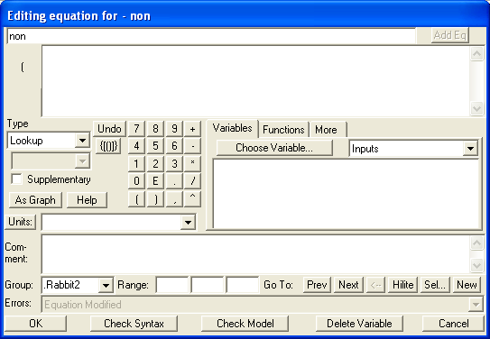
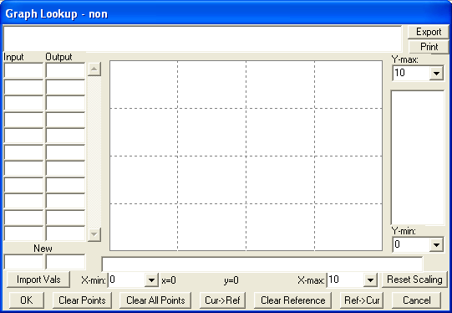
Creating Lookups
With the Equations tool selected, click on “EFFECT OF RABBIT CROWDING ON DEATHS F”
Under the Type label there are two drop down boxes, one showing “Constant”, the other showing “Normal”.
Click on the drop down box showing “Constant” and select with “Lookup”.
Click on the button “As Graph” in the Equation Editor (below the Type boxes). The Graph Lookup Editor opens:

Slide 159
Entering Lookup Data
Click on the left hand New (values) box near the bottom left corner and type in 0 then press the Enter key. The cursor moves to the right hand box; type 0.9 and press Enter again. The cursor moves back to the left hand box and the old numbers are moved to the input/output columns making way for new numbers to be entered.
Continue typing in the rest of the pairs of values below, pressing the Enter key each time a value is typed. The graph will draw itself.
  (0,0.9), (1,1), (2,1.2), (3,1.5), (4,2)
Alternatively, you can sketch the graph using the pointer by clicking on the graph to add points, and dragging the points to reposition them on the graph. You will first need to set the X-max and Y-max values to 4 and 2 respectively.
Click on the button Reset Scaling to set the X and Y scales to your points.

Slide 160
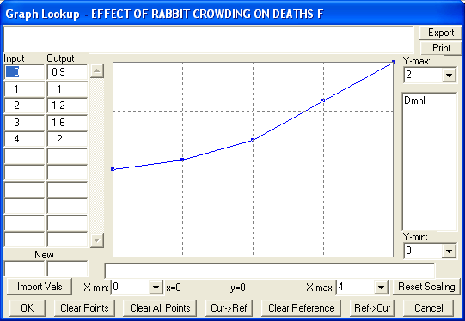
Graphical Lookup Data

Slide 161
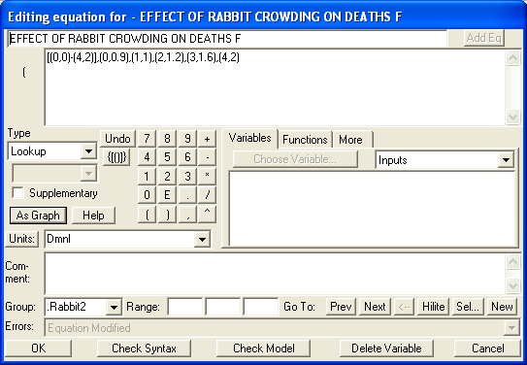
Editing Values
You can modify values in the Input/Output list, or by dragging a point around on the graph.
To remove a point, click on the button Clear Points and then with the Delete icon, click on the point on the graph.
Click on OK and the Graph Lookup Editor closes.
Now you will see the graph equation expressed as a table of values enclosed in parentheses. These values could have been typed in directly, but instead we generated them in the Graph Lookup Editor.

Slide 162
Editing Values
Add the units Dmnl (for Dimensionless, which you could also have typed in) to the Units editing box, then click OK to close the Equation Editor.
The units Dimensionless are pretty important to understand. When we normalised the input to the Lookup, we divided the Rabbit Population (measured in rabbits) by carrying capacity (also measured in rabbits) leaving a dimensionless variable.

Slide 163

Getting a Value from Lookup
Edit eqn for “effect of rabbit crowding on deaths”
Select the lookup table name from the variable list
Point to the table by appending the eqn with:
  “(normalized population)”
Set units to dimensionless
Click OK
Save the model
Run the model

Slide 164
Results

Slide 165
Lookup Variants
Lookup(x) –
  Extrapolate between points and horizontal tail below min and above max table values
LOOKUP EXTRAPOLATE(lookup,x)
  extrapolation of the extreme Lookup pairs when the input is out of range of the Lookup
LOOKUP BACKWARD(lookup,x)
  the previous y value is held between x values instead of interpolating between points
LOOKUP FORWARD(lookup,x)
  the next y value is used between x values instead of interpolating between points
LOOKUP AREA (lookup,start,end)
  the area under a Lookup table between start and end
LOOKUP INVERT(lookup,y)
  Finds the first input (x)that, when used in the Lookup lookup would return y
LOOKUP SLOPE(lookup,x,m)
  Finds the slope at x in the lookup. Between points on a Lookup the slope is just the change in y divided by the change in x from one point to the next. If x is the same as a point in lookup then the average of the slope before and after x is returned, unless there is more than one point with that x value in which case :NA: is returned.

Slide 166
Mass Balance Check

Slide 167

IPOD Model
2 Stocks of People

Slide 168

IPOD Model

Slide 169

IPOD Model

Slide 170

IPOD Model

Slide 171

IPOD Model

Slide 172
IPOD Model Scenario
1000 people in sample
Initially 5% own an IPOD
On average, each person meets 30 other people during a month
0.1% of people without an IPOD are convinced to buy one after meeting someone with one.

Slide 173
Ipod Model Input Constants
1000 people
5%
30 Meeting a month
P = 0.001

Slide 174
IPOD1 Model
1000 people
5%
0

Slide 175

IPOD2 Model
30

Slide 176

IPOD3 Model
5%

Slide 177

IPOD4 Model

Slide 178
IPOD Model Units
people
Dimensionless
people
Ipod/month
people
people/month
dimensionless
Ipod/people
Ipod/month
people/people/month
dmnl

Slide 179
Miscellaneous Vensim `
Mass Balance Checks
Copy/Paste/Replicate
Customising Tools
Multiple Models Open
Initial Defaults (Box Sizes etc)
Graph Colours
Unit Synonyms

Slide 180
Model Workshop
Developing a Rework Model
How to use Lookup tables
Delay Functions

Slide 181
Model Workshop
Creating a generic Rework Model
Sketch on paper first to set the boundaries of the model
  Start small & simplistic
    Add only a few variables to the sketch at a time
    Enter equations
    Check dimensions
    Simulate
    Save model name1.mdl
  Once working as planned, saveas name2.mdl
  Add further structure, repeating from step (1)

Slide 182
Model Building Workshop
Rework Model

Slide 183
Rework Model
Why do projects rarely get completed on time and in budget ?
Lack of
Quality
Checking
Design
Errors
Vague
Design
Specs
Lack of
Quality
Checking
Design
Errors
Vague
Design
Specs
Time
Pressure
Time
Pressure
Too
Few
Staff
Lack
Of Required
Skills
Too
Few
Staff
Lack
Of Required
Skills
Time
Training
New Staff
Time
Training
New Staff
Delay in
Discovering
Errors
Delay in
Discovering
Errors
Worker
Fatigue
Worker
Fatigue

Slide 184
Rework Model 1
A software company has a new project for a client.
The project has been divided into 100 individual tasks
Four programmers have been assigned to complete all the tasks
A programmer can on average complete 1 task per month
The programmers are not perfect ! 25% of the code they complete contain bugs
The project deadline is 3 years from the start

Slide 185
Rework Model 1
DATA
100 Initial Tasks
Capacity 4/month
5 Year Simulation
~Daily Calculations
QUESTION
How long to complete 99% of the tasks ?
Remember to always assign units to variables and to check them !

Slide 186
Rework Model 1
Takes just over 33 months to clear task list

Slide 187
Rework Model 2
Remember - the programmers are not perfect , 25% of the tasks they complete contains bugs
However these bugs are not obvious, and are only spotted after an average 6 months of comprehensive testing
Tasks completed with bugs have to be redone
Expand the structure of your model . A new stock, two flows and one constant will be required

Slide 188
Rework Model 2
DATA
Time to Discover Errors is
6 months
QUESTION
How long to complete 99% of the tasks ?
Create a graph showing all three stocks

Slide 189
Rework Model 2
It now takes 56.5 months to clear task list

Slide 190
Rework Model 3
Quality
So far QUALITY has been a constant (75%)
One influence on the current quality is the quality of
previous tasks completed
Poor previous quality reduces current quality
since new work is based on yet unknown bugs
How could we measure average quality so far using the
only the variables we have already defined ?

Slide 191
Rework Model 3
Average Quality So Far =
Completed Tasks /
(Completed Tasks + Unknown Rework)
Why won’t this work ?
Use this to point to the table
to get the modifier to Normal Quality
Quality = Normal Quality x Modifier
Also create & calculate a
new variable for
Perceived Tasks Complete
Add these new variables to a new model view
Average Quality So Far | Effect on Current Quality
0 | 0.1
0.1 | 0.25
0.2 | 0.35
0.3 | 0.45
0.4 | 0.55
0.5 | 0.65
0.6 | 0.725
0.7 | 0.8
0.8 | 0.875
0.9 | 0.95
1.0 | 1.0

Slide 192
Rework 3

Slide 193
Dynamic Quality

Slide 194
Rework Model 4
Error Discovery
Time to find errors unlikely to be constant
The discovery time is likely to be longer in earlier project stages
and shorter in the latter stages
Early project stages tend to be development and latter stages concentrate on testing

Slide 195
Rework Model 4
Time to Discover Errors
Table provides data to modify
“Time to Discover Errors”
based on
“Proportion Work Complete”
Calculate
“Time to Discover Errors”
From this modifier and a
“Normal time to discover errors”
(6 months)
Prop Tasks Complete | Effect on Rework Discovery
0 | 1
0.1 | 1
0.2 | 1
0.3 | 1
0.4 | 1
0.5 | 1
0.6 | 0.95
0.7 | 0.8
0.8 | 0.45
0.9 | 0.2
1.0 | 0.1

Slide 196
Time to Discover Errors

Slide 197
Sample If True
Returns input when condition is true and otherwise remains constant.
The function initially holds constant at the stated initial value.
This function is useful for retaining information about a variable's behaviour.
=Sample If True(condition, true val, init value)
Time Project Completed =
Sample If True(Project Completed=1 :AND: Time Project Completed=0, Time, 0)

Slide 198
Compare Rework Models 1- 4 Results

Slide 199
Rework Model 5
Workforce
One way to change rate tasks are completed is to add extra workers
Transferring in or hiring extra workers takes time, on average
3 months
New staff require 6 months to gain experience and be fully effective
Thus worker fall into two levels,
Experienced Workers
Inexperienced Workers
The initial 4 assigned workers are all fully experienced
Create a new model view for the project workforce where the Desired Workforce is a definable constant.
Create a new model view for modelling the workforce

Slide 200
Rework Model 5
DATA
Initial Exp workers
4
Initial Inexperienced worker
0
Time to Hire
3 Months
Time to Gain Experience
6 Months
Desired Workforce
4
Try Changing Desired Workforce to 6

Slide 201
Adding Extra Workers

Slide 202
Rework Model 6
Workforce Productivity
Extra Workers means greater productivity
Create a new model view called Productivity
The constant Task Completion Capacity should be a function of:
      Total Workforce
      Individual Worker Productivity (1 task per month)
      Maximum Capacity -
        Function of (Minimum Time to Complete Task ( ~1 week) & Tasks Remaining)
TIP – Make the existing Task Completion Capacity a shadow variable then add the variable to the new view for Productivity using the Model Variable tool

Slide 203
Productivity

Slide 204
Task Completion Capacity

Slide 205
Rework Model 7
Project Schedule
The Project Manager initially estimates the project man month requirement based on:
      Worker Productivity
      Initial Estimated Rework Proportion (0.0)
And calculates the project completion date on this and the initial size of the workforce
Using the initial estimated project man months and the current perceived proportion of the project complete, the project manager can revise his completion date estimate and monitor a likely overrun proportion.
Create a new model view for Project Schedule, estimating the likely overrun proportion

Slide 206
Rework Model 7
Project Schedule
Add the variables in two steps, first create
Initial Project Man Months Estimate
Initial Estimated Rework Proportion
Initial Estimated Completion Date
Then add
Estimated Effort Still Required
Estimated Completion Date
Estimated Project Overrun Proportion

Slide 207
Project Schedule

Slide 208
Project Overrun Proportion

Slide 209
Rework Model 8
Desired Workforce
The Project Manager calculates the scheduled project time remaining.
He then combines this with his perceived man months of effort still required to estimate the Desired Workforce to allow him to complete on time.
However, he can only assign up to a maximum of 20 workers to the project due to space limitations
Once the project has been completed, the project requires no workers

Slide 210
Desired Workforce

Slide 211
Project Completion Date

Slide 212
Rework Model 9
Excess Workforce
If the Desired Workforce is less than the Total Workforce, the PM wants to remove the excess workers assigned to the project.
On average it takes 2 months to reassign a worker
Workers are reassigned proportionally from the pool of “inexperienced” and “experienced” workers
Modifiy the Workforce view to include the removal of excess workers

Slide 213
Excess Workers

Slide 214
Total Workforce

Slide 215
Rework Model 10
Inexperienced Workers
Inexperienced Workers are only 50% as productive as experienced workers
Inexperienced workers have a 50% error rate in the tasks they completed, compared to only 25% for experienced workers.
Update the views for Quality and Productivity to reflect the impact of inexperienced workers

Slide 216
Effect of Inexperienced Workers

Slide 217
Productivity & Quality

Slide 218
Time Project Completed

Slide 219
Rework Model 11
Softer Issues
What are the effects of over-time, fatigue, deadline pressure ?
Over-time – Increases Productivity
Deadline Pressure – ?
Fatigue – Reduces Productivity

Slide 220
Rework Model 11
Softer Issues
Deadline Pressure on Workers =
Estimated Time Remaining / Scheduled Time Remaining
Use this value to point to first 2 lookup tables below
Use “Averaged Over Time” to point to third lookup table
All three modifiers can then be applied to Productivity
Pressure | -0.1 | 0 | 1 | 1.2 | 1.5 | 2 | 3
Overtime Proportion | 0 | 0.3 | 1 | 1.1 | 1.2 | 1.3 | 1.3
Pressure | 0 | 1 | 2 | 5 | 10
Pressure Mod | 1 | 1 | 1.1 | 1.2 | 1.25
Pressure | 0.5 | 1 | 1.1 | 1.2 | 1.3 | 1.4 | 1.5
Fatigue Mod | 1 | 1 | 0.95 | 0.9 | 0.85 | 0.8 | 0.7

Slide 221
Softer Issues

Slide 222

Dashboard

Slide 223
Delays
Key element to System Dynamics modelling
Nothing happens instantly
Cause -> Reaction (today, tomorrow, next year)
Labour shortfall ->
  Time to advertise positions
  Time to interview candidates
  Time to select new recruits
  Notice period of individuals
  and so on

Slide 224
Delay Functions
Two categories of functions :
  Continuous
  Discrete
Apply one which most closely represents reality
Continuous most suited to “large” flows
Discrete better for smaller flows
Selection of Time Step size critical

Slide 225
Continuous Delays
Also known as “Ordered Delays”
Use “Average” delay time
Some elements flow through quicker, some slower than the average

Slide 226
First Order Delay (Fn Delay1)
Returns a exponential delay of the input.
Equivalent to the equations:
  DELAY1=LV/delay time
  LV=INTEG(input-DELAY1,input*delay time)

Slide 227
Third Order Delay (Fn Delay3)
Returns a 3rd order exponential delay of the input, conserving the input if the delay time changes. Equivalent to the equations:
DELAY3=LV3/DL
LV3=INTEG(RT2-DELAY3,DL*IN)
RT2=LV2/DL
LV2=INTEG(RT1-RT2,LV3)
RT1=LV1/DL
LV1=INTEG(input-RT1,LV3)
DL=delay time/3
DELAY3I=LV3/DL
LV3=INTEG(RT2-DELAY3I,
initial value*DL)
RT2=LV2/DL
LV2=INTEG(RT1-RT2,LV3)
RT1=LV1/DL
LV1=INTEG(input-RT1,LV3)
DL=delay time/3

Slide 228
Third Order Delay Calculations

Slide 229
Ordered Delays
Time of entry
Average delay = 3 mths

Slide 230
AVERAGE TIME IN QUEUE = 3
Units: Month
FINAL TIME = 100
Units: Month inflow = PULSE(40, TIME STEP)/TIME STEP
Units: people/Month
INITIAL TIME = 0
Units: Month
ORDER = 3
Units: Dmnl
Outflow =
DELAY N ( inflow ,
AVERAGE TIME IN QUEUE ,0, ORDER )
Units: people/Month
Queue = INTEG( inflow - Outflow , 0)
Units: people saveper = TIME STEP
Units: Month
TIME STEP = 0.0625
Units: Month
Create a simple delay model

Slide 231
Remember Time Step Rules
Equivalent to a binary fraction
  1, 0.5, 0.25, 0.125, 0.0625…
Small enough to capture smallest delay of significance
Also - Must be less than :
  Minimum Delay / 4n
  Where n is the order of the delay function used
  For example, if the delay is 3 months and a 3rd order delay is being used, Time Step must be a binary fraction less than :
  3 / (4 * 3) = 1/4 ->less than 1/4 = (0. 125)

Slide 232
Fixed Delays
There are three basic discrete delay functions:
  DELAY FIXED,
  DELAY MATERIAL
  DELAY INFORMATION
The first requires a fixed delay time and, with a fixed delay time all the functions behave the same.
It is only when the delay time changes over time that differences emerge.

Slide 233
Delay Fixed
DELAY FIXED (input, delay time,initial value)
  Returns the value of the input delayed by the delay time.
  The initial value is the value of the variable on the left-hand side of the equation at the start of the simulation.
  The delay time can be an expression, but only its initial value is used.

Slide 234
Fixed Delay – Effect of Changing Delay Time
3 hour delay, time step = 0.5
Next Outflow
5
2
7
9
3
2
3
4
Increase to 4 hour delay, time step = 0.5
5
2
7
9
3
4
3
Reduce to 2 hour delay, time step = 0.5
5
2
7
9
3
3
4
Delay Fixed always uses the initial value of the delay time

Slide 235
Material Delay
DELAY MATERIAL (input, delay time, initial value, missval)
  The same as DELAY FIXED except that delay time can be a variable.
  If delay time is decreasing, some values of the input will be added to more recent inputs for output.
  If delay time is increasing, missval will be used when no output is available at a time.
  This function is particularly useful for modelling queues and production processes with varying and often random processing times.

Slide 236
Changing Delay Time Effect on Material Delay
3 hour delay, time step = 0.5
Next Output
no change
5
2
7
9
3
2
7
4
3
Next Output
after change
Increasing to 4 hour delay
5
2
7
9
3
0
4
0
0
Reducing to 2 hour delay
5
2
7
4
16

Slide 237
Information Delay
DELAY INFORMATION (input, delay time, initial value)
  The same as DELAY FIXED except that delay time can be a variable.
  If delay time is decreasing some values of the input will be discarded and replaced by more recent inputs.
  If delay time is increasing existing values will be held.

Slide 238
Changing Delay Time Effect on Information Delay
3 hour delay, time step = 0.5
Next Output
no change
5
2
7
9
3
2
7
4
3
Next Output
after change
Increasing to 4 hour delay
5
2
7
9
3
0
4
0
0
Reducing to 2 hour delay
5
2
7
4
3
Ignores the 9 & 3

Slide 239
Some other Delays Types
Conveyor Delays
  This delay function allows you to introduce a delay process that is analogous to putting material on a conveyor and then possibly speeding up and slowing down that conveyor.
  The DELAY CONVEYOR function has the additional capability of draining the elements on the conveyor which breaks the analogy somewhat but can be quite useful
Batch Delays
  Most delays take some inflow, shift it in time, and smooth it out.
  As we saw in the first section the higher order the delay the less smoothing occurs.
  In some cases, however, you might want a smooth inflow to be broken up into batches, and this is what DELAY BATCH does.

Slide 240
Exercise - Modelling Delays

Slide 241
Model Validity
No model can be 100% valid – they are simplifications of reality.
System Dynamics uses the concept of building confidence in a model along multiple dimensions.
A list of questions a more can use to develop confidence have been created.
  Peterson (1975), Forrester and Senge (1980), Barlas (1989, 1996), and Sterman (2000, p. 852 and pp. 858-891) & Radzicki (2004)

Slide 242
Tests of Model Purpose
Does the model have a clear purpose?
Does the model have a well-defined perspective? (i.e., has the modeller "stepped back" far enough from the actual system to view it holistically and at the proper level of aggregation?)
Does the model address important questions and problems?

Slide 243
Boundary Adequacy Test
Are the important concepts for addressing the problem to which the modelling study is directed endogenous to the model?
Does the behavior of the model change when its boundary assumptions (i.e., what to include and exclude) are relaxed?
Do the policy recommendations stemming from the model change when the model’s boundary is extended?

Slide 244
Structural Assessment Tests
Is the model’s structure consistent with the relevant descriptive knowledge of the actual system?
Does the model conform to the basic laws of physics?
Do the model’s decision rules accurately capture the behavior of actors in the systems?
Does every variable and parameter have a precise definition relating to things in the real world?
Are the model’s parameter values consistent with the relevant descriptive and numerical knowledge of the actual system?
Are the model's constants really constant for the purpose of the model?
Are the model's exogenous variables really independent of all the other variables in the model?
Do all of the critical points in the model's functions and relationships have physical meanings and plausible justifications?
Does the model’s structure include policy space?

Slide 245
Dimensional Consistency Test
Is each equation dimensionally consistent without the need to add parameters or “fudge factors” that have no real world meaning?

Slide 246
Extreme Conditions Tests
Does each equation in the model make sense even when its inputs take on extreme values?
Does the model respond plausibly when tested with extreme policies, shocks, and parameters?

Slide 247
Integration Error Test
Are model results sensitive to the choice of time step or numerical integration method?

Slide 248
Tests of Model Sub-Sector Behaviour
Do sudden or large changes in the model's input variables cause the model to behave in a plausible manner that is consistent with past observations and historical data (where appropriate)?
Is the behaviour of equations and sub-sectors reasonable for extreme values of input variables?

Slide 249
Tests of Overall Model Behaviour
Does the model reproduce the qualitative and quantitative behaviours of interest observed in the real system?
Does the model endogenously generate the symptoms of difficulty that motivate the study?
Do the frequencies and phase relationships among the variables match the data?
Do abrupt changes in model behaviour make sense? Do they correspond with those seen historically in the real system?

Slide 250
Behaviour Anomaly Test
Do anomalous behaviours result when the assumptions of the model are changed or deleted?

Slide 251
Family Member Test
Can the model generate the behaviour observed in other instances of the same system?

Slide 252
Surprise Behaviour Test
Does the model generate previously unobserved or unrecognized behaviour? Is it reasonable?
Does the model successfully anticipate the response of the system to novel conditions?

Slide 253
Sensitivity Tests
Do the model’s numerical values change significantly when assumptions about its parameters, boundary, and aggregation are varied over the plausible range of uncertainty?
Do the modes of behaviour generated by the model change significantly when assumptions about its parameters, boundary, and aggregation are varied over the plausible range of uncertainty?
Do the policy implications of the model change significantly when assumptions about its parameters, boundary, and aggregation are varied over the plausible range of uncertainty?

Slide 254
Pragmatic Tests
Did the modelling process help to change the actual system for the better?
Does the model correctly predict the direction of system change resulting from policy changes?
Does the model correctly predict the extent of system change resulting from policy changes?

Slide 255
System Dynamics using Vensim
Advanced Topics
Time Permitting

Slide 256
Advanced Topics
Subscripts

Slide 257
Subscripting (Arrays)
What’s it for?
  Managing detail with few equations
How does it work?
  Create subscript ranges (lists):

Slide 258
Subscripts
Subscripting provides a convenient way to represent a number of repetitions of model structure over such things as:
  geographic areas,
  commodities,
  competitors,
  products,
  project stages,
  production stages,
  age groups,
  technologies
  energy sources.
For example, suppose you have a model including Inventory, production and shipments as in:

Slide 259
Subscripts
You might want to include this piece of structure for a number of products.
One possibility would be to replicate the structure for each product as in:

Slide 260
Subscripts
This is tedious, and impractical when there are more than a few products.
An alternative is to keep the same structure, and add subscripts.
In this case only the equations, and not the diagram change.
Specifically, we replace:
Inventory = INTEG(production-shipments,INITIAL INVENTORY)
With:
Inventory[product] = INTEG(production[product]-
shipments[product],
INITIAL INVENTORY[product])

Slide 261
Subscripts
Inventory[product] =
INTEG(production[product] - shipments[product],
INITIAL INVENTORY[product])
This equation says that for each product, Inventory is the accumulation of production (for that product) minus shipments (of that product) starting at the initial value for that product.
The subscript product is defined by an equation which describes the individual products:
product : P 1, P 2, P 3, P 4, P 5, P 6

Slide 262
Subscripts
There are several big advantages to using subscripts:
  Less clutter
  Easy to add/remove elements
  Easier to change equations
  Faster model completion

Slide 263
Subscripts
Terminology Example
  Company : GM, Ford, Toyota, Nissan
  sales[Company] = ...
sales is a subscripted or array variable.
GM is an element of the subscript range

Slide 264
Subranges
Terminology Example
  Company : GM, Ford, Toyota, Nissan
  US Company : GM, Ford
  US sales[US Company] = ...
US Company is a subrange of the subscript range Company.
One Subscript Range is said to be a Subrange of a second Subscript Range if all of its elements are included in the second Subscript Range.
The use of Subranges can often simplify equation writing and improve the clarity of a model's structure.
Subranges can overlap, and need not be exhaustive
However, all the members of a Subrange must be contained in a single Subscript Range.

Slide 265
Subscripts
Subscript Rules
  A Subscript Range that appears on the right of an equation must also appear on the left of the equation, unless a special Mapping is defined.
  A variable must always appear with the same number of subscripts, and these must always be in the same order.

Slide 266
Basic Mechanics
Subscripts, like other variables in Vensim, have equations that define their meaning. However, they are different from other model variables in that they do not appear in diagrams. You create and edit the equations for Subscript ranges in the Equation Editor. Subscript elements are defined on the right hand side of the equation for the subscript range, which takes the form:
range : element1, element2

Slide 267



Creating Subscripts
To create a subscript, click on the [Sub] button on the menu bar
Click on Edit
Enter name for subscript
In the eqn editor, enter the subsript range elements, separated by commas

Slide 268

Editing Subscripts
You can edit an existing subscript by opening the Equation Editor on any variable, clicking on the Choose button and selecting the subscript from the list.
Or, click on the and select edit in the dialogue box
Because subscript names do not appear on the diagram, there is no way to open the Equation Editor directly on a subscript definition.

Slide 269
Using Subscripts
Once you have created a subscript, you can use it in equations.
The subscript appears in square brackets after the variable it applies to.
The subscript tab of the Equation Editor lists the subscript ranges defined in the model.
Clicking on a name will place the subscript in the equation. Vensim will automatically add the necessary brackets.
If placing more than one subscript in an equation, put the cursor inside the square brackets. Vensim will add a comma to separate the subscript names.

Slide 270

Using Subscripts

Slide 271
Subscripted Constants
Subscripted variables represent more than one value. For this reason, constants that are subscripted can take on a number of values. There are several different methods for assigning values to subscripted constants
For Example,
  the subscript range Country : UK, Norway, Swiss
  Population M[Country]=60,4.5,7.6
  Proportion Male[Country] = 0.5
  {assigns value 0.5 to all subscript elements}
  Proportion Male[UK] = 0.45
  Proportion Male[Norway] = 0.55
  Proportion Male[Swiss] = 0.51
  {assigns values individually to each subscript elements}

Slide 272
Subscripting
Exercise 1
Open a model CustB1.mdl
Create Subscript range COMPANY
Companies are PwC, KPMG, McKinseys
Add subscript range to all equations

Slide 273
Custb1 Model

Slide 274
Subscripted Two Dimension Constants
 | Compact | Saloon | 4WD
Herts | 12 | 23 | 9
Alamo | 20 | 20 | 10
Budget | 33 | 9 | 0
  Initial Fleet[Company, Vehicle Type]=
  12,23,9 ;
  20,20,10;
  33,9,0 ;
Or again, a separate equation could be written for each subscript combination.

Slide 275
Subscripted Constants with more than two dimensions
Eg 3 dimensions – [Country, Company, Car Type]
Swiss | Compact | Saloon | 4WD
Herts | 12 | 23 | 9
Alamo | 20 | 20 | 10
Budget | 33 | 9 | 0
Norway | Compact | Saloon | 4WD
Herts | 12 | 23 | 9
Alamo | 20 | 20 | 10
Budget | 33 | 9 | 0
UK | Compact | Saloon | 4WD
Herts | 12 | 23 | 9
Alamo | 20 | 20 | 10
Budget | 33 | 9 | 0
A separate equation would be written for each subscript combination.
Or
Better to read values from .cin file or spreadsheet file

Slide 276
Vector Functions
There are five predefined Vensim functions that have been designed to make common subscript operations easy to perform. These functions are:
  SUM, which takes a sum over the indicated subscript values.
  PROD, which takes a product over the subscript values.
  VMIN, which takes a minimum over all subscript values.
  VMAX, which takes a maximum over all subscript values.
  ELMCOUNT, which returns the number of elements in a Subscript Range.

Slide 277
Vector Functions
Total Inventory=SUM(Inventory[Firms!])
Max Inventory=VMAX(Inventory[Firms!])
Min Inventory=VMIN(Inventory[Firms!])
Prod Inventory=PROD(Inventory[Firms!])
No Firms=ELMCOUNT(Firms)
With a Vector Function the exclamation “!” is used to note the subscript range(s) to calculate over.

Slide 278
Subscript Summing Example
The variable Vehicle Fleet[Rental Company , Car Type] represents the table below :
 | Compact | Saloon | 4WD
Herts | 12 | 23 | 9
Alamo | 20 | 20 | 10
Budget | 33 | 9 | 0
Total Cars by Type[Car Type]=SUM(Vehicle Fleet[Rental Company! , Car Type])
Total Cars By Company[Rental Company]= SUM(Vehicle Fleet[Rental Company , Car Type!])
Total Cars [Rental Company]= SUM(Vehicle Fleet[Rental Company! , Car Type!])

Slide 279
Amend Model
Add new variables to the model to:
  Total Customer base across ALL companies
  Minimum Customer base across ANY company
  Maximum Customer base across ANY company
  Number of companies
Create a second subscript range: Country
  Country : UK, USA
Subscript following variable by COUNTRY & COMPANY
  Customer Base
  Adoption Rate
  Dropout Rate
  initial customer base

Slide 280
Numerical Ranges
When dealing with large numbers of subscripts such as you might encounter in manufacturing or detailed project models, it is convenient to not have to write out all Subscript Constant values. To facilitate this you may specify numeric ranges, as in
Which is the same as:
You must enclose ranges in parentheses. Everything preceding the numbers must match, and the numbers must increase. Vensim does not allow truly numeric subscripts (1,2,3 ... ).
lot : (LOT1-LOT3),LOT12,(LOT14-LOT16) ~~|
lot : LOT1,LOT2,LOT3,LOT12,LOT14,LOT15,LOT16 ~~|

Slide 281
Advanced Subscripting
In many practical situations, it is desirable to use different subscript families to mean the same thing. If no special preparation is made, this leads to an error message (typically that a Subscript Range appears on the right, but not on the left, of an equation). Mapping allows you to do this sort of thing when you are very sure that you want to override the exact correspondences normally enforced

Slide 282
Aging Models
These two models will provide the same results.
The second model uses subscript mapping.

Slide 283
Subscript Mapping
Age:
infant, child, teen, middle, old
all but youngest:
child, teen, middle, old
previous cohort:
infant, child, teen, middle -> all but youngest

Slide 284
Mapped Equation
Population[infant]= INTEG (
births - aging[infant],
initial population[infant])
Population[all but youngest]= INTEG (
aging[previous cohort] - aging[all but youngest],
initial population[all but youngest])

Slide 285
Subscript IPOD Model
Subscript by Age Group :
Children (1000)
Teenagers (600)
Young Adults (5000)
Mature Adults (10000)
Senior Citizens (8000)
Give model a new name

